Slide 1

Flood Risk Assessment for Lilongwe City and Recommendations for an Integrated Flood Risk Management Strategy
By
Eng Cleaverson K Nyando
City Engineer for Lilongwe City Council
Climate and Disaster Risk Management Symposium
10 December 2024: Soche Hotel

Slide 2
Presentation Outline
Background
Flood Risk Assessment Approach
Flood Risk Assessment Results
Flood Risk Drivers And Recommendations for an Integrated Flood Risk Management Strategy

Slide 3
Background

Slide 4
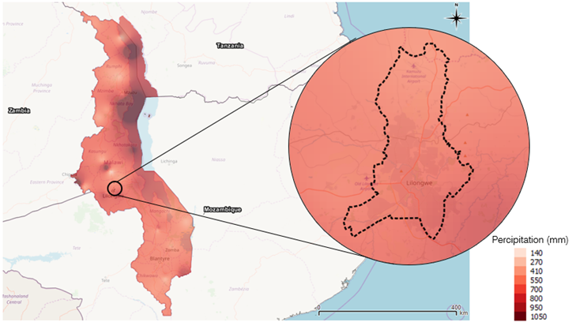
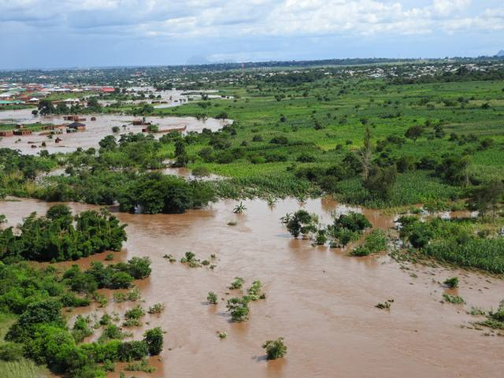
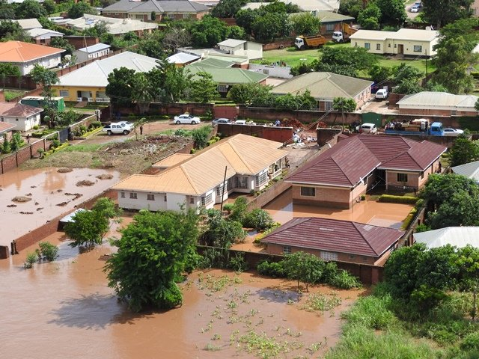
Background to flood Risk Assessment in Lilongwe City
Lilongwe city has experienced damaging floods since 2015
The city has had floods in 2017, 2019 and 2020 ……
It is now evident that flood risk in Lilongwe is on the rise and that it is taking lives and impacting economic growth and opportunity in the city
The city is growing at a rate of 4.38% per year, it currently has a population of over 1.5million and it is expected to almost double in the next 20 years.
There is mostly informal growth which increases exposure as well as vulnerability and, at the same time, exacerbating flood hazard by reducing the rainfall infiltration capacity of the city.
A baseline of the flood risk in Lilongwe was therefore built from the historical flood events

Slide 5
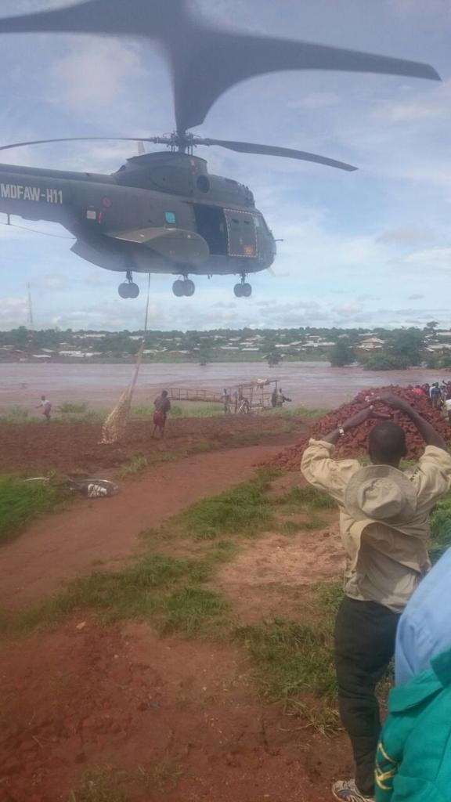
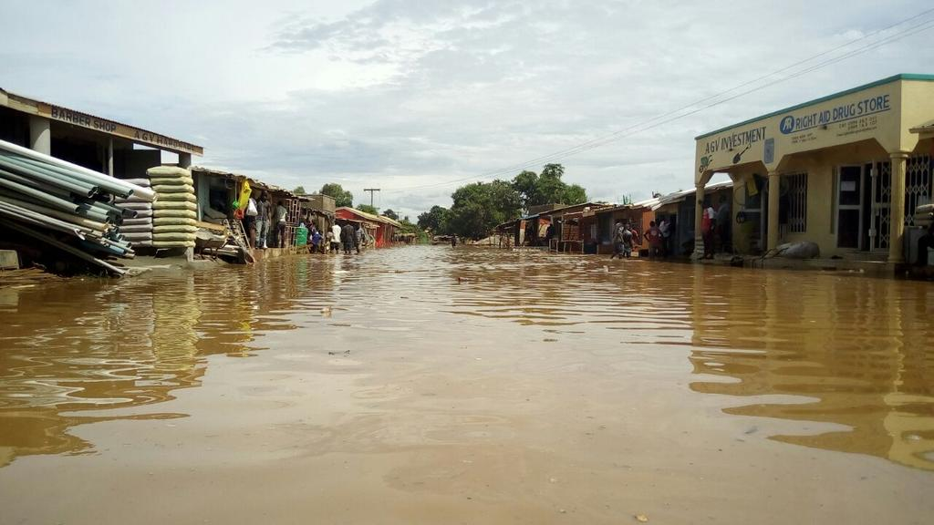
Background to flood Risk Assessment in Lilongwe City
The flood risk assessment was done with the following Objectives:
Produce the most accurate flooding scenarios with return periods of 10, 25, 50 and 100 yr to guide Lilongwe Land Use planning and Urban Master Planning.
Quantify the overall flood risk of the city: the annual average damage (AAD) caused by flooding in the city, calculated in monetary terms..
Model and map the spatial distribution of damage from flooding events with return periods of 10, 25, 50 and 100 yr
Identify the main drivers of flood risk in the City

Slide 6
Flood Risk Assessment Approach

Slide 7
Flood Risk Assessment Approach
Modelling for risk assessment followed a semi-probabilistic approach.
Five event return period events (or annual probabilities) (2, 10, 25, 50 and 100yr) were used.
The modelling approach was adopted:
  to better understand the frequency and scale of the flood hazard,
  to categorize and quantify the potential impacts, and
  to understand the relevance of the different drivers behind the recent flood risk growth
Sources of data for hazard modelling were:
  A Satellite based DTM for a 2D hydraulic model
  locally surveyed ground truth levels in 1D elements for main bridges and culverts within the city
  Local rainfall data from published intensity, depth, frequency (IDF) curves
Exposure data (mainly from OpenStreetMap) and vulnerability curves (derived using global flood depth damage functions adjusted to local values) were combined with the hazard data to prepare spatially varying damage to buildings
This Photo by Unknown Author is licensed under CC BY-NC

Slide 8
Flood Risk Assessment Approach
The assessment was carried out for two main flood generating conditions
  1) – Fluvial events, with widespread and heavy rainfall across the whole area, where the flood event is driven largely by high flows in the rivers running into and through the city, and
  2) – Pluvial events, where the rivers are relatively high, but the flooding is caused by more intense localized rainfall affecting mainly the city.
A 6-hour storm was used for the main river catchments, and a 3-hour storm for the small drainage basins as part of sensitivity testing to determine the critical storm duration,
A mean annual peak flow of approximately 140 cumecs was used with an appropriate regional flood frequency curve to approximate flows at the range of modelled return periods.
The model was developed using the U.S. Army Corps of Engineers latest version of HEC-RAS software (HEC-RAS V6.0.0)
Risk-assessment models are generally made up of four modules: hazard, exposure, vulnerability and damage
This Photo by Unknown Author is licensed under CC BY-NC

Slide 9
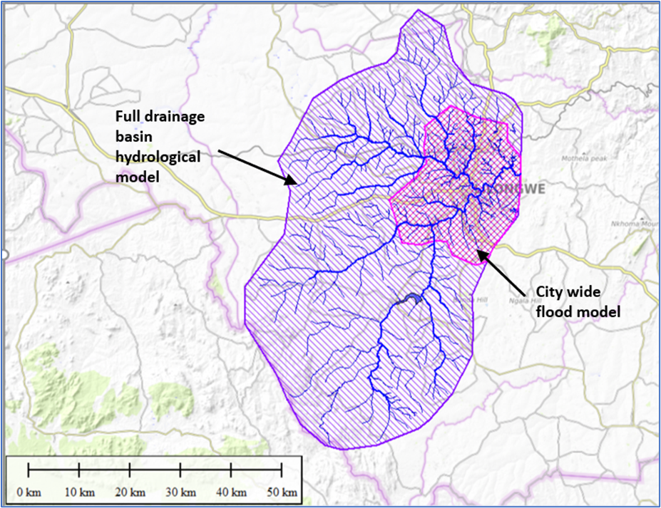
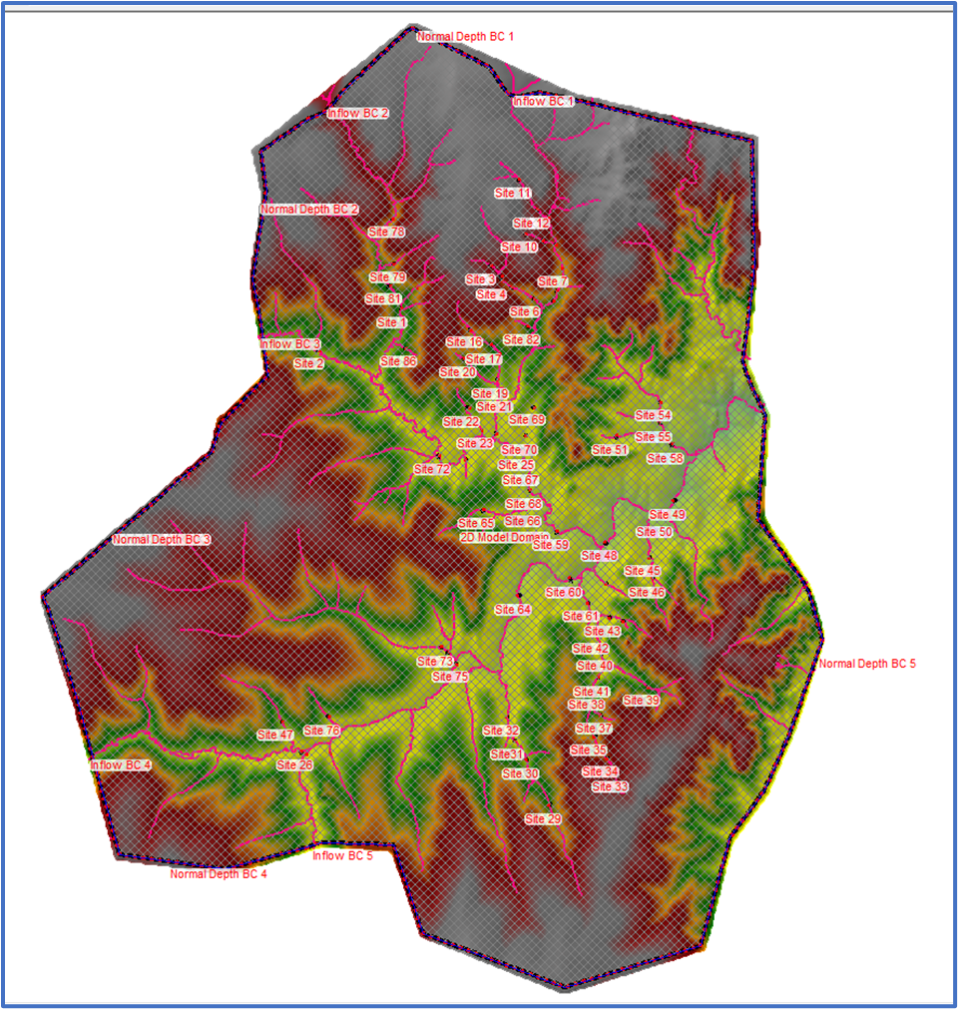
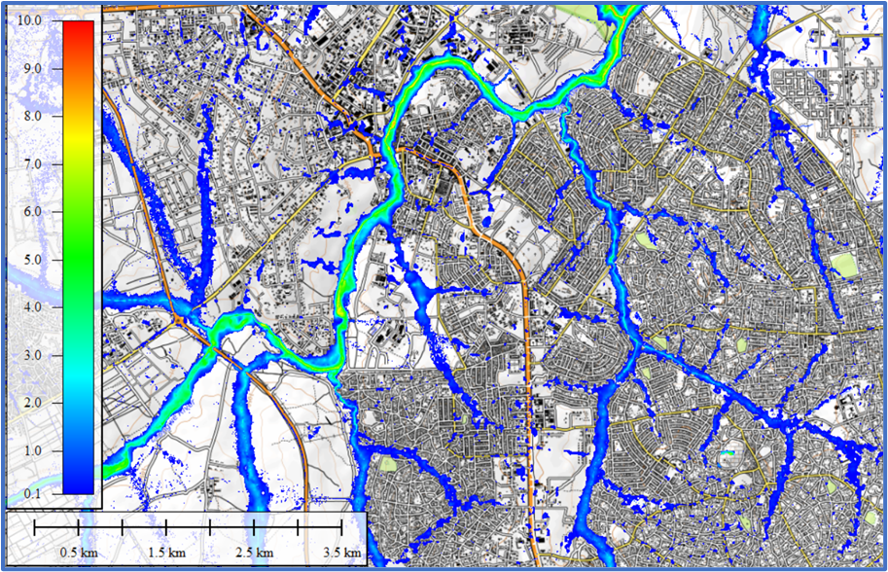
Flood Risk Assessment Approach
Hydraulic Modelling – Flood Hazard
Broadscale basin and City-wide flood models
Main model structure with added streams, and 1D bridges and culverts
The flood hazard results for a 1:10 year flood event as an example
The Broadscale basin model based on single 2D domain with a computational grid size of 50m2 with 10m resolution DTM
City model was also run using a 50m2 computational grid size with a 2m resolution DTM
A full momentum equations and the simpler diffusion wave were run for both cases
Each scenario was run for 36 hours for the basin model and 24 hours for the city model
The models were run using a variable time step, regulated by the courant number constrained between 0.5 and 3
Manning’s ‘n’ was set using a detailed land use maps provided by Ministry of Environment
This Photo by Unknown Author is licensed under CC BY-NC

Slide 10
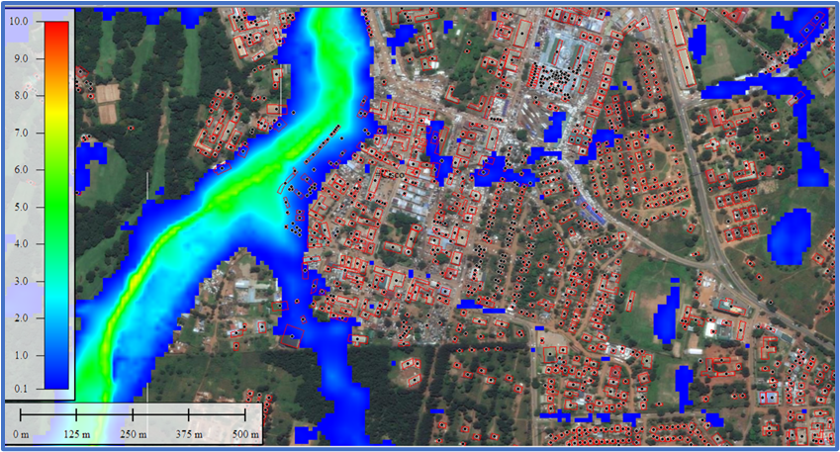
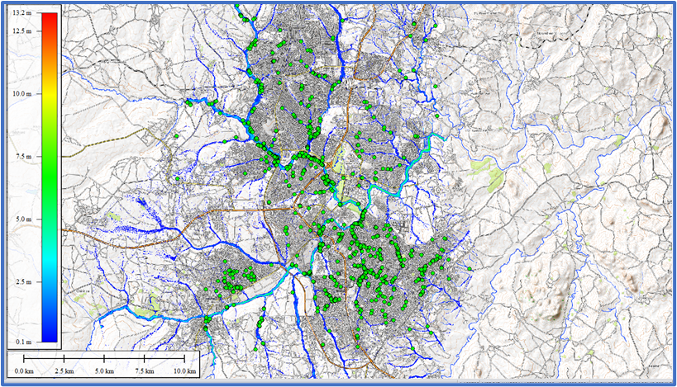
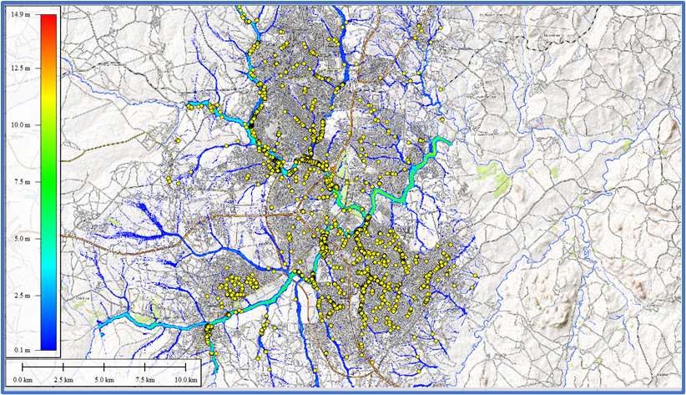
Flood Risk Assessment Approach
Modelling – Exposure
The risk assessment looked principally at quantifying the economic impact on buildings and contents, and quantified social impact in terms of numbers of people affected.
Flood hazard data was overlaid on OSM (Open Street Mapping) with building outlines as polygons for the vast majority of buildings within the city
Flooding was considered to have occurred if inundation of more than 10cm occurred to the centroid of each building polygon
Pluvial 10yr Flood event and location of flood impacted buildings
Pluvial 100 year event and location of flood impacted buildings
This Photo by Unknown Author is licensed under CC BY-NC

Slide 11
Flood Risk Assessment Approach
Modelling – Exposure
The exposure module provides information about the properties that may be affected
Types of Building | Fluvial Flooding Buildings affected |  | Pluvial Flooding Buildings affected
 | 10yr | 100yr | 10yr | 100yr
Residential | 1,683 | 2,938 | 1,988 | 2,823
Commercial | 5 | 6 | 7 | 7
Industrial | 425 | 710 | 567 | 829
Traditional | 947 | 1,450 | 1,379 | 1,912
Total | 2,060 | 5,104 | 3,941 | 5,571
Types of building | Fluvial Flooding People affected |  | Pluvial Flooding People affected
 | 10yr | 100yr | 10yr | 100yr
Residential | 7,237 | 12,633 | 8,548 | 12,139
Traditional | 6,629 | 10,150 | 9,653 | 13,384
Total | 13,866 | 22,783 | 18,201 | 25,523
Number of people directly impacted by flooding to their homes
Buildings in total at risk from flooding
This Photo by Unknown Author is licensed under CC BY-NC

Slide 12
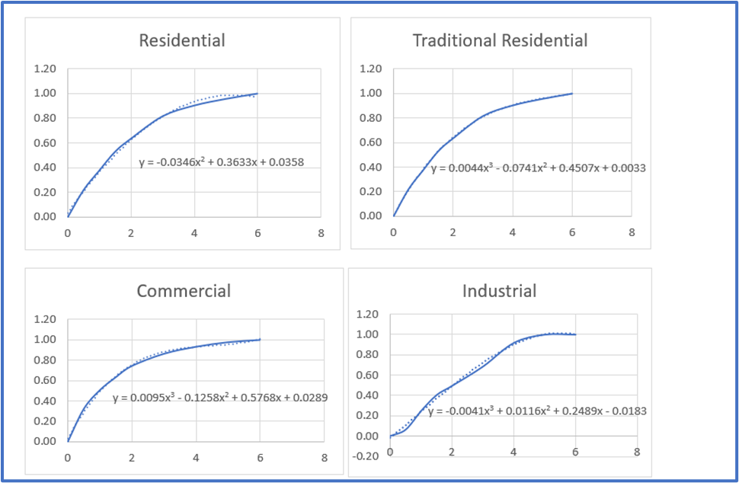
Flood Risk Assessment Approach
Modelling – Vulnerability and Risk Calculation
The vulnerability curves were a combination of the UK Multi Coloured Handbook & the EU European Commission “Global flood depth-damage functions” Joint Research Centre (JRC) Technical Report, (EUR 28552 EN), 2017.
The damage value (building and contents) was estimated by multiplying the depth by the building area, the building total value, and by the appropriate damage function
Total losses for buildings and contents were computed using JRC data adjusted for local variables.
In order to quantify the risk, the damages for all return periods for each or a sub-set or all building types were plotted against frequency (i.e. 1/Return Period) and the risk was defined as the area under the curve on this plot, and is referred to as the Annual Average Damage (AAD).
Depth damage functions for the predominant building types in Lilongwe (flood depth in metres on the x axis and % damage on the y axis,)
This Photo by Unknown Author is licensed under CC BY-NC

Slide 13
Flood Risk Assessment Results

Slide 14
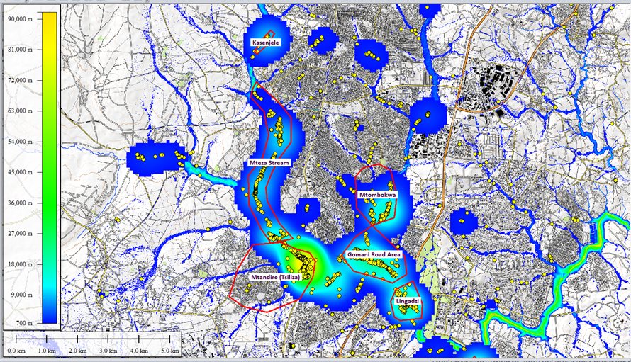
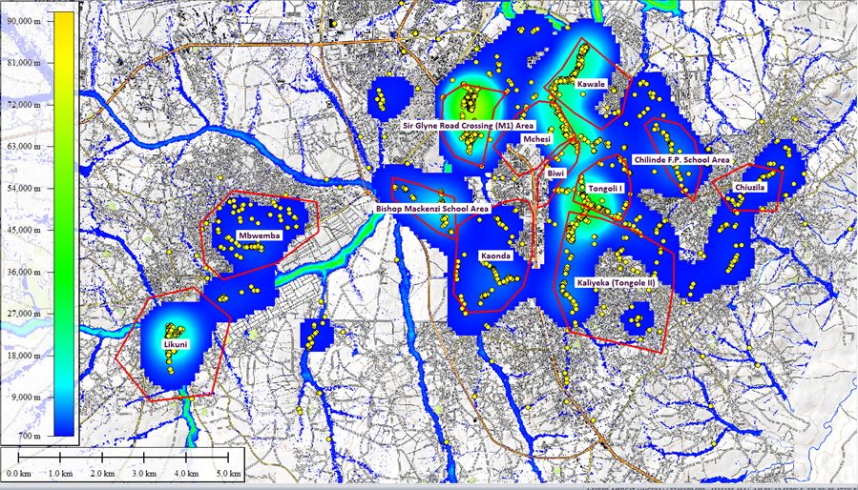
Flood Risk Assessment Results
18 ‘hot spots’ across the city were identified. Areas were based high Annual Average Damage values for combined pluvial and fluvial hazard
Flood hot-spots for the northern parts of the city of Lilongwe
Flood hot-spots for the southern parts of the city of Lilongwe
This Photo by Unknown Author is licensed under CC BY-NC

Slide 15
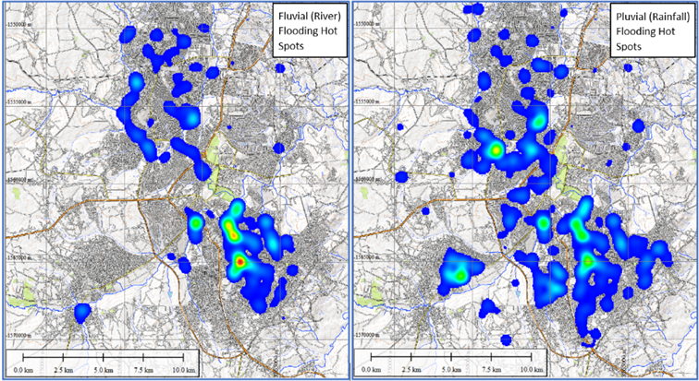
Flood Risk Assessment Results
The high risk hot-spots tend to be in similar areas for both fluvial and pluvial
Most areas are in low lying wetland areas near water courses
It is clear that the wider distribution of pluvial flooding in urban areas are not necessarily close to a stream or water course
Distribution of hot-spot risk areas for pluvial and fluvial risk separately
This Photo by Unknown Author is licensed under CC BY-NC

Slide 16
Flood Risk Assessment Results
Results of the analysis for both pluvial and fluvial flooding tabulated as annual average damage (AAD) values
It is clear that pluvial flood impact is more significant than fluvial
The fluvial damage values tend to be similar and even larger than the pluvial damage values for the same return period
A 2yr year pluvial flood cause almost the same damage than 5yr fluvial flood
Small pluvial floods are expected to happen more frequently than small fluvial floods and the cumulative effect of very frequent low damage pluvial floods result in a higher AAD than fluvial floods
This Photo by Unknown Author is licensed under CC BY-NC

Slide 17
ASSESMENT OF FLOOD RISK DRIVERS AND RECOMMENDATIONS FOR AN INTEGRATED FLOOD RISK MANAGEMENT STRATEGY

Slide 18
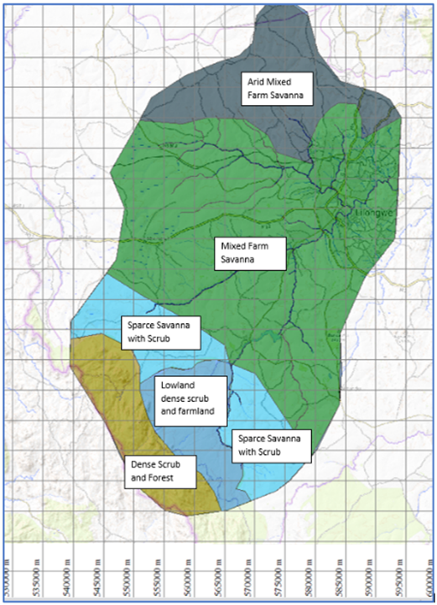
ASSESMENT OF FLOOD RISK DRIVERS AND RECOMMENDATIONS FOR AN INTEGRATED FLOOD RISK MANAGEMENT STRATEGY
The flood risk model estimated that the AAD due to flooding in Lilongwe was between US$11.2m and US$18.5m.
The flood risk model was also used to validate and assess the relevance of each of the suspected flood risk drivers of Lilongwe and proposed recommendations to address them.
Recommendations were formulated taking into consideration elements of both, the Sendai Framework for Disaster Risk Reduction, and the integrated water resource management conceptual frameworks
Flood Risk Drivers in Lilongwe
The Model identified five major flood risk drivers
Flood Risk Drivers in Lilongwe
Environmental degradation of the catchment upstream Lilongwe
Lilongwe urban growth using impervious and smooth surfaces
Climate change, increasing the frequency and intensity of extreme rainstorms
Encroachment, siltation and obstruction of the natural drainage system of Lilongwe
Formal and informal city growth in flood prone areas without flood risk considerations
This Photo by Unknown Author is licensed under CC BY-NC

Slide 19

ASSESMENT OF FLOOD RISK DRIVERS AND RECOMMENDATIONS FOR AN INTEGRATED FLOOD RISK MANAGEMENT STRATEGY
Recommendations in Lilongwe
Environmental degradation of the catchment upstream Lilongwe – promote and advocate sustainable catchment management upstream; Catchment of Lilongwe & Lingadzi Rivers and Dzalanyama Forest
Lilongwe urban growth using impervious and smooth surfaces - Cities can grow maintaining the rain infiltration and runoff speed regulation capacity of the ground; review building standard, review urban road design standards and use sustainable urban drainage systems (SUDS) and nature-based solutions.
Encroachment, siltation and obstruction of the natural drainage system of Lilongwe - Protect the natural drainage system of Lilongwe city (and its water evacuation capacity); secure buffer zones and reduce sand mining
This Photo by Unknown Author is licensed under CC BY-NC

Slide 20
ASSESMENT OF FLOOD RISK DRIVERS AND RECOMMENDATIONS FOR AN INTEGRATED FLOOD RISK MANAGEMENT STRATEGY
Recommendations in Lilongwe
Formal and informal city growth in flood prone areas without flood risk considerations
4.1. Reduce flood risk of existing city infrastructure and settlements - cost-effective investments can strengthen / improve /protect public infrastructure within flood prone areas
4.2. Prevent the creation of new flood risk as the city expands and develops – civic education and law enforcement
4.3. Provide Flood Forecasting and Early Warning Systems
4.4. Adopt risk informed land use planning – adhere to use flood hazard maps based on flood zones for a probability (i.e. 10yr, 25yr, 50yr, 100yr)
4.5. Formulate comprehensive Flood Risk Management Strategy for Lilongwe
This Photo by Unknown Author is licensed under CC BY-NC

Slide 21
AN INTEGRATED FLOOD RISK MANAGEMENT STRATEGY

Slide 22
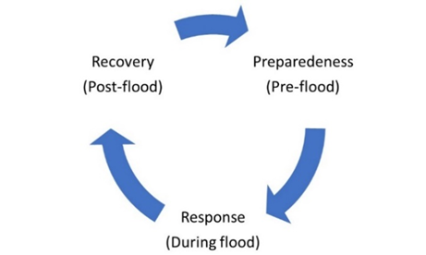
AN INTEGRATED FLOOD RISK MANAGEMENT STRATEGY
Lilongwe City Council with funding from Lilongwe Water and Sanitation Project developed an integrated flood risk management strategy based on Sendai Framework for Disaster Risk Reduction 2015-2030 (UN, 2015)
An integrated flood emergency management considers actions for three stages
This Photo by Unknown Author is licensed under CC BY-NC

Slide 23
Drainage Master Plan

Slide 24
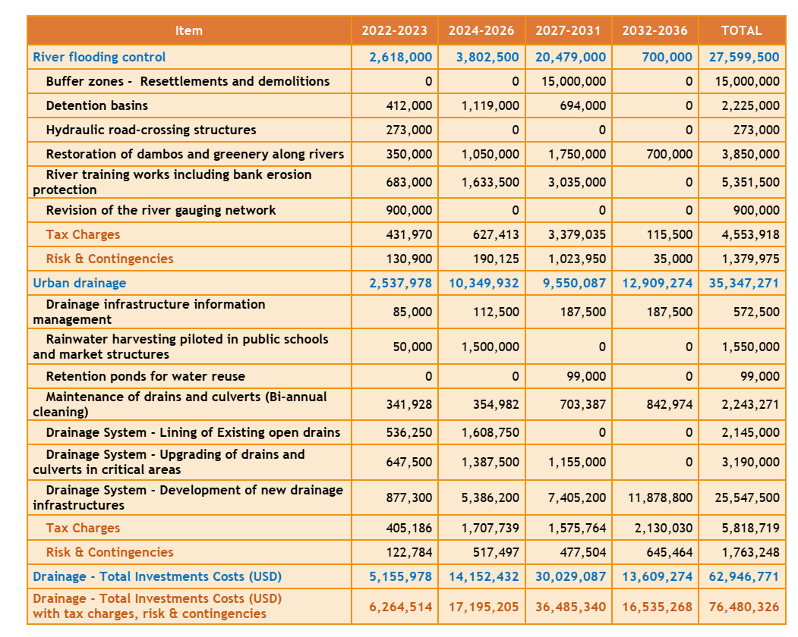
Snap Shot of Drainage Master Plan
This Photo by Unknown Author is licensed under CC BY-NC

Slide 25
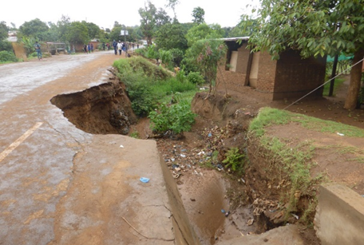
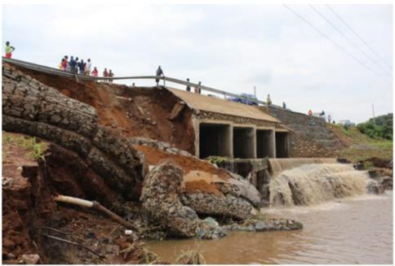
The End Zikomo Kwambiri

