Slide 1
Road Vulnerability Assessment (RVA) for Malawi RESTORE Project
タイトルスライド
Dec 10th, 2024
DMR Symposium Session 5 (13:30 – 14:30)
Blantyre, Malawi

Slide 2
Table of Contents
Project Background
Flood Modeling for Risk Assessment
Road Structure Inspection and Assessment
Geographic Information System (GIS) & Cost-Benefit Analysis (CBA)
Implications and Applications

Slide 3
Project Background
1

Slide 4

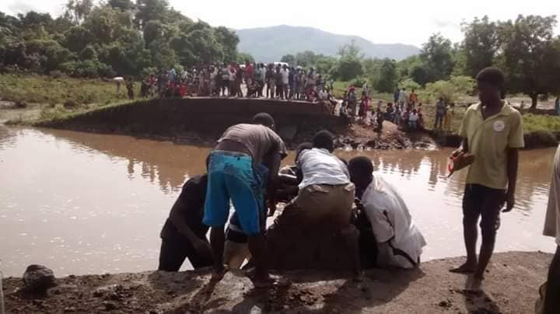
Project Background
目次
Malawi's transportation network is limited and in poor condition
Only 17% of classified roads are paved, and only a third of these are in good condition.
The road network is vulnerable to climate shocks, with 4,350 km potentially affected by severe flooding events.
The economic risk from climate events to the road network is estimated at $163 million per year.
The World Bank's RESTORE project aims to improve climate-resilient transport connectivity in the Lower Shire Valley.
The project focuses on rehabilitating the M1 (90km) and feeder roads, one of such is the S152 (60km), in the Lower Shire Valley, which are crucial for international trade, agriculture and tourism.
The M1 connecting Chikwawa to Blantyre cut off some 500 meters from Kamuzu Bridge on the way to Thabwa in 2019.
Source: Malawi Government Facebook Page.
Goal of this Vulnerability Assessment:
Inform further decisions about which investments to make, with a view on maximizing resilience

Slide 5
Road User Effects vs. Community Effects
HDM-4 vs. RVA
Key Component of RVA
Flood Model and Risk Assessment: RVA models the possible flood losses based on return period (RP) and the effects of different intervention strategies.
Flood Intervention Costs (FIC): It calculates the costs associated with any interventions based on design period with-holding target flood with corresponding RP
Community Effects: This includes the impact on communities, such as income, building, crop, safety, accessibility to public health & education facilities, and commerce activities, considering its interrupted durations by flood depth.
Economic Analysis: RVA performs cost-benefit analysis to evaluate the economic viability of flood risk management projects.
Environmental and Social Impact: It will assess the environmental and social impacts of flood risk management projects qualitatively.
Key Component of HDM-4
Pavement Deterioration and Maintenance: HDM-4 models the deterioration of road pavements over time and the effects of different maintenance strategies.
Vehicle Operating Costs (VOC): It calculates the costs associated with vehicle operation, including fuel consumption, tire wear, and maintenance.
Road User Effects: This includes the impact on road users, such as travel time, vehicle operating costs, and safety.
Economic Analysis: HDM-4 performs cost-benefit analysis to evaluate the economic viability of road projects.
Environmental and Social Impact: It assesses the environmental and social impacts of road projects, including emissions and noise.

Slide 6
Flood Modeling for Risk Assessment
2

Slide 7
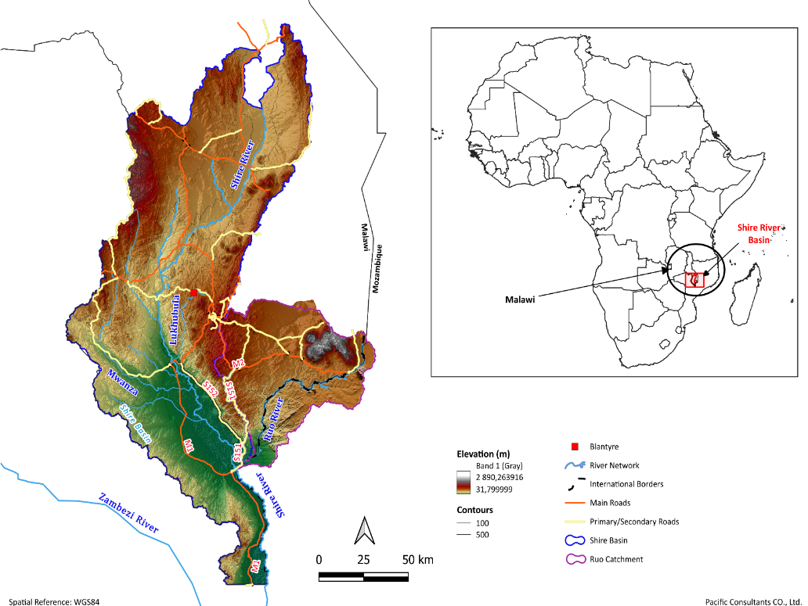
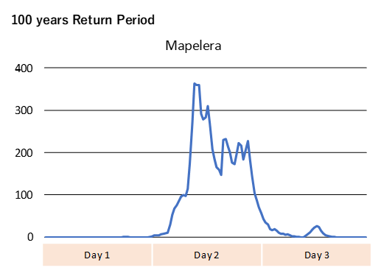
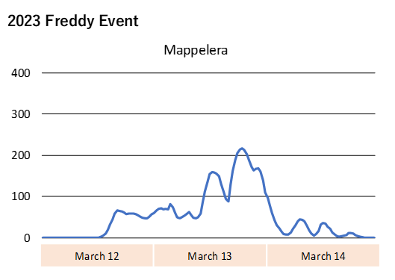
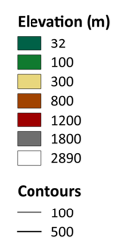
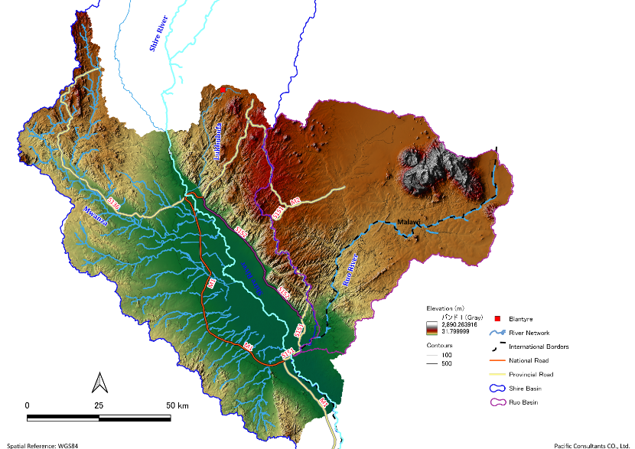

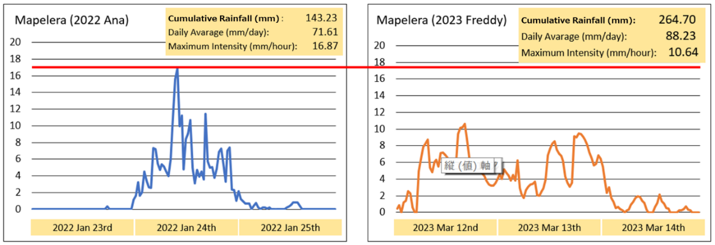
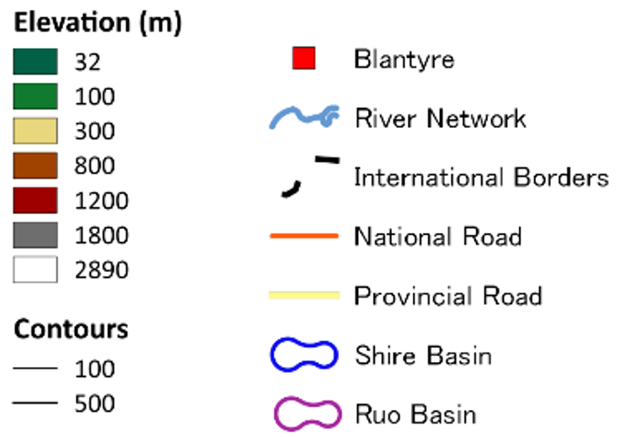
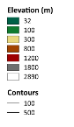
Overview of the Shire River Basin: General
River Name | 1/20 | 1/100 | 1/400
Mwanza | 1,949 | 3,113 | 4,505
Fodya | 741 | 1,796 | 2,002
Namikalango | 185 | 653 | 722
Lukhubula | 722 | 1,354 | 1,913
Mwaphanzi | 210 | 705 | 881
Mapelera | 108 | 364 | 415
Discharge
Kapichira Dam
Kapichira Dam
Bangula
Rainfall Analysis
Bangula

Slide 8
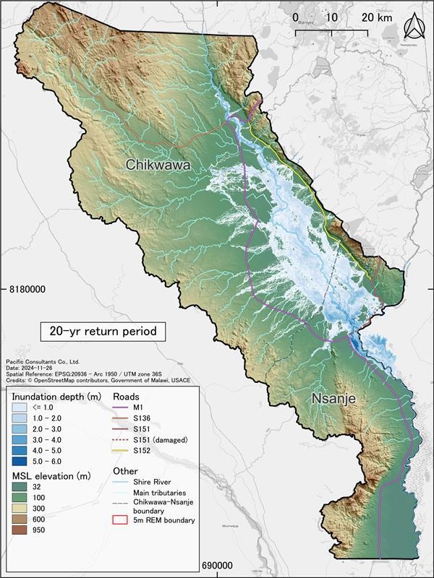
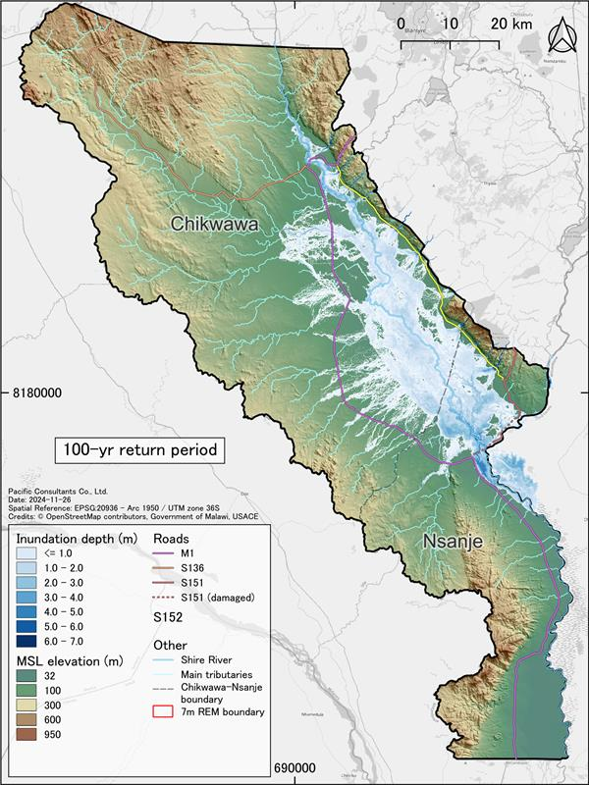
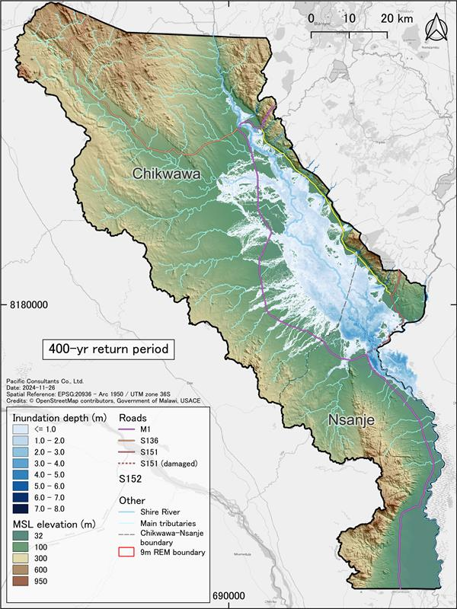
Overview of the Shire River Basin: Flood Model

Slide 9
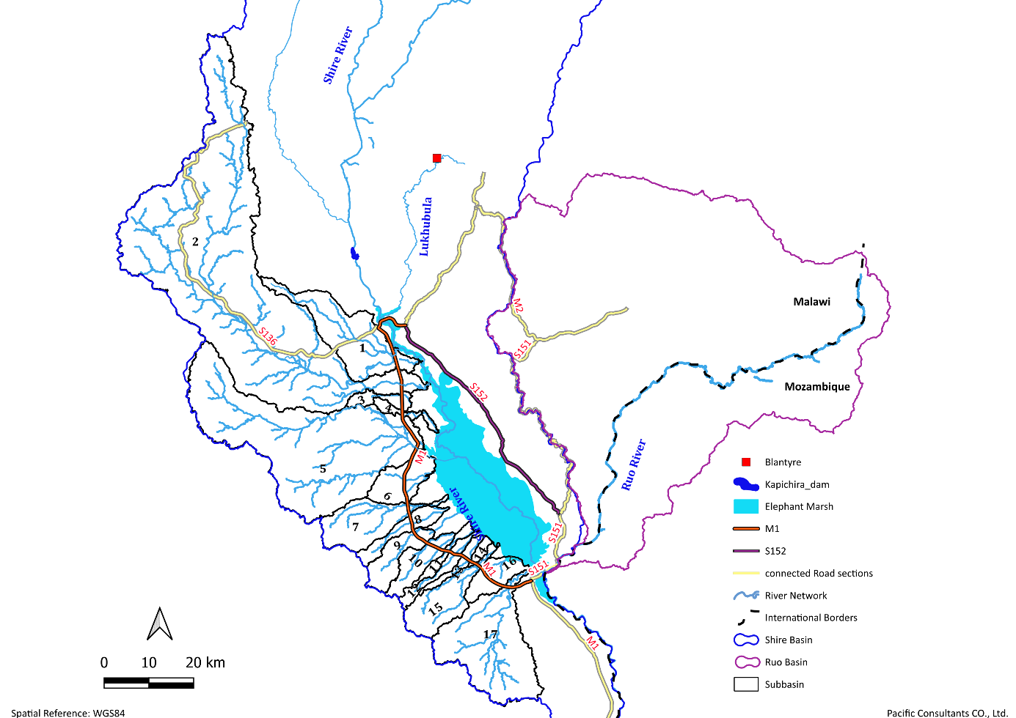
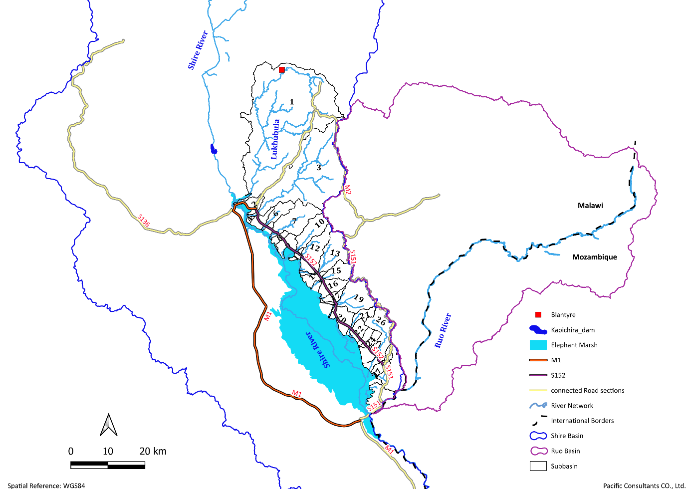
Project Background
The Lower Shire contains multiple subbasins draining directly into the Elephant Marsh.
Subbasins are divided into: West-side: Gentler slopes and larger capacity. East-side: Steeper gradients.

Slide 10
Road Structure Inspection and Assessment
3

Slide 11
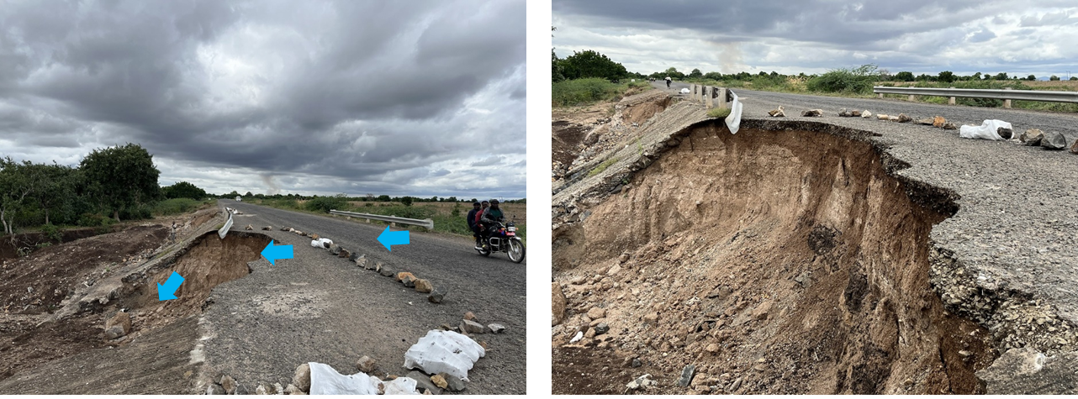
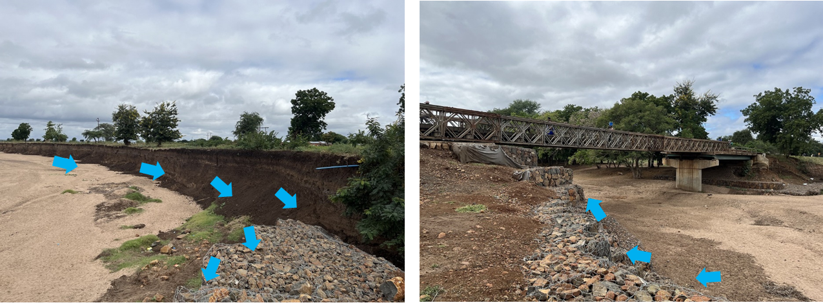
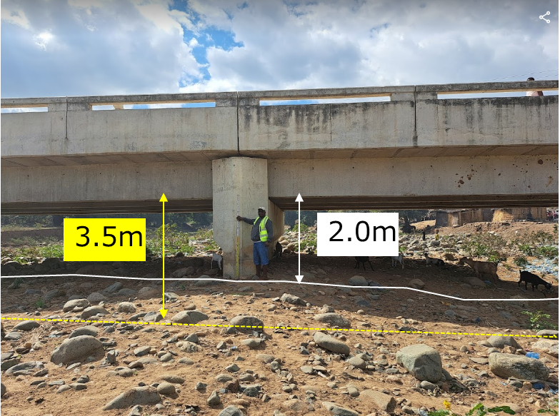
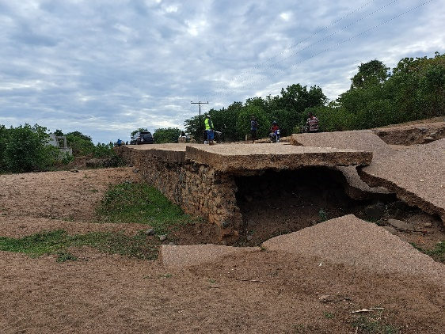
Site Situation
Flood water from the upstream overtopping the roads with insufficient capacity of culverts resulting in damage on the downstream side of the road
Erosion of the riverbank around the bridge structure with result in the erosion of the riverbank protection in the bridge structure resulting in washing away the bridge
Heavy sedimentation / siltation (1.5m of sedimentation in 3 to 4 years)
Erosion and scouring at apron which destabilized the concrete wall/slab and lead to the loss of fill material.

Slide 12
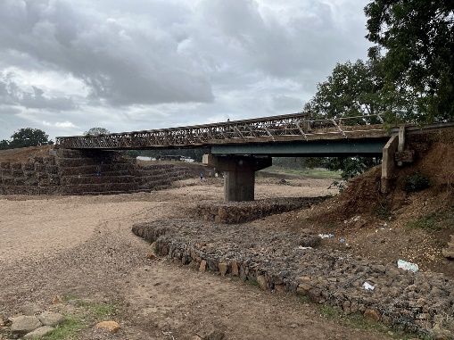
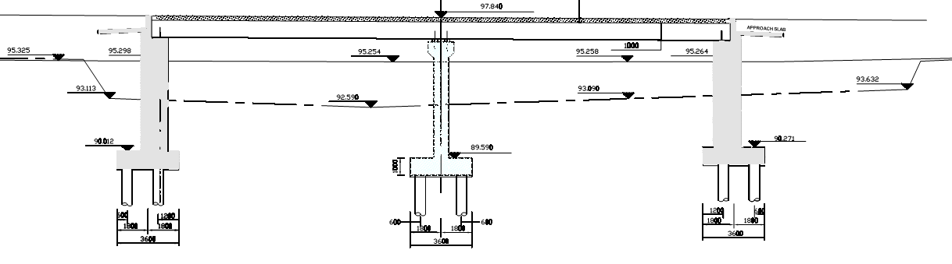
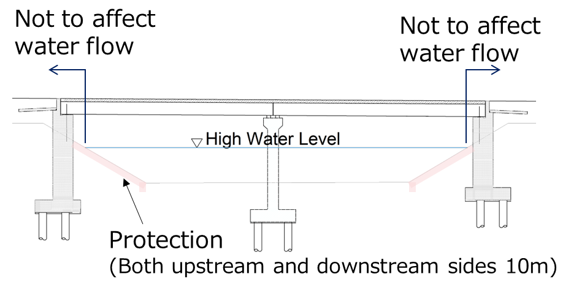
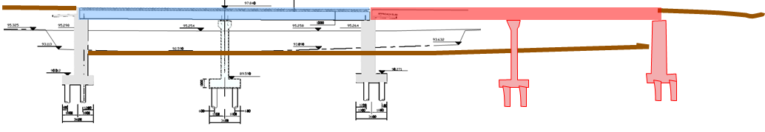
Review of Crossing Structure Design
Example: M1- NAMIKALANGO Bridge (#M1-82)
RVA Study Review (Review Conditions)
Design Discharge For the catchment No.7 | Q20 = 210 m3/s Q100 = 653 m3/s Q400 = 722 m3/s
 | Improvement Concept “without overtopping”
Q20 =210 m3/s | Provide permanent Bridge Structure with same dimension (2 Spans)
Q100 =653m2/s | Provide permanent Bridge Structure with 4 Spans (Additional 2 spans)
Review of the Flow Capacity (uniform flow)
40m
Current Capacity
Q=350 m3/s
V=2.8m/s
(temporary structure)
>3.5m
80m

Slide 13
Landslide Susceptibility Analysis (LSA)
Overview of the site visit
Data Collected: Key factors included precipitation, NDVI, land use, soil type, slope, and elevation.
Site Investigation: Conducted over a week with Vane Shear Tests and soil probes along the S152 road to evaluate soil characteristics.
Findings: The soil composition was primarily silty clay and sandy clay with boulders. No immediate damage to roads was observed from slope failures.
Landslide Mechanisms: Debris flows were the predominant landslide type, influenced by intense rainfall, steep slopes, external triggers (earthquakes, human activities), and the absence of vegetation, which reduces soil stability.
This comprehensive analysis is essential for understanding and mitigating potential landslide hazards in the region.

Slide 14
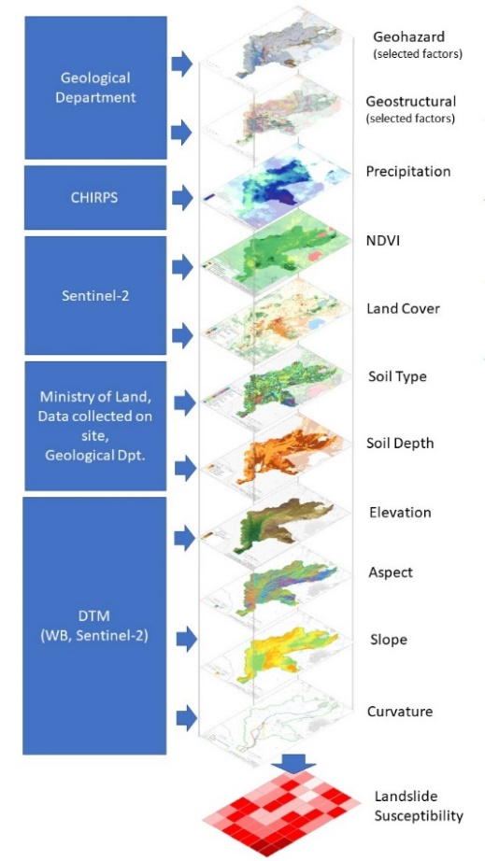
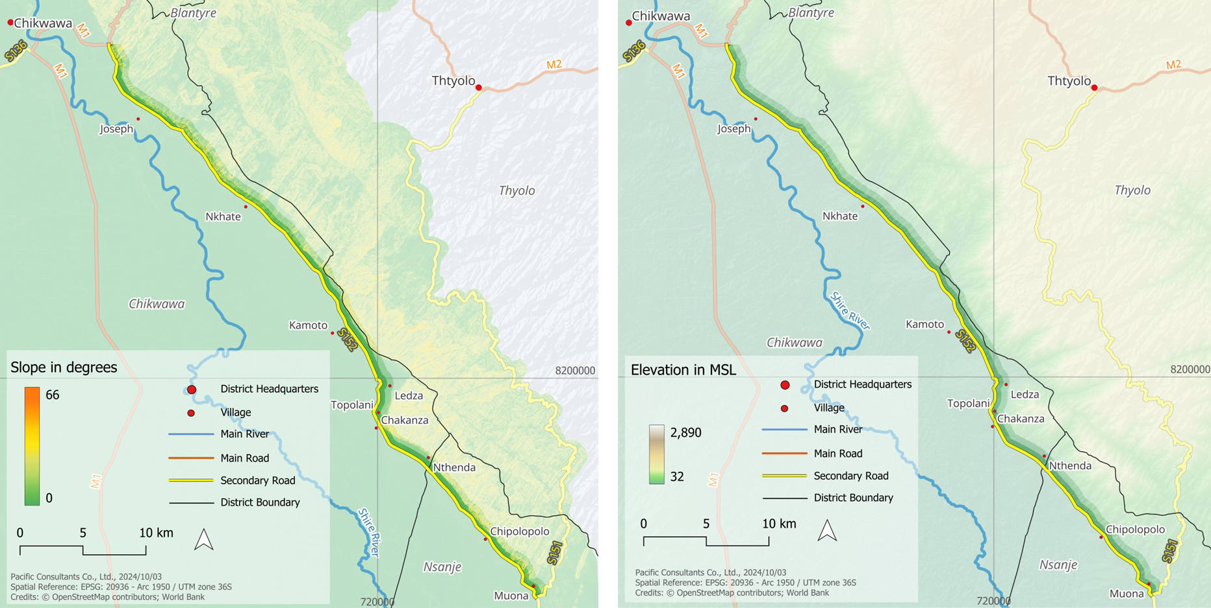
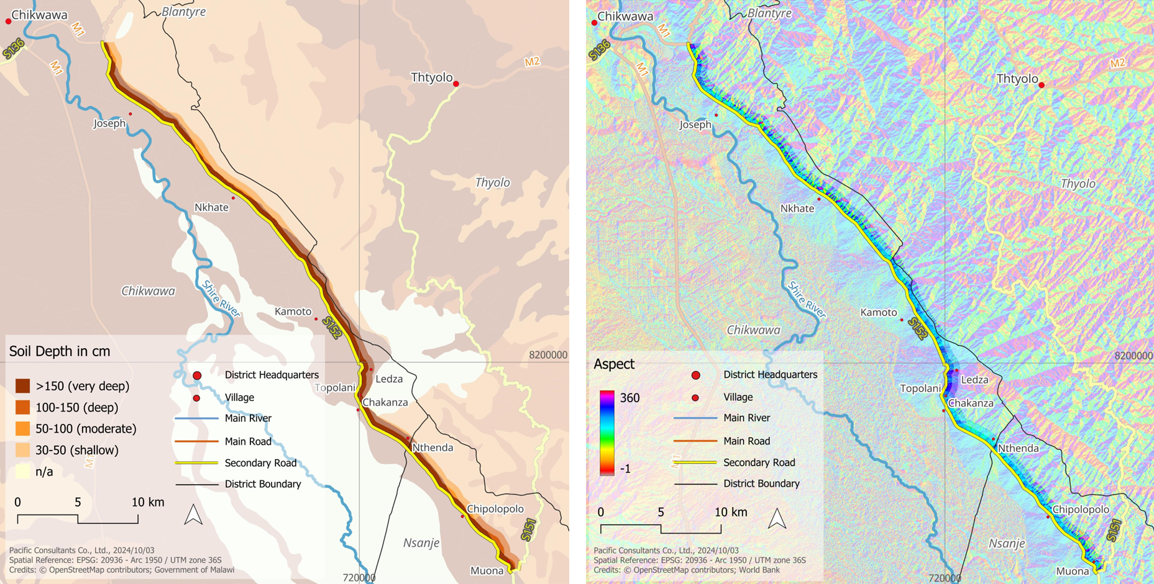
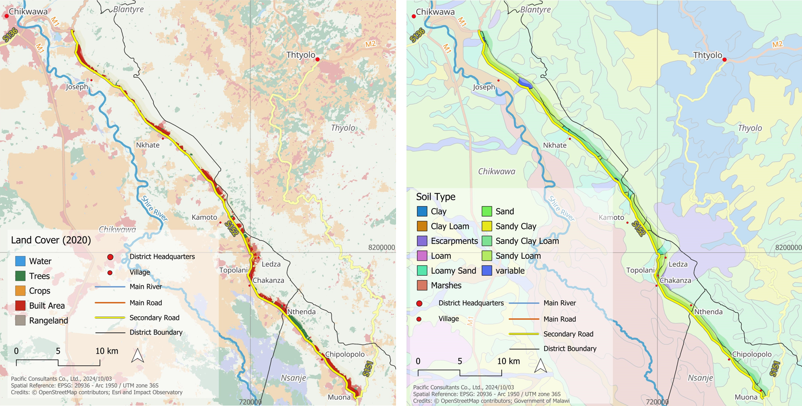
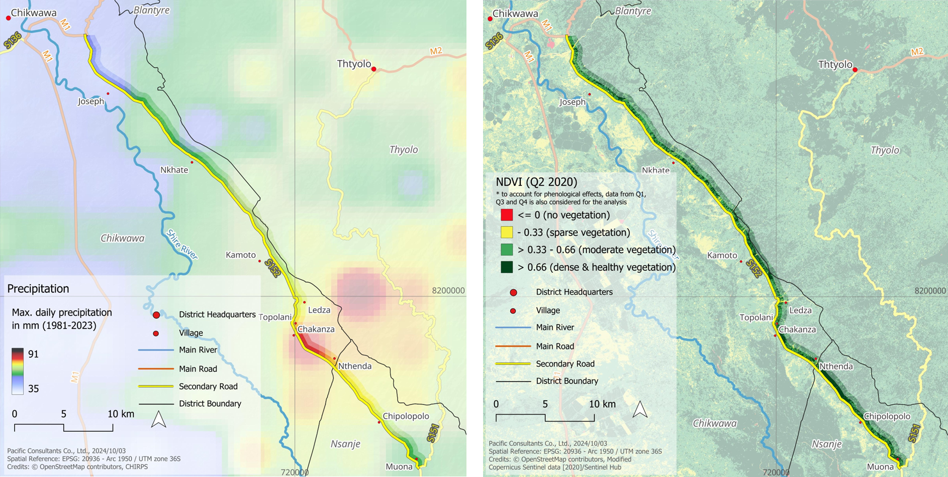
Landslide Susceptibility Analysis (LSA)
Data Collection: All available data for the Landslide Susceptibility Analysis has been gathered, including on-site data, contributions from counterparts, and open-source information. This includes results from the Vane Shear Test conducted along S152.
Data Visualization: Landslides susceptibility, provides a comprehensive view of data collection on S152, illustrating that each data layer corresponds to the same segment. Notably, the data layers for precipitation and Digital Terrain Model (DTM) are particularly clear and detailed.
Pending Information: Additional data, including the landslide inventory, is awaited from counterparts. Once received, this data will be standardized for resolution and alignment across all layers. This step is essential for developing a landslide susceptibility map using statistical models, with a focus on frequency ratio modeling (FRM).
Landslide Susceptibility –Susceptibility Factors and Available Open-source Input and Collected Data.
Source: Formulated by the Consultants Team
＊Normalized Difference Vegetation Index （NDVI）

Slide 15
Road Vulnerability Assessment Results
Key Interventions for S152
Bridges (RP100): This incudes; reconstruction (widening & rising) of 1 bridge at Chinolo, and extension and/or raising of 3 bridges at Livunzu, Thangazi, and KP-54.2
Box Culverts (RP50): This includes; protection of road embankment and installation of additional box culverts.
Pipe Culverts & Drifts (RP20): This includes; replacement of blocked and/or damaged pipe culverts and drifts.
Other Interventions: This includes; provision of wider shoulders, widening along roadside markets with traffic safety facilities, river training works and removal of excess sedimentations along tributaries.
Pavement: Asphalt Concrete (AC) thickness of 40 mm ensures durability for light traffic volumes.
M1 and S152
Key Interventions for M1
Bridges (RP100): This incudes; reconstruction (extension & rising) of 1 bridge at Namikalango, and extension and/or raising of 3 bridges at Mwanza, Nyakamba and Thangazi.
Box Culverts (RP50): This includes; protection of road embankment and installation of additional box culverts.
Pipe Culverts (RP20): This includes; replacement of blocked and/or damaged pipe culverts.
Other Interventions: This includes; provision of wider shoulders, widening along roadside markets with traffic safety facilities, river training works and removal of excess sedimentations along tributaries.
Pavement: Asphalt Concrete (AC) thickness of 50 mm ensures durability for heavy traffic volumes.

Slide 16
Geographic Information System (GIS) & Cost-Benefit Analysis (CBA)
4

Slide 17
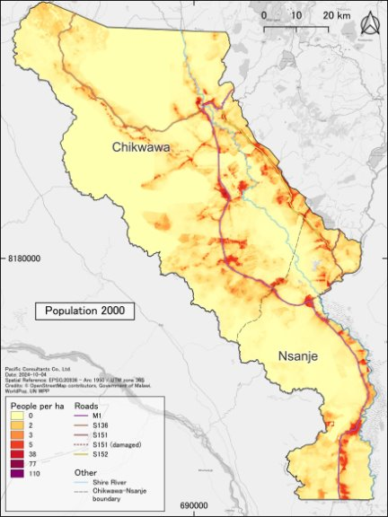
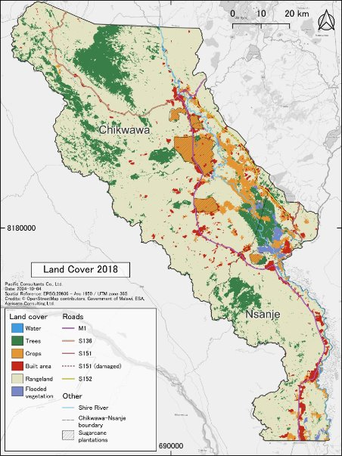

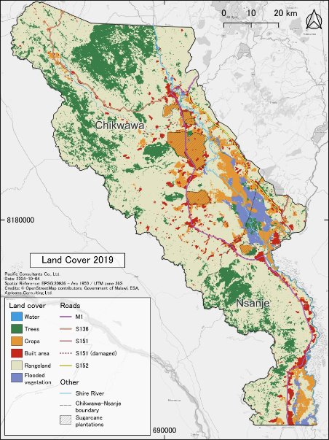
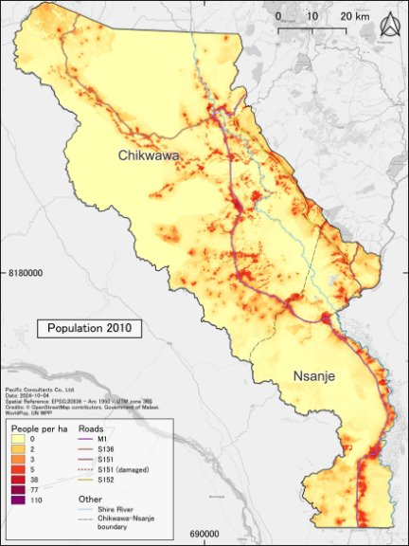
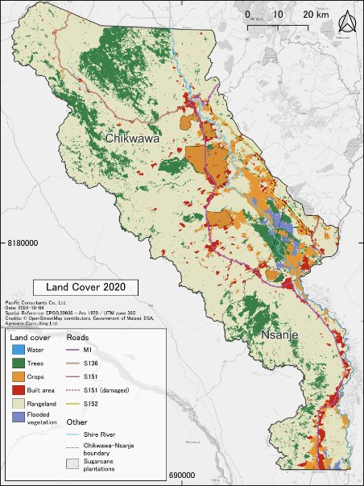

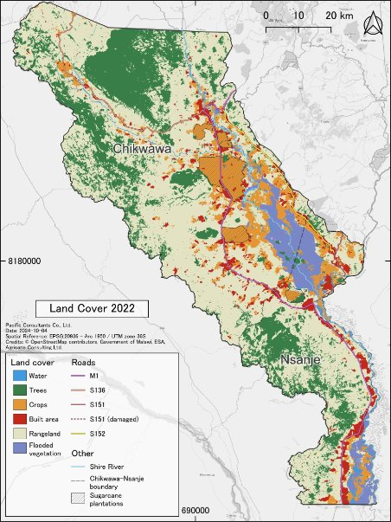

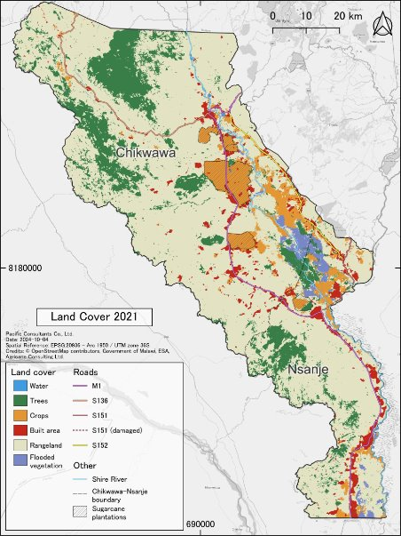
Population 2000-2020
Land Use 2017-2023

Slide 18
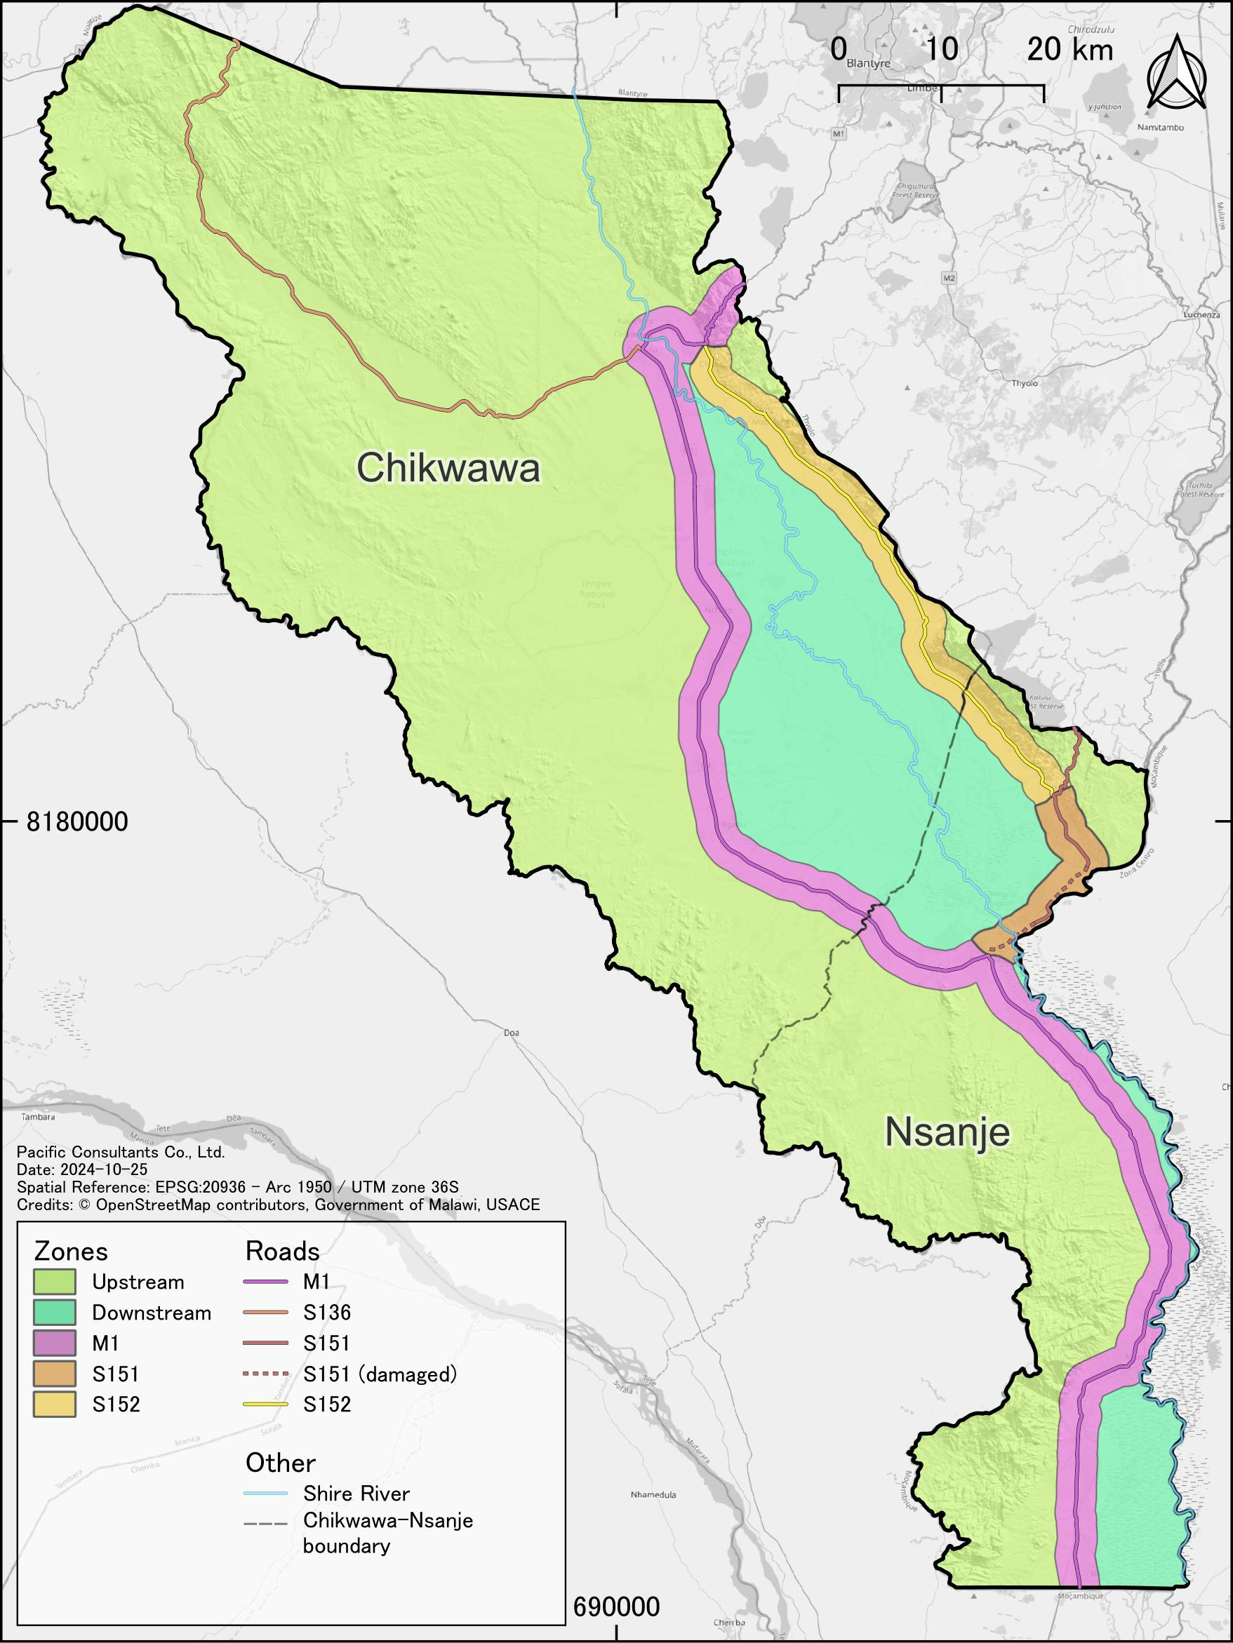
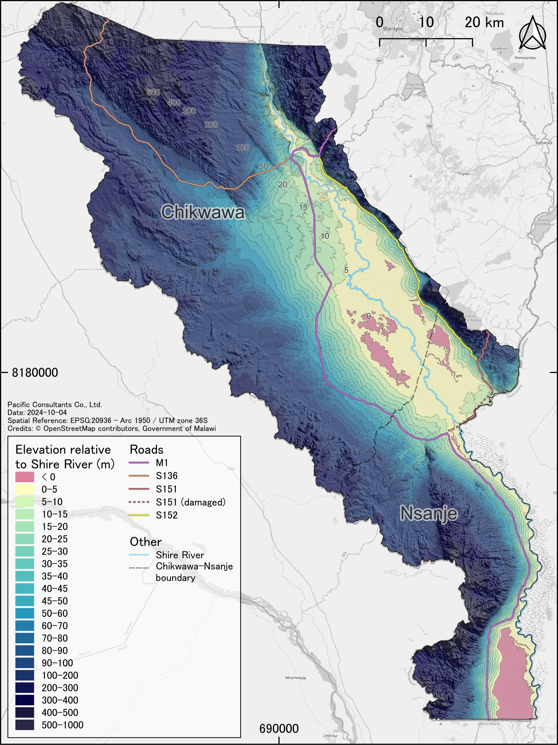
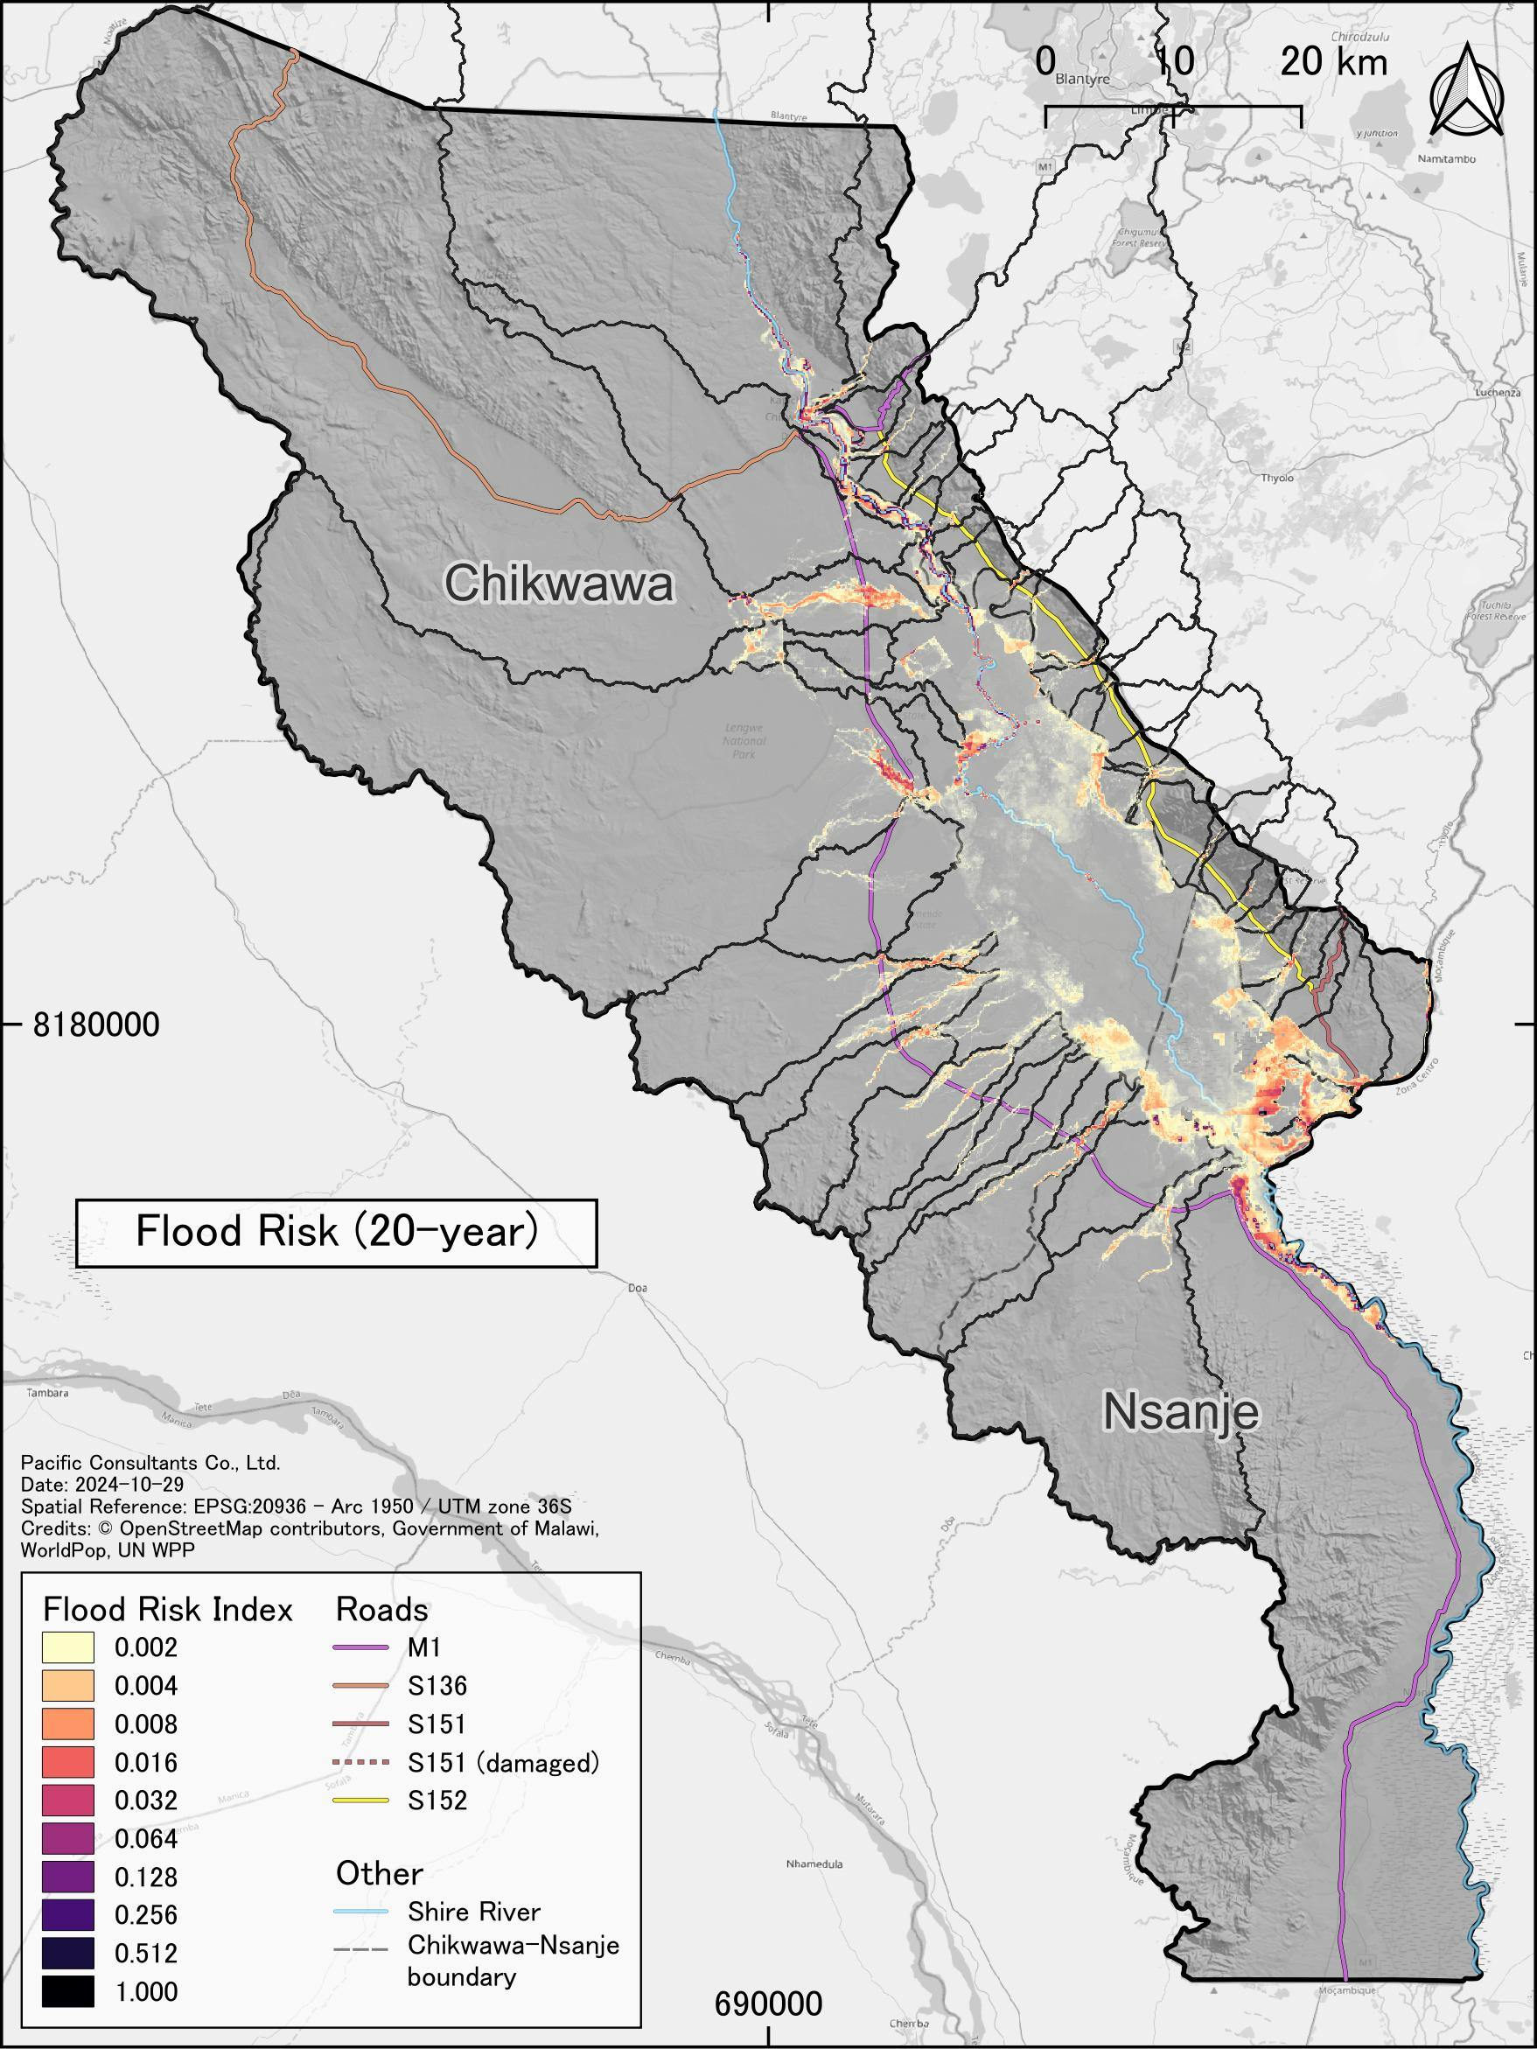
Zonings and High Flood Risk Area along Tributaries

Slide 19
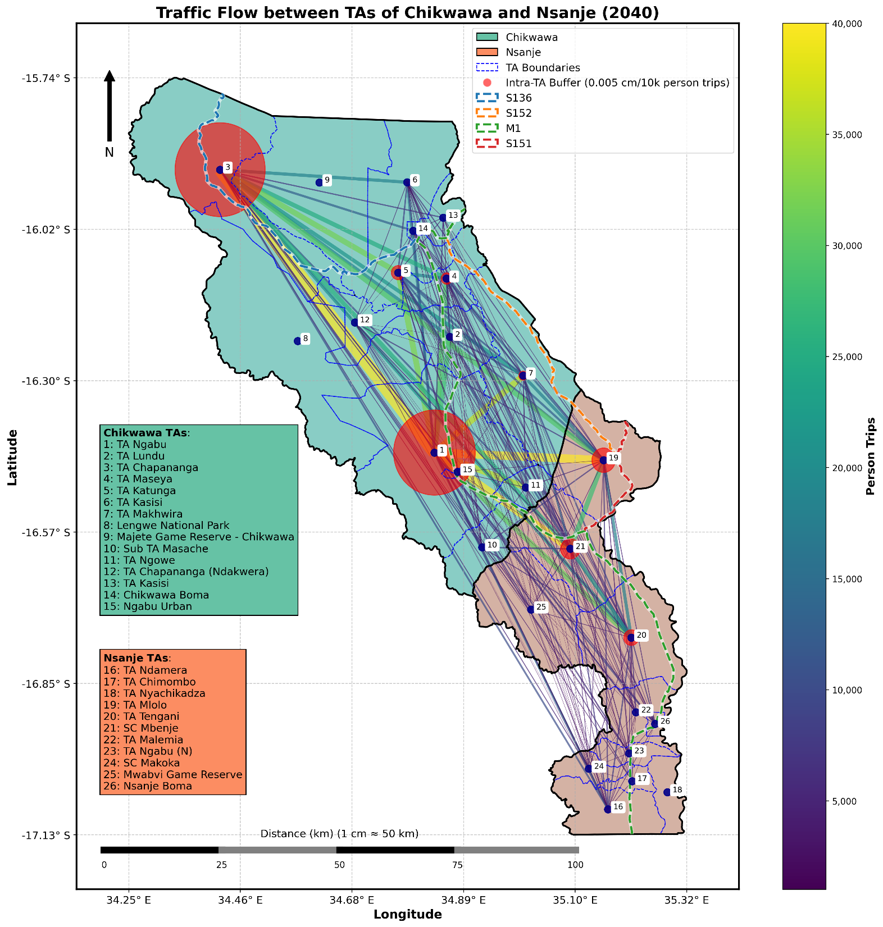
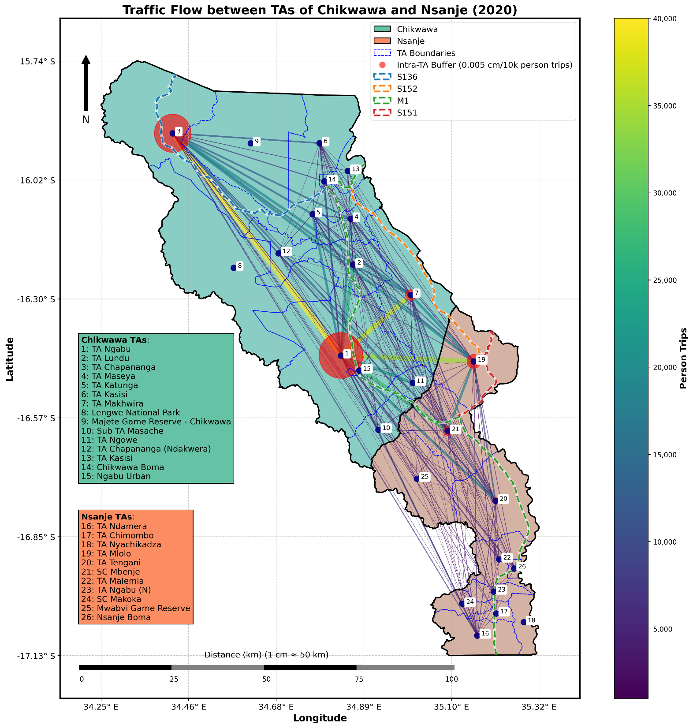
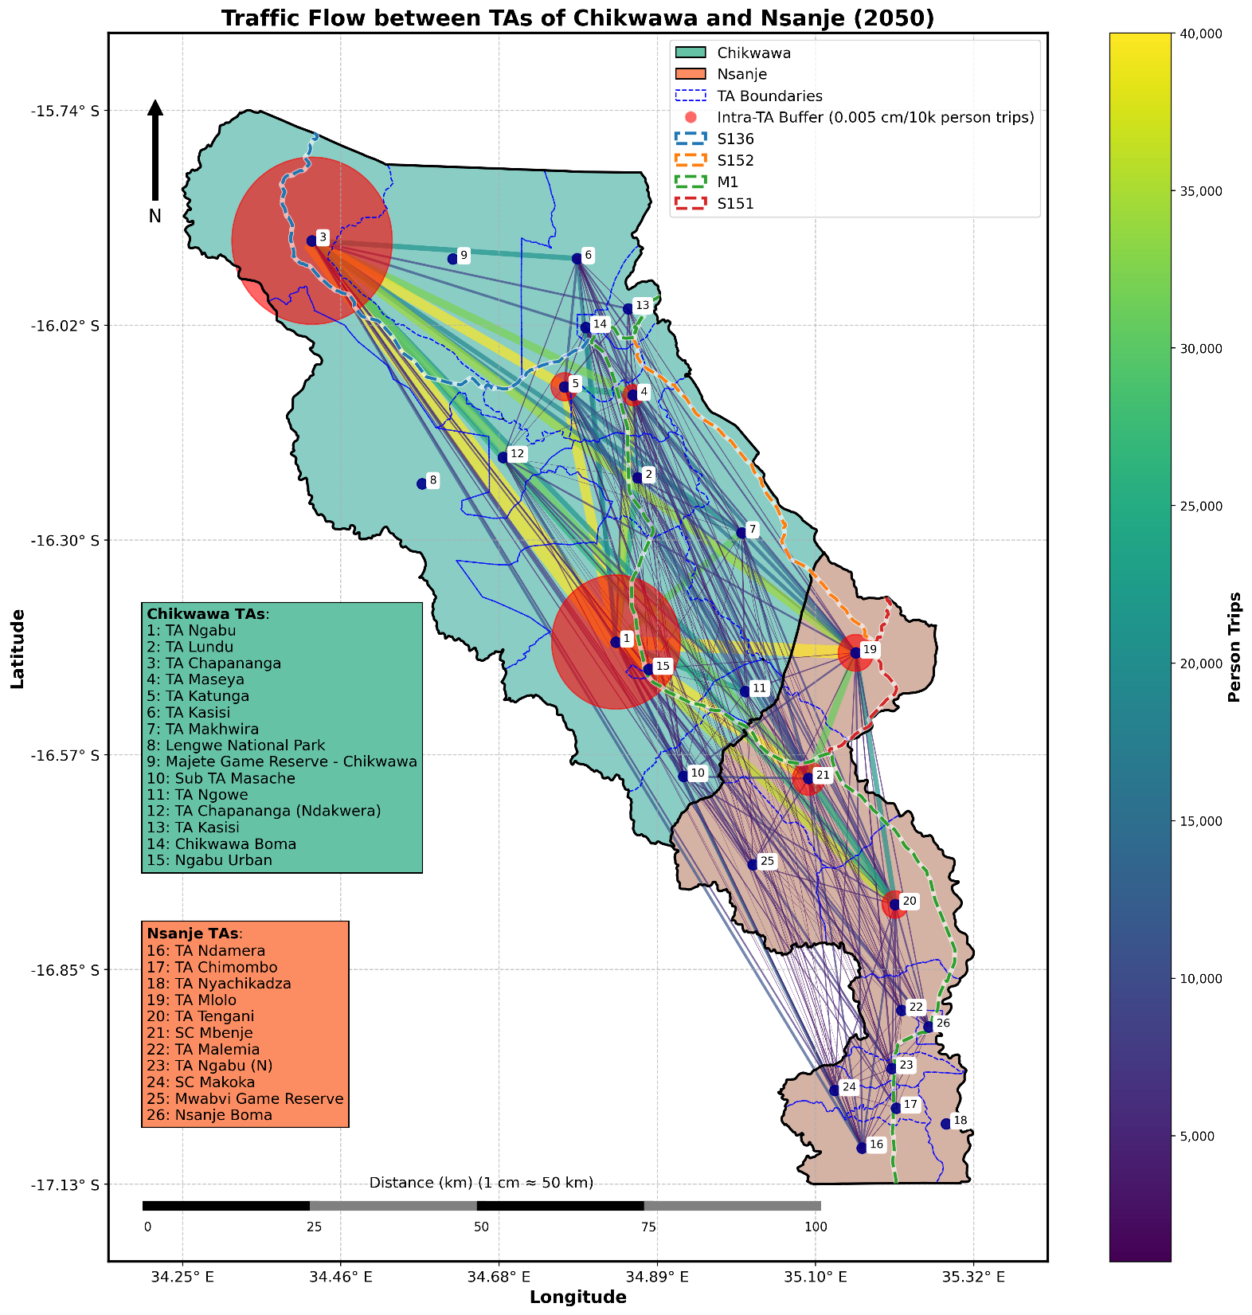

Potential Movements of the Communities in SRB
Year | Pop- Ckw | Pop- Nsj | Pop-Sum | Ckw-Ckw | Ckw- Nsj | Nsj- Ckw | Nsj- Nsj | Trip-Sum | Pop | Trip | Trip/ Pop
2020 | 606.2 | 330.8 | 937.0 | 1,145.2 | 408.1 | 408.8 | 380.8 | 2,343.0 | 1.00 | 1.00 | 2.50
2030 | 724.7 | 396.0 | 1,120.7 | 1,414.0 | 501.7 | 501.3 | 469.4 | 2,886.4 | 1.20 | 1.23 | 2.58
2040 | 831.9 | 455.3 | 1,287.2 | 1,677.8 | 594.9 | 591.9 | 560.6 | 3,425.2 | 1.37 | 1.46 | 2.66
2050 | 909.7 | 498.8 | 1,408.5 | 1,872.3 | 658.8 | 658.8 | 615.3 | 3,805.1 | 1.50 | 1.62 | 2.70

Slide 20
GIS & National Statistics
Various Documents
1st Layer: Land Use Land Cover (Built-up & Crop)
2nd Layer: Population Distribution/Concentration
3rd Layer: Health / Education / Accident
4th Layer: Trading Logistics (Export & Import) / GHG
5th Layer: Emergency Relief (Not Counted Yet)
1st; Asset Values (Built-up) & Production Values (Crop)
2nd; National Average Income (GDP per Capita)
3rd; DALYs / Educational Opportunity Cost / iRAP
4th; Logistics Cost Gap (Durban vs Beira) / CO₂ Price
5th; Accessibility & Redundancy
RVA Benefit Analysis Flow
HEC-RAS for
RP=20/100/400
Flooded
Not Flooded
Bank (West for M1, East for S152) /
Zone (Downstream/Corridor/Upstream) /
Flood Risk by Inundation Depth /
Probable Maximum Loss (PML)
Direct Loss
Indirect Loss
Average Annual Growth Rate (AAGR)
1st~3rd Layers: 2%
4th Layer: 3%
(5th Layer: n/a)
Reduction of 30 +/- 20% Flood Loss
= Intervention Benefit

Slide 21
Implications and Applications
(Other Researches)
5

Slide 22
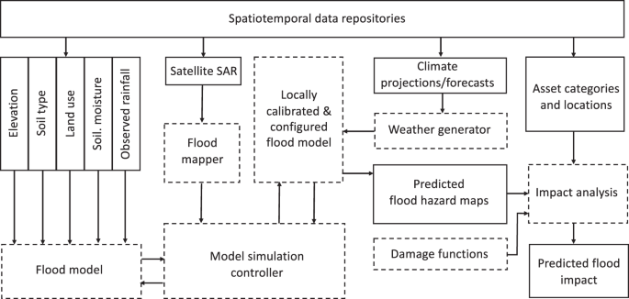
Example Impact Modeling Workflow to Calculate Pluvial Flood Impact
AI for climate impacts: applications in flood risk | npj Climate and Atmospheric Science

Slide 23
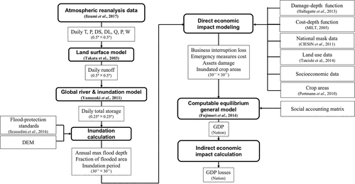
Example Estimate Direct and Indirect Economic Impact
Estimation of Direct and Indirect Economic Losses Caused by a Flood With Long‐Lasting Inundation: Application to the 2011 Thailand Flood - Tanoue - 2020 - Water Resources Research - Wiley Online Library

