Slide 1
Consultancy Services for the Development of a Comprehensive Risk Atlas and Risk Management Strategy for Blantyre City with an Integrated Flood Risk Management Plan
Project Report Summary
Tarek Rashed, Ph.D., NIRAS Team Lead
National Disaster Risk Management Symposium – Dec 9, 2024
Notes:
Slide-1

Slide 2

About the Project

Slide 3
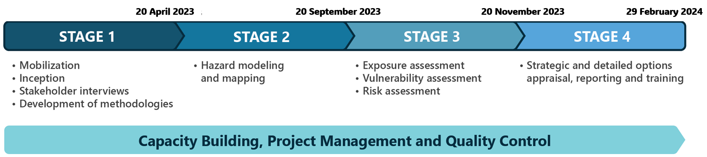
Project Implementation and Stages

Slide 4

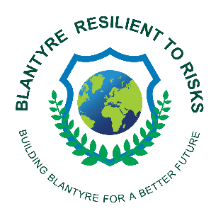
About Stage 2
Data Synthesis
Hazard Analysis and Characterisation
Collect and integrate diverse data sets, such as topography, meteorological and climate records, geological information, etc., into a coherent GIS framework for hazard analysis
Conduct in-depth analysis and mapping of the most critical and frequent hazards affecting Blantyre City, namely floods, droughts, earthquakes, and landslides
1
2
Stage II
4
3
Spatial Understanding
Modelling Scenarios
Provide a visual representation of where specific hazards are likely to occur using GIS
Model and simulate different scenarios of hazard events to predict future occurrences based on current and past data

Slide 5
About Stage 3
Vulnerability Survey and Community Assessment
Exposure Assessment
Comprehensive survey design tailored to community specifics; Methodical execution of surveys to gather critical data; In-depth analysis of survey findings to understand community vulnerabilities.
Estimation of Average Annualised Losses (AALs) for flood hazards; Earthquake, landslides, and drought risk analysis; Development of a composite risk index.
1
2
Online GIS Server
Development of Damage Curve Functions
Stage III
Deployment of an interactive online GIS platform for real-time data access; User-friendly interface for stakeholders to analyse spatial risk data.
6
3
Developing damage curves for residential and non-residential buildings for floods, earthquakes, and landslides, and modeling infrastructure resilience in natural disasters.
5
4
Development of the Risk Atlas
Disaster Risk Assessment
Comprehensive visualisation of hazard zones and risk levels; Detailed mapping of areas by risk category for strategic planning.
Detailed evaluation of hazard impacts on the population; Economic impact analysis from potential hazard scenarios; Structural and infrastructural resilience assessment against diverse hazards.

Slide 6
About Stage 4
Stakeholders Workshop
Multi-Hazard Risk Management Strategy
Engaged stakeholders in workshops to ideate, brainstorm, and prioritize disaster risk management strategies (and related interventions), building on Stage 3 outcomes.
Formulating a six-year multi-hazard risk management strategy for Blantyre City, the first of its kind, building on the workshop outcomes.
1
2
Stage IV
Final Presentation and Report
Integrated Flood Risk Management Plan
4
3
Culmination of the project with a presentation and report summarizing the proposed strategies and implementation roadmap
Detailed elaboration on flood-specific interventions, refining them for targeted risk reduction and management, and running simulations to assess savings and reductions in AALs when possible.

Slide 7

What is a Risk Management Strategy?
A comprehensive framework designed to:
  manage natural hazard risks that could adversely affect Blantyre City and their potential impacts on its infrastructure, population, and economy;
  provide authorities with a systematic approach to proactive actions aimed at protecting Blantyre City's residents, enhancing infrastructure and response capabilities, and increasing community awareness and resilience;
  and
  represent a commitment to prioritising and investing in strategies that contribute to Blantyre's long-term sustainability and resilience.

Slide 8
Key Questions Answered by the Risk Management Strategy
Goals
Interventions/KPIs
Objectives
What long-term risk reduction goals/outcomes does the city want to achieve?
What specific actions will the Malawian government, BCC, community organizations and others take to achieve these outcomes?
How can the city measure its progress towards stated actions and goals?

Slide 9
What Does the Risk Management Strategy NOT Cover?
Goals
Interventions
Implantation Plan
Objectives
Operational details and how proposed interventions and actions will be implemented.
  These details are tactical components of the overall risk management strategy that translate the Risk Management Strategy into actionable steps that can be implemented before, during, or after a natural hazard event.
Notes:
Specify the "who," "what," "when," and "how" of risk management activities.
Developed based on priorities and guidelines outlined in the Risk Management Strategy, ensuring alignment with the city's long-term goals.
Updated regularly to adapt to changes in risk assessments and strategic direction to ensure Blantyre City is prepared for natural hazards.

Slide 10

Building a Resilient Blantyre: From Risk Assessment to Robust Action Plan
Risk Assessment Review:
Develop problem statements developed from the risk assessment. For each problem statement, consider different types of mitigation actions for addressing the problem.
Strategy Formulation:
Establish a clear set of goals and objectives that prioritize human safety, infrastructure integrity, and environmental stability., keep into account Determine the resources available.
Action Development (high-levels):
Outline specific interventions for each identified risk and performance metrics.
Communication Plan:
Develop a communication strategy to keep stakeholders informed and to disseminate warnings and information quickly during emergencies.
Monitoring and Review: Establish a process for ongoing monitoring, evaluating the effectiveness of the strategy and interventions, and updating plans in response to new insights or changing conditions.

Slide 11

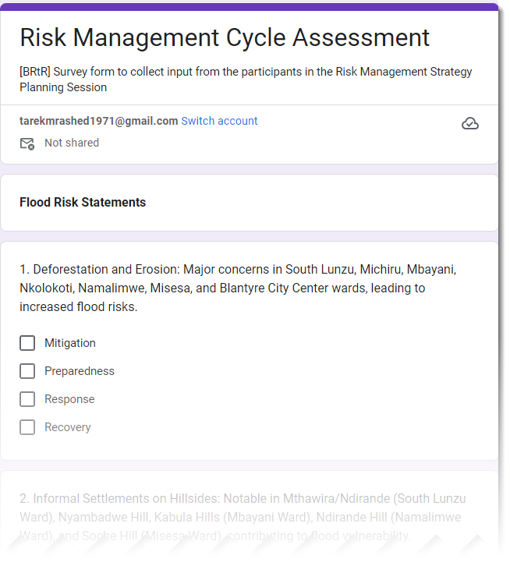

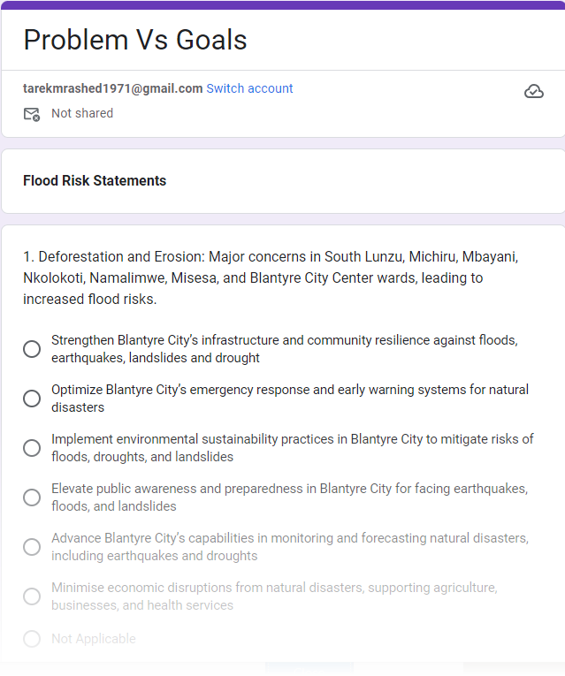
Process of Driving Strategic Goals from Problem Statements
https://bit.ly/47LbI8w
https://bit.ly/3t4Jgzl
Step 1: Filter Problem Statements
1
Step 2 Link Statements to the Four Phases of the Disaster Risk Management Cycle
2
Step 3: Group Related Problem Statements Per Phase to Form Broader Strategic Goals
3
Step 4: Combine Overlapping Goals to Create Comprehensive and Efficient Strategic Goal for BRtR Risk Management Strategy
4

Slide 12
Blantyre RMS Framework
Mission
Vision
Strategic Goal 1
Measurable Objective 1
Intervention1
Intervention 2
……….
Intervention n
Measurable Objective 2
….
Measurable Objective n
Strategic Goal 2
…..
Strategic Goal n
Guiding Principles
Goals (6)
Interventions (30)
Objectives (27)
KPIs (50)

Slide 13
Mission
To safeguard Blantyre City from natural hazards by strengthening infrastructure and community resilience, optimising disaster response, and implementing sustainable practices, ensuring a safe, prepared, and resilient environment for all.

Slide 14
Vision
Blantyre Resilient to Risks: A city embodying resilience and sustainability, where every resident, business, and structure is equipped to withstand and thrive amid natural disasters through innovation, education, and collective action.

Slide 15
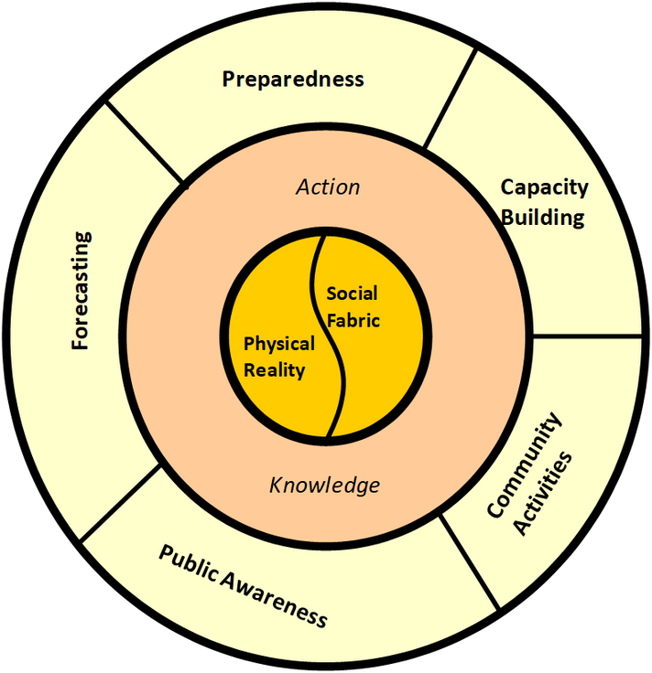
Guiding Principles
Resilience, Preparedness, and Proactive Integrated Risk Management
Prioritise infrastructure resilience, enhance emergency services, and align actions with disaster risk management phases, ensuring a cohesive approach to defending against natural disasters.
Data-Driven and Evidence-Based Decision Making
Emphasise the importance of utilizing data and evidence in planning, implementing, and evaluating risk management strategies to ensure effective and efficient resilience efforts
Innovation, Monitoring, and Forecasting
Advanced technology and research support precise disaster monitoring and forecasting, with innovative and flexible solutions enhancing response capabilities and resilience.
Collaboration and Inclusivity
Partnerships with diverse stakeholders ensure inclusivity and leverage expertise and resources, focusing on the needs of all community members, especially the most vulnerable.
Financial and Environmental Sustainability
Financially sustainable initiatives and environmental stewardship form the core of resilience efforts, emphasising the significance of a healthy ecosystem for long-term sustainability.
Community Engagement, Education, and Well-being
A culture of preparedness is fostered through comprehensive community education and engagement, prioritising residents' health and well-being as central to disaster resilience strategies.

Slide 16
Blantyre RMS Framework
Mission
Vision
Strategic Goal 1
Measurable Objective 1
Intervention1
Intervention 2
……….
Intervention n
Measurable Objective 2
….
Measurable Objective n
Strategic Goal 2
…..
Strategic Goal n
Guiding Principles
Goals (6)
Interventions (30)
Objectives (27)
KPIs (50)

Slide 17
Strategic Goals (SGs)
SG1-Strengthened Infrastructure and Community Resilience - Strengthen Blantyre City's infrastructure and resilience through risk-informed planning to protect against natural disasters.
SG2-Optimised Emergency Response and Early Warning Systems - Improve Blantyre City's disaster response and warning systems to boost preparedness and safety.
SG3-Implemented Environmental Sustainability Practices - Adopt environmental sustainability practices like reforestation and soil conservation to reduce flood, drought and landslide risks.
SG4-Elevated Public Awareness and Preparedness - Enhance community preparedness for natural disasters through education and outreach.
SG5-Advanced Monitoring and Forecasting Capabilities - Improve monitoring and forecasting of natural disasters to enable timely risk management.
SG6-Minimised Economic Disruptions - Reduce economic impacts of disasters by supporting agricultural, business, and healthcare continuity
Response
SG2
Recovery
SG6
Mitigation
SG1, SG3, SG5. SG6
Preparedness
SG1, SG2, SG4, SG5
Notes:
Slide-17

Slide 18
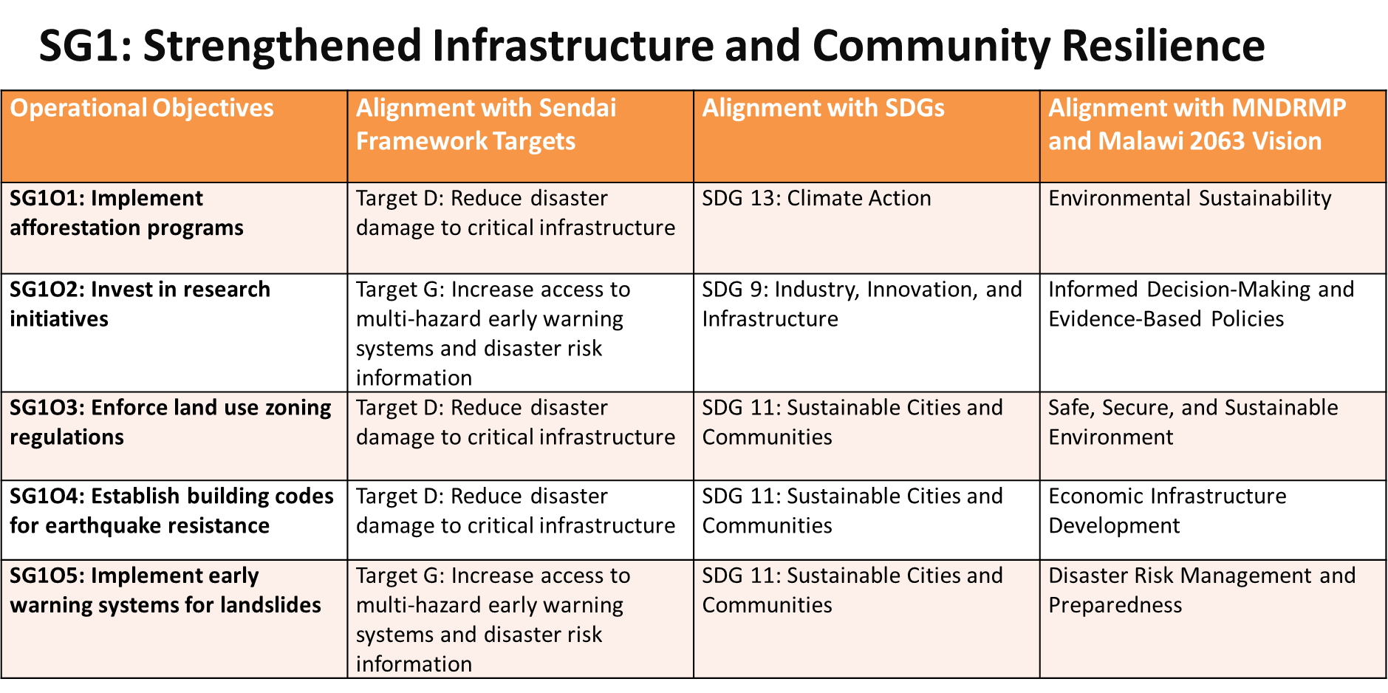
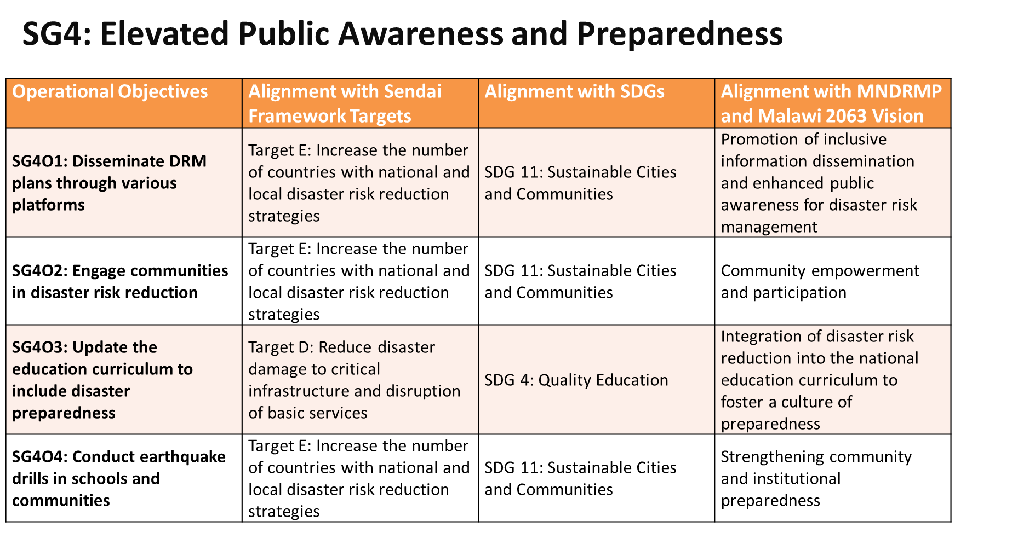
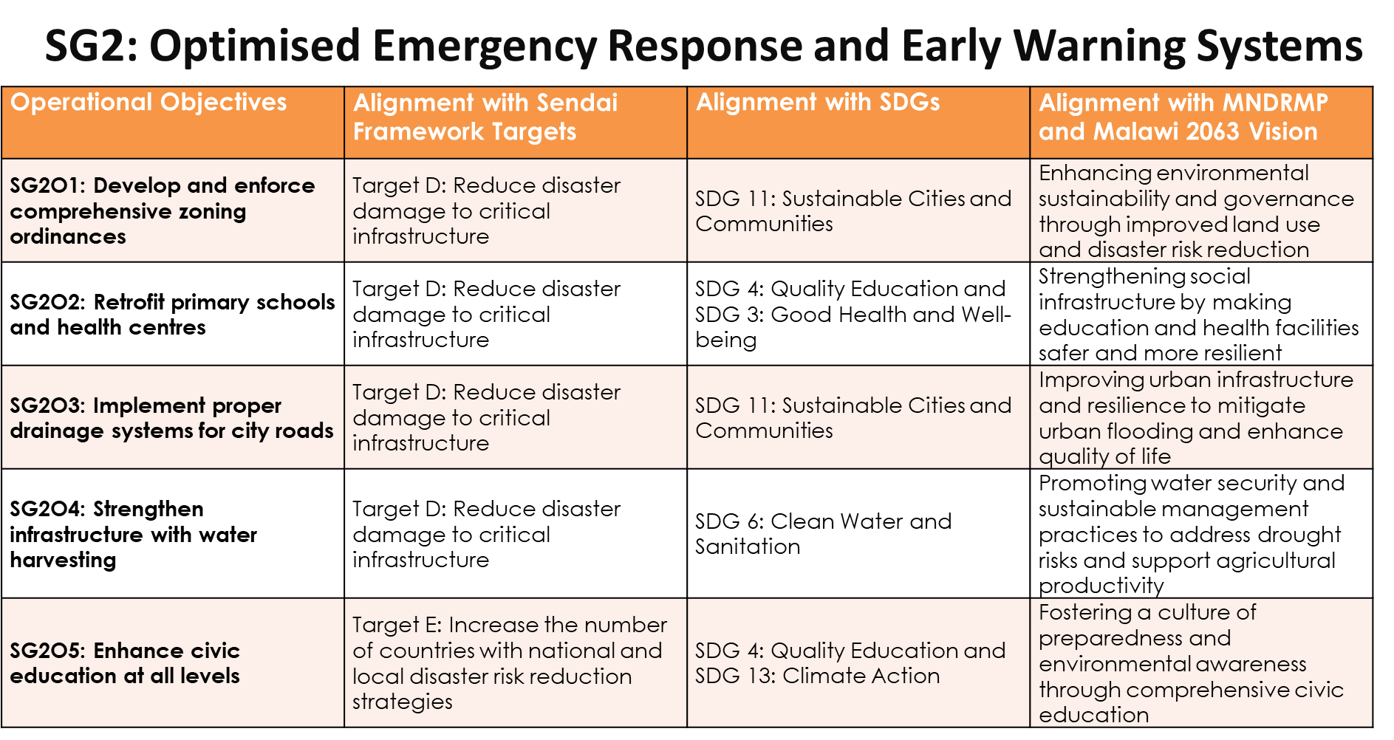
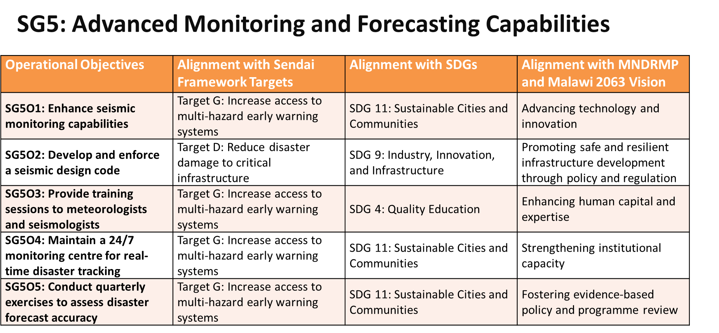
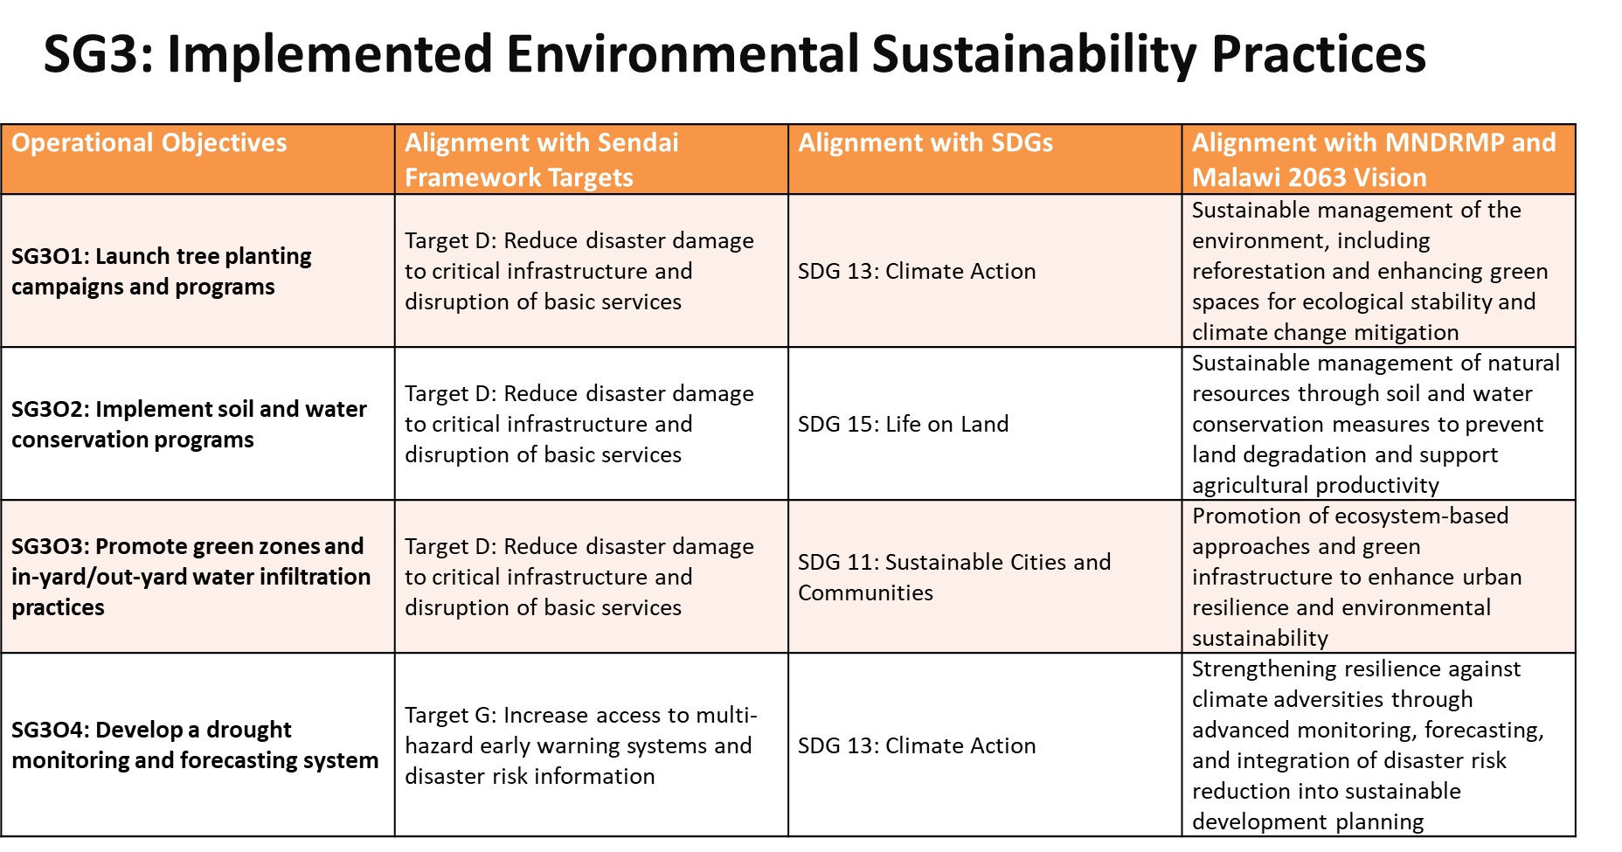
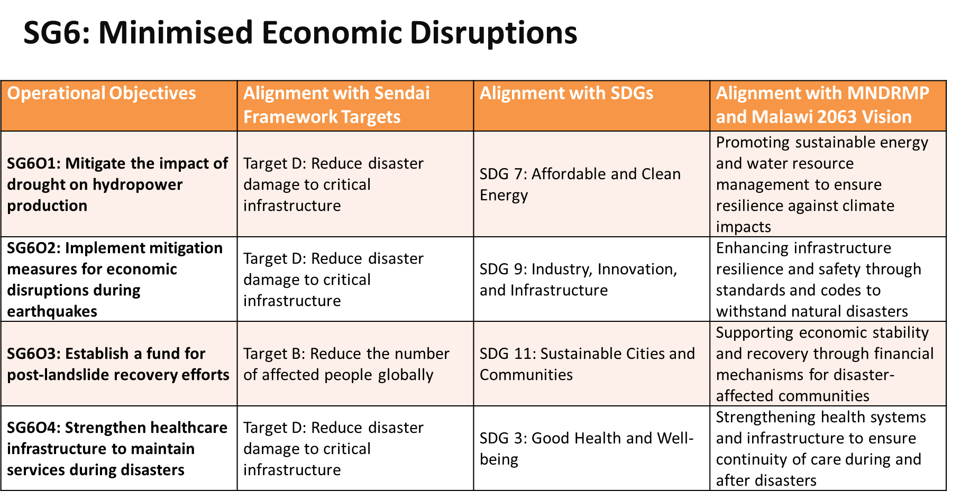

Slide 19
Analysis of the RMS Operational Objectives
Hazard-Specific (13) | Cross-Cutting (14)
SG1O5 (Landslides): Implement early warning systems for landslides. | SG1O1 (Cross-Cutting): Implement afforestation programs.
SG2O3 (Floods): Implement proper drainage systems for city roads to mitigate urban flooding. | SG1O2 (Cross-Cutting): Invest in research initiatives to assess afforestation and land use zoning.
SG2O4 (Drought): Strengthen infrastructure resilience with water harvesting and management. | SG1O3 (Cross-Cutting): Enforce land use zoning regulations to restrict development in high-risk areas.
SG3O4 (Drought): Develop a drought monitoring and forecasting system. | SG1O4 (Cross-Cutting): Establish building codes that prioritize earthquake resistance.
SG4O4 (Earthquakes): Conduct earthquake drills in schools and communities. | SG2O1 (Cross-Cutting): Develop and enforce comprehensive zoning ordinances to restrict development in flood-prone areas.
SG5O1 (Earthquakes): Enhance seismic monitoring capabilities. | SG2O2 (Cross-Cutting): Retrofit primary schools and health centers with flood and landslide-resistant features.
SG5O2 (Earthquakes): Develop and enforce a seismic design code for buildings. | SG2O5 (Cross-Cutting): Enhance civic education at all levels to improve public awareness for earthquakes, floods, and landslides.
SG5O3 (Earthquakes): Provide training sessions to meteorologists and seismologists. | SG3O1 (Cross-Cutting): Launch tree planting campaigns and programs.
SG5O4 (Earthquakes): Maintain a 24/7 monitoring centre for real-time disaster tracking. | SG3O2 (Cross-Cutting): Implement soil and water conservation programs.
SG5O5 (Earthquakes): Conduct quarterly exercises to assess disaster forecast accuracy. | SG3O3 (Cross-Cutting): Promote green zones and in-yard/out-yard water infiltration practices.
SG6O1 (Drought): Mitigate the impact of drought on hydropower production. | SG4O1 (Cross-Cutting): Disseminate DRM plans through radios, social media, and other platforms.
SG6O2 (Earthquakes): Implement mitigation measures to reduce economic disruptions. | SG4O2 (Cross-Cutting): Engage communities in disaster risk reduction through workshops.
SG6O3 (Landslides): Establish a fund for post-landslide recovery efforts. | SG4O3 (Cross-Cutting): Update the education curriculum to include disaster preparedness.
 | SG6O4 (Cross-Cutting): Strengthen healthcare infrastructure to maintain services during disasters.

Slide 20
Blantyre RMS Framework
Mission
Vision
Strategic Goal 1
Measurable Objective 1
Intervention1
Intervention 2
……….
Intervention n
Measurable Objective 2
….
Measurable Objective n
Strategic Goal 2
…..
Strategic Goal n
Guiding Principles
Goals (6)
Interventions (30)
Objectives (27)
KPIs (50)

Slide 21
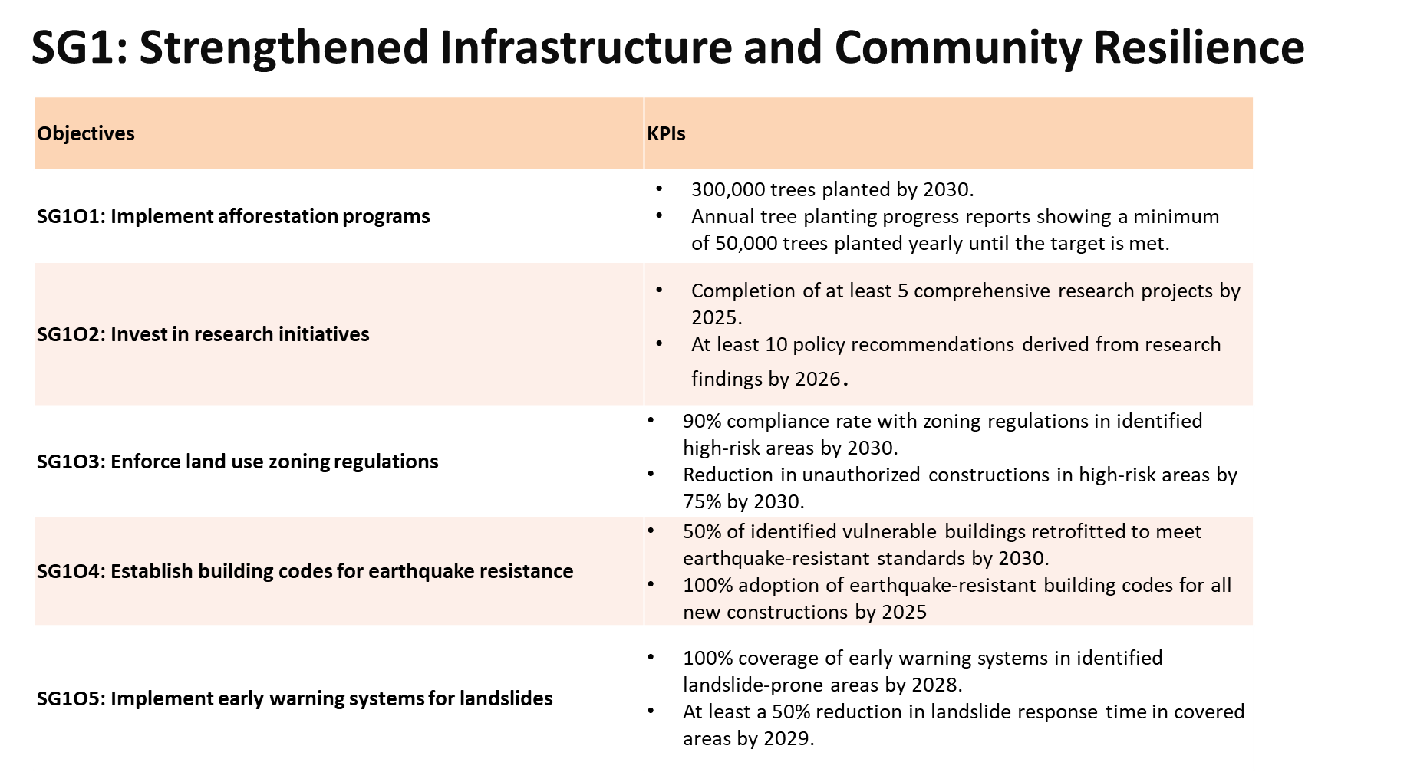
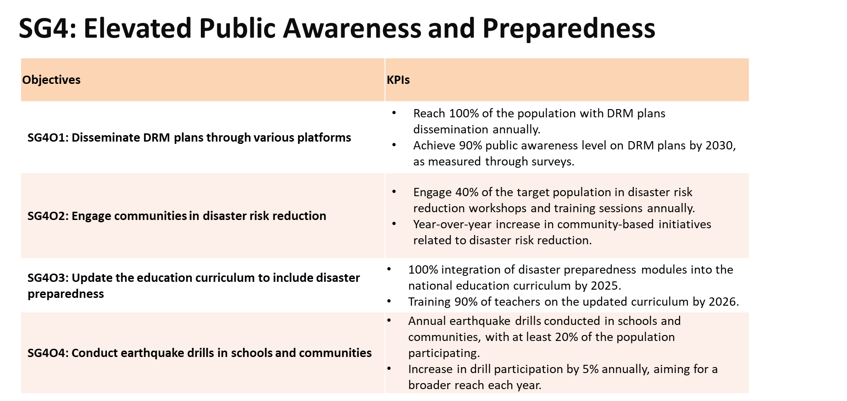
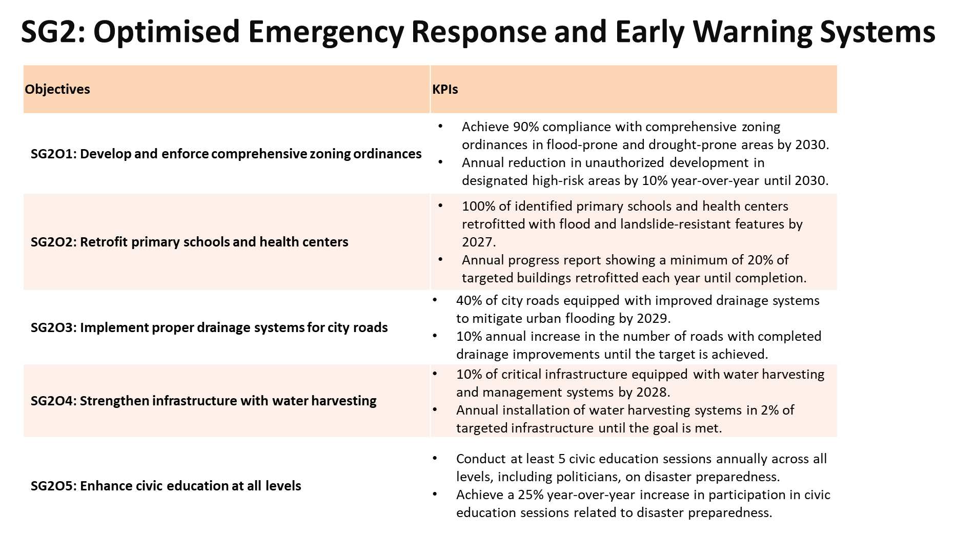
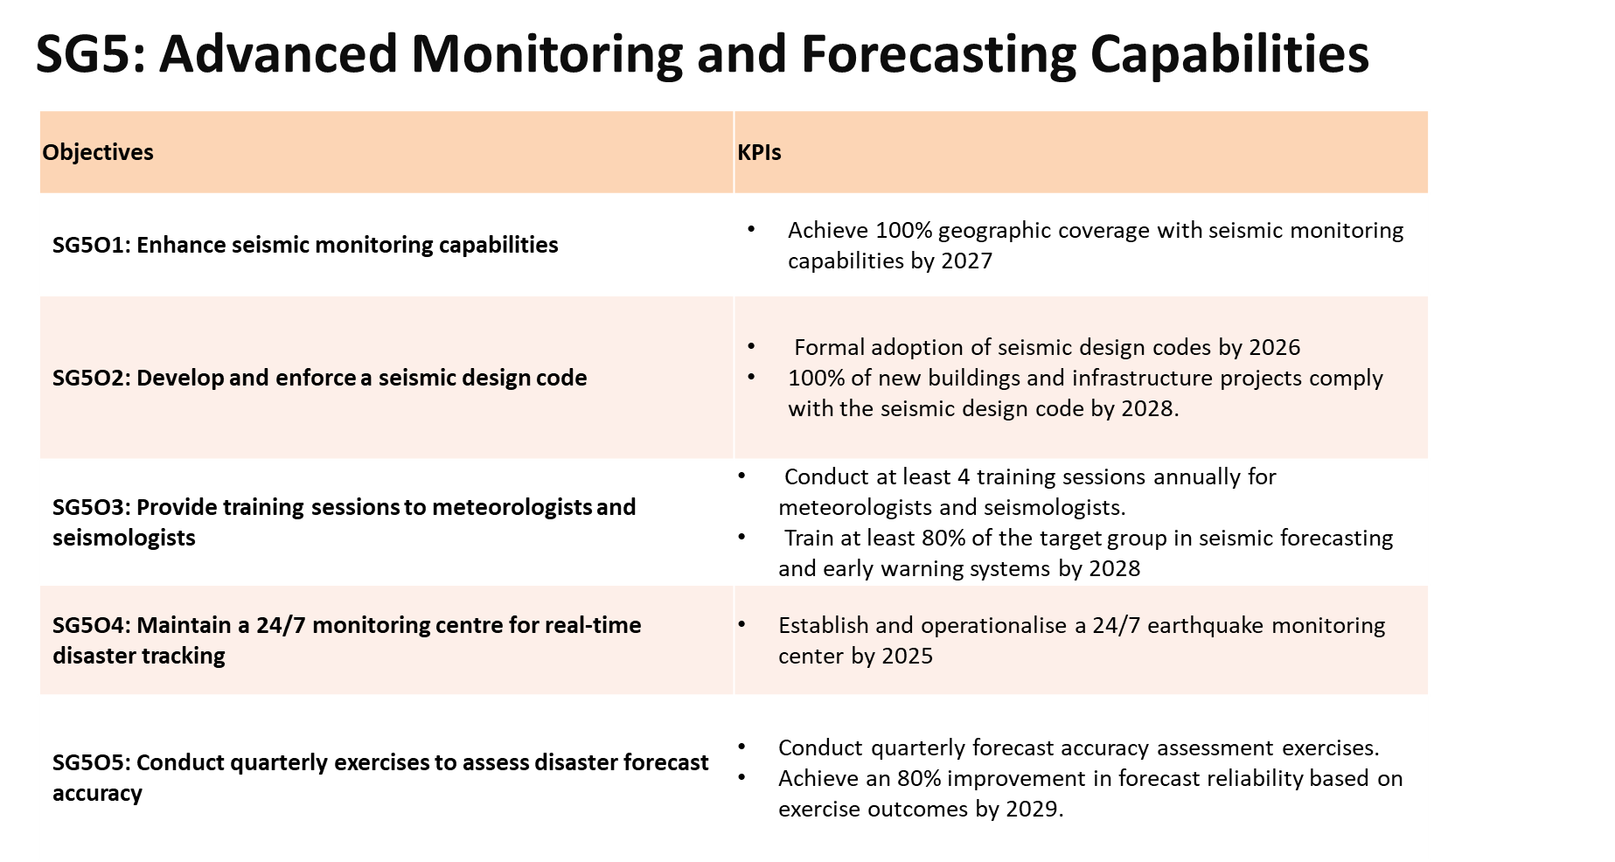
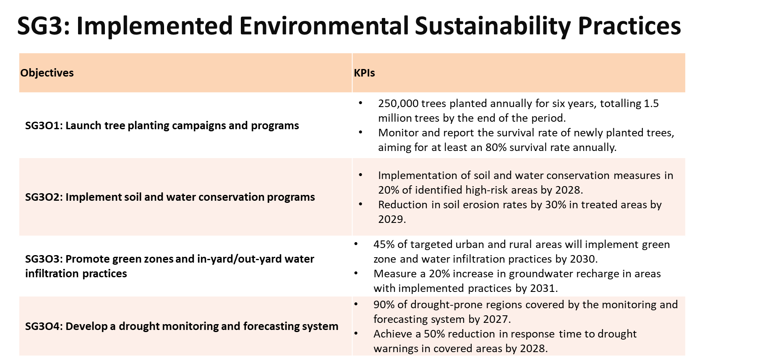
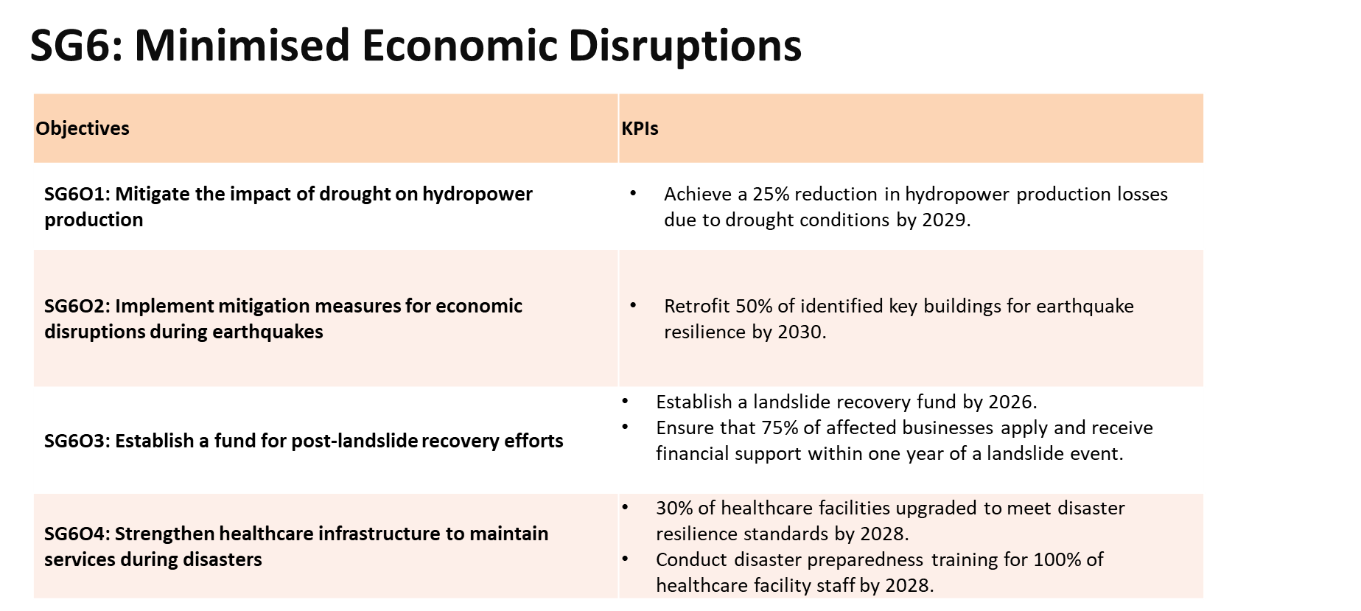

Slide 22
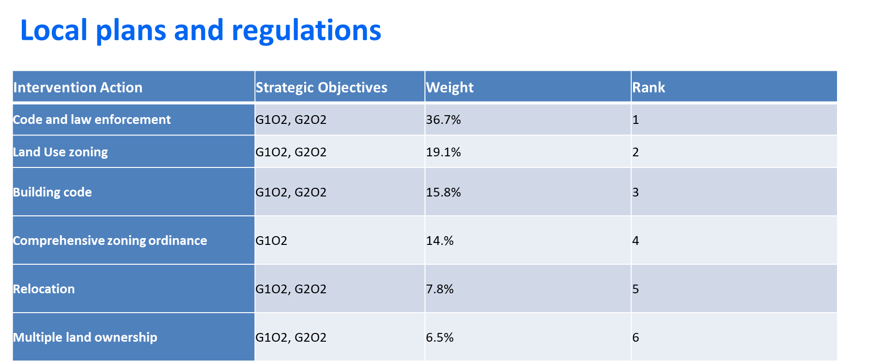
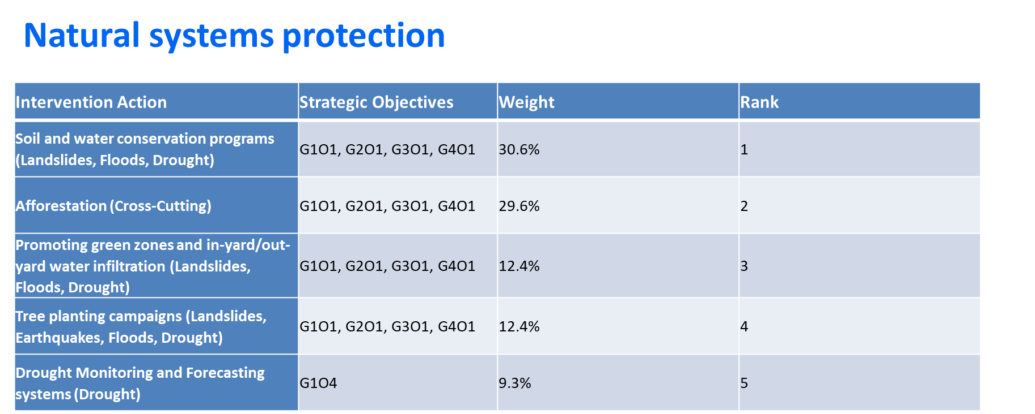
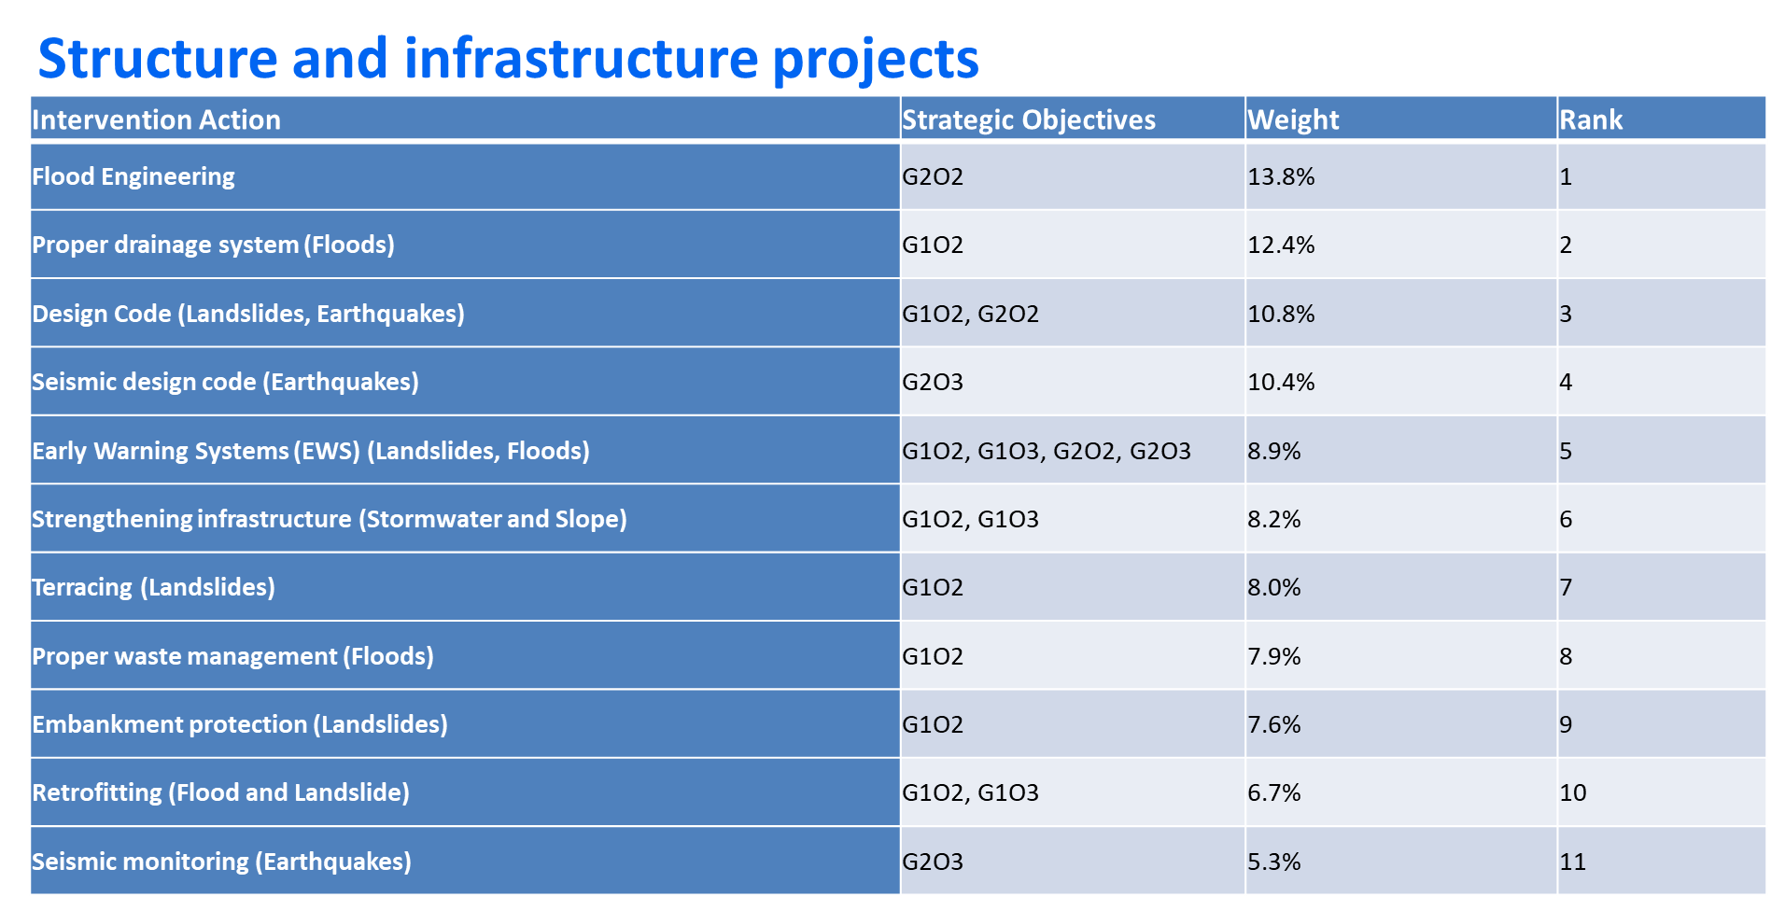
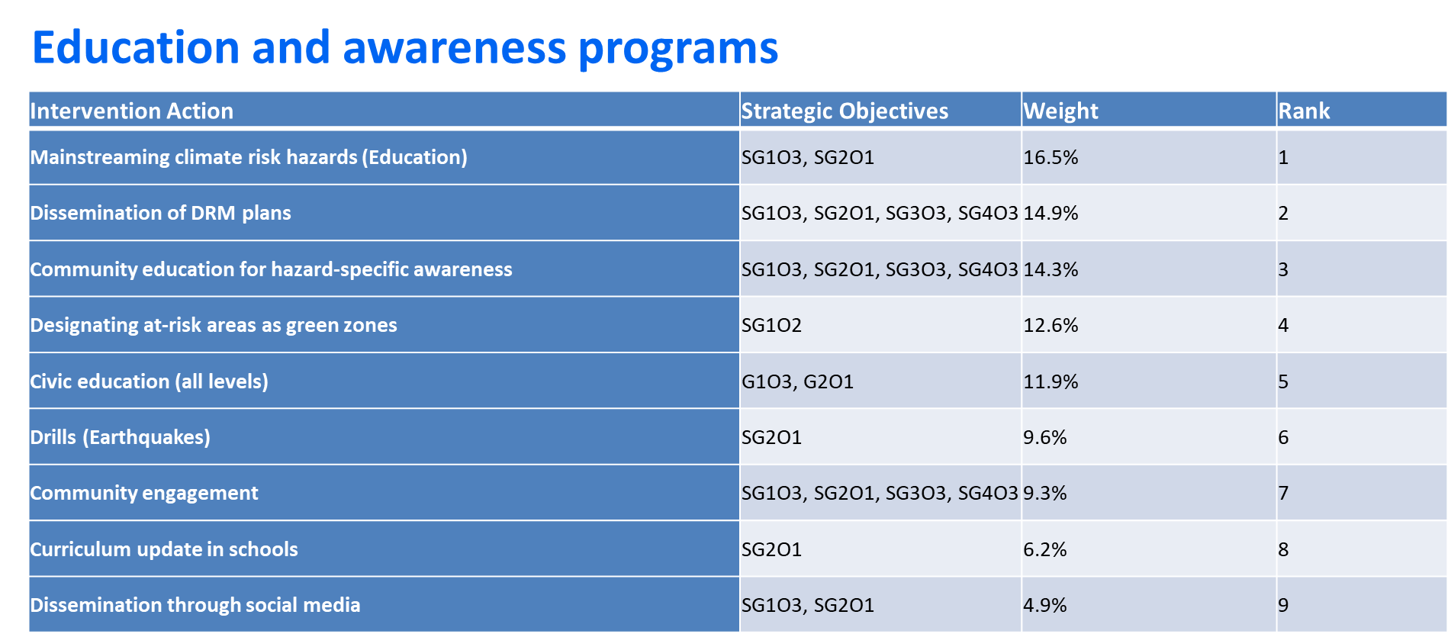
Four Groups of Interventions

Slide 23
Strategy Adoption
Timeline: A structured 6-year plan from June 2024 to May 2030 for phased and effective strategy execution.
Adaptation Mechanisms: Dynamic adaptation based on real-time data, emerging risks, and stakeholder feedback.
Monitoring & Evaluation: Rigorous M&E framework to ensure progress, accountability, and transparency.
Feedback Loop: Continuous improvement through regular feedback and adjustment to interventions and tactics (embrace proposed workflows for vulnerability analysis and risk assessment).

Slide 24
Communication Plan
Objective: Foster active involvement in disaster management through robust communication and collaboration among all stakeholders.
Target Stakeholders: Engage with local communities, governmental bodies at all levels, NGOs, international partners, donors, and private sector firms.
Communication Channels:
  Conduct workshops and public forums to share vital messages, collect feedback, and drive community involvement.
  Utilise social media and websites, alongside traditional media, such as radio, TV,
  and newspapers, to reach diverse audiences, including those in remote areas.
Feedback Mechanisms: Implement surveys, feedback forms, and regular community forums to enable ongoing dialogue and input from all stakeholders.
Timeline and Frequency:
  Hold quarterly stakeholder meetings to evaluate progress, confront challenges, and refine strategies.
  Disseminate monthly newsletters with the latest updates, educational content, and actionable guidance.
Training Initiatives:
  Deliver practical workshops centred on disaster preparedness, response, and recovery.
  Offer webinars and online courses for continuous learning and skill development.
Notes:
Objective: To actively involve communities, government, and partners in disaster management through effective communication and collaboration.
Target Stakeholders:
Local Communities
Government Agencies (local, regional, and national)
Non-Governmental Organizations (NGOs)
International Partners and Donors
Private Sector Entities
Communication Channels:
Workshops and Public Meetings: To disseminate information, gather feedback, and encourage community participation.
Social Media and Websites: For regular updates, educational content, and engagement with a broader audience.
Newsletters and E-mails: To keep stakeholders informed about progress, upcoming events, and ways to contribute.
Local Media (Radio, TV, Newspapers): To reach a wide audience, including those in remote areas.
Key Messages:
Importance of stakeholder involvement in disaster risk management.
Opportunities for community participation in planning and implementation.
Benefits of collaboration between government, NGOs, and private sector.
Success stories and lessons learned from ongoing initiatives.
Feedback Mechanisms:
Surveys and Feedback Forms: Distributed at events and online to gauge stakeholder satisfaction and gather suggestions.
Community Forums: Regularly scheduled forums for open dialogue between stakeholders and project teams.
Contact Points: Dedicated email and phone lines for enquiries and feedback.
Timeline and Frequency:
Quarterly Stakeholder Meetings: To review progress, discuss challenges, and adjust strategies as needed.
Monthly Newsletters: Providing updates, educational materials, and calls to action.
Ongoing Social Media Engagement: Daily to weekly posts to maintain visibility and interaction.
Capacity Building Communication Plan
Objective: To enhance the disaster management capacities of communities, government agencies, and partners through targeted training and information sharing.
Target Audience:
Community Leaders and Volunteers
Government Officials and Emergency Responders
NGO and Private Sector Personnel
Communication Channels:
Training Workshops: Hands-on sessions focusing on disaster preparedness, response, and recovery techniques.
Webinars and Online Courses: Accessible education on disaster risk management topics.
Training Manuals and Resource Materials: Distributed during workshops and available online for self-study.
Key Messages:
Importance of building local capacity to manage disaster risks effectively.
Availability of training programs and resources for skill development.
Encouragement to apply learned skills in community planning and emergency response.
Feedback Mechanisms:
Post-Training Evaluations: To assess the effectiveness of training sessions and identify areas for improvement.
Success Stories: Encourage participants to share experiences of applying learned skills in real-world scenarios.
Timeline and Frequency:
Annual Training Calendar: Outlining all scheduled training events and registration details.
Continuous Online Learning Opportunities: Webinars and courses available throughout the year.
Follow-Up Sessions: Scheduled 6 months post-training to review application of skills and further learning needs.
This communication plan aims to foster an inclusive approach to disaster risk management in Blantyre, encouraging active participation and collaboration among all stakeholders, while also focusing on building the necessary capacities to effectively manage and mitigate disaster risks

Slide 25
Integrated Flood Risk Management Plan

Slide 26
What is an Intervention Implementation Plan?
Goals
Interventions
Implantation Plan
Objectives
An Intervention Implementation Plan outlines the specific actions to respond to identified risks, focusing on operational details and how they will be prioritised and implemented.
  Example: Timelines and costs for specific initiatives, such as community workshops, policy reinforcements, etc.
Intervention plans are tactical components of the overall risk management strategy that translate the Risk Management Strategy into actionable steps that can be implemented before, during, or after a natural hazard event.
Notes:
Specify the "who," "what," "when," and "how" of risk management activities.
Developed based on priorities and guidelines outlined in the Risk Management Strategy, ensuring alignment with the city's long-term goals.
Updated regularly to adapt to changes in risk assessments and strategic direction to ensure Blantyre City is prepared for natural hazards.

Slide 27
15 Interventions Selected for the IFRMP
Local Planning and Regulations (LP&R)
  Comprehensive zoning ordinance
  No buildings permitted in river buffer zones
  Disaster resilient capital improvement and asset management plan for Blantyre
Structural and Infrastructure Interventions (S&I)
  Improving flood and weather monitoring
  Proper waste management
  Strengthening infrastructure
  Elevate all residential buildings by 30cm plinth
  Increase the hydraulic capacity of structures
  Leverage technology capabilities for BCC to oversee the implementation and monitoring of RMS and IFRMP implementation
Natural Systems Protection (NSP)
  Promoting green zones and water infiltration
  Tree planting campaigns
  Soil and water conservation programmes
  Afforestation programme
Education and Awareness Programmes (E&AP)
  Civic education
  Community education
Notes:
Slide-27

Slide 28
Template for Interventions
Intervention Name: [Insert Name]
Problem Addressed:
  Description: [Briefly describe the flood-related problem]
  Affected Area: [City-wide/specific location in Blantyre]
  Severity and Impact: [Assessment based on Task 3 report]
Proposed Intervention:
  Design: [Overview of intervention measure]
  Type: [LP&R/S&I/E&A/NSP]
Scale of Implementation:
  Geographical Scope: [Specific location/city-wide]
  Target Population/Infrastructure: [Who/What is affected]
  Implementation Agencies: [Lead agency and partners]
Timeline:
  Time Frame: [Duration from start to completion]
  Milestones: [Key implementation phases]
Stages:
  Planning and Design
  Preparation and Mobilization
  Execution
  Monitoring and Adjustment
  Completion and Evaluation
Expected Impacts/Benefits
Cost-Benefit Analysis:
  Costs: [Estimated costs]
  Funding: [Potential sources]
  Benefits: [Expected benefits]
  ROI: [Analysis of cost-effectiveness]
Considerations:
  Challenges: [Potential issues]
  Mitigation: [Strategies to manage challenges]
Supporting Documentation:
  [References to supporting documents]

Slide 29
Intervention Valuation and Cost-Benefit Analysis
Methods
Limitations in This Project
Direct Cost-Benefit Focus: Concentration on tangible outcomes and direct intervention costs, ensuring clear and factual reporting.
Opportunity for Future Research: Identifying the need for more comprehensive data to support robust future CBAs.
Comparative Scenario Analysis: Using comparative analyses to highlight the potential higher costs of inaction.
Inherent Complexity: Valuing life, environmental integrity, and quality of life presents methodological challenges beyond straightforward quantification.
Non-Monetary Focus: Emphasis on qualitative benefits like community resilience and wellbeing, which cannot be accurately represented financially.
Data Scarcity: Limited local data and the unpredictability of disasters make precise economic valuation difficult.
Avoiding Misinterpretation: Avoiding speculative figures to maintain the report's credibility and prevent stakeholder misinterpretation.
Precautionary Principle Application: Employing the precautionary principle to justify preventive measures without complete scientific certainty.
Notes:
The Precautionary Principle is a fundamental concept in risk management and environmental policy, advocating for preventive action in the face of uncertainty. Its application is particularly relevant in scenarios where there is potential for significant harm to the environment or human health, and scientific consensus on the matter is not yet established. The principle suggests that the absence of full scientific certainty should not be used as a reason for postponing cost-effective measures that prevent environmental degradation or potential harm
Slide-29

Slide 30
IFRMP Implementation Timeline: A Phased Approach to Flood Resilience
1
Immediate Actions (2025-2026)
Establish foundational planning and initial actions, including leveraging BCC technology capabilities, comprehensive zoning ordinances, no-build zones in river buffer areas, and civic education campaigns. Implement proper waste management and leverage technology for monitoring.
2
Short-Term Actions (2025-2027)
Focus on early implementation of structural and monitoring systems. Promote green zones and water infiltration, designate at-risk areas as green zones to prevent construction and reduce flood damage.
3
Medium-Term Actions (2027-2029)
Undertake major infrastructure projects and continue education efforts. Strengthen stormwater infrastructure, stabilize slopes, and elevate residential buildings. Initiate tree planting campaigns and afforestation programs to improve soil stability and manage water flow.
4
Long-Term Actions (2029-2030)
Integrate advanced technology and focus on afforestation. Increase hydraulic capacity of structures, retrofit buildings, and implement soil and water conservation programs. Establish robust monitoring and evaluation frameworks to ensure sustainability of all measures.

Slide 31
Estimated Costs for Implementing IFRMP Interventions
Example: Detailed Breakdown of Expected Costs to Leverage Technology Capabilities at BCC
Intervention | Total Cost (USD Million)
Comprehensive Zoning Ordinance Interventions | 4.90
Capital Improvement and Asset Management Plan | 32.00
Integrated Hydrological and Weather Monitoring Network | 0.34
Waste Management Interventions | 5.63
Support to BCC on Implementing Resilient Investments | 2.90
Leveraging Technology Capabilities at BCC | 1.36
Civic Education Intervention | 0.86
Community Education Intervention | 1.02
Promoting Green Zones and Water Infiltration Intervention | 11.32
Tree Planting Campaigns | 3.30
Soil and Water Conservation Programmes (Table | 5.05
Total Estimated Cost | 68.72
Particulars | USD ($)
A. Investment Costs
Updating GIS Infrastructure | 300,000
Procurement of Hardware and Software | 450,000
Integration of Cloud Solutions | 250,000
Comprehensive Training Programs for BCC Staff | 120,000
Development and Deployment of Web GIS Tools | 200,000
Implementation of Mobile GIS Applications | 150,000
Installation and Configuration of Hazard Modelling and Risk Simulation Software | 180,000
Monitoring and Evaluation of System Performance | 100,000
Infrastructure Costs related to Internet and Intranet Connectivity | 175,000
Taxes & Duties | 125,000
Subtotal - Other Costs | 200,000
Subtotal (A) | 2,250,000
B. Contingencies
Physical Contingency | 150,000
Price Contingency | 225,000
Subtotal (B) | 375,000
C. Financing Charges
Commitment Charge | 150,000
Financing Charge During Implementation | 125,000
Subtotal (C) | 275,000
D. Total Investment Cost | 2,900,000

Slide 32
Example of an Intervention: No buildings permitted in River Buffer Zones
Problem addressed:
  Higher damage to houses constructed near rivers was clear during post-Freddy surveys
  Section 129(2) of the Water Resources Regulations (2018) addresses no-building zones
Proposed intervention:
  After consultations with the BUSP project, it was agreed to test how flood losses would reduce if no buildings were allowed in the “River Buffer Zones”
  River Buffer Zones are defined as the “50-yr return period flood extent as modelled in this project”
How to test the impact of the intervention:
  All houses in the “River Buffer Zones” were removed and relocated to “Non-River Buffer Zones”
  The reduction in 50-yr return period losses and AAL were estimated

Slide 33

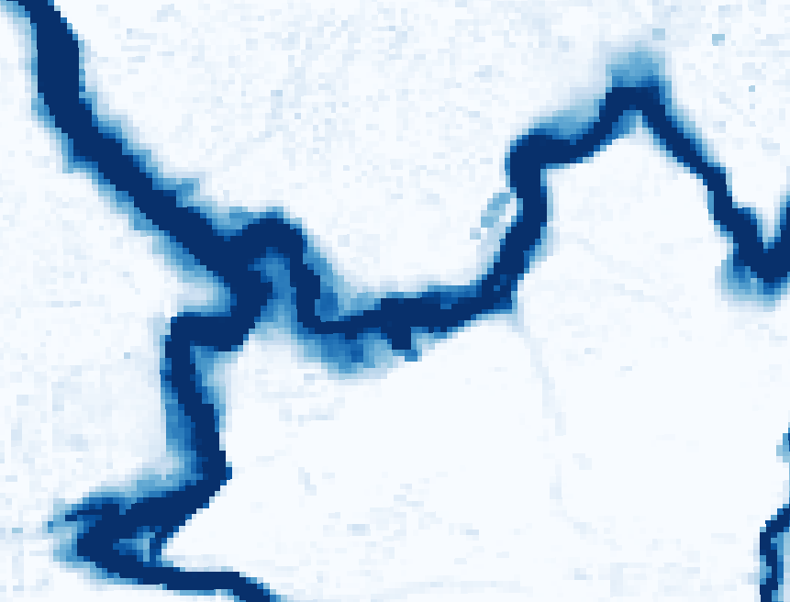
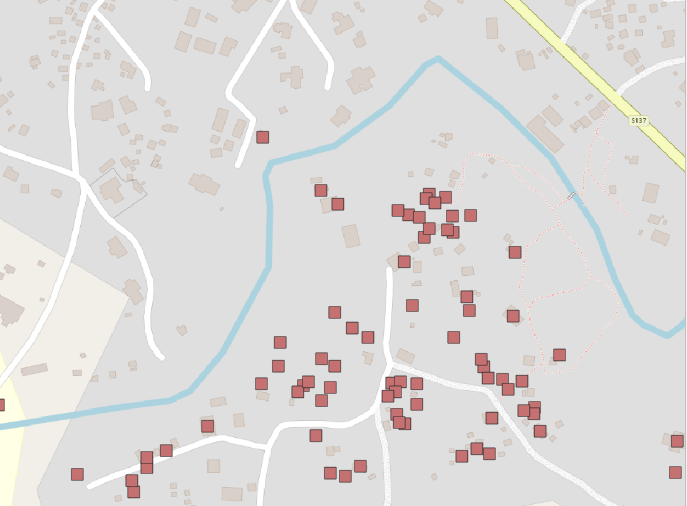
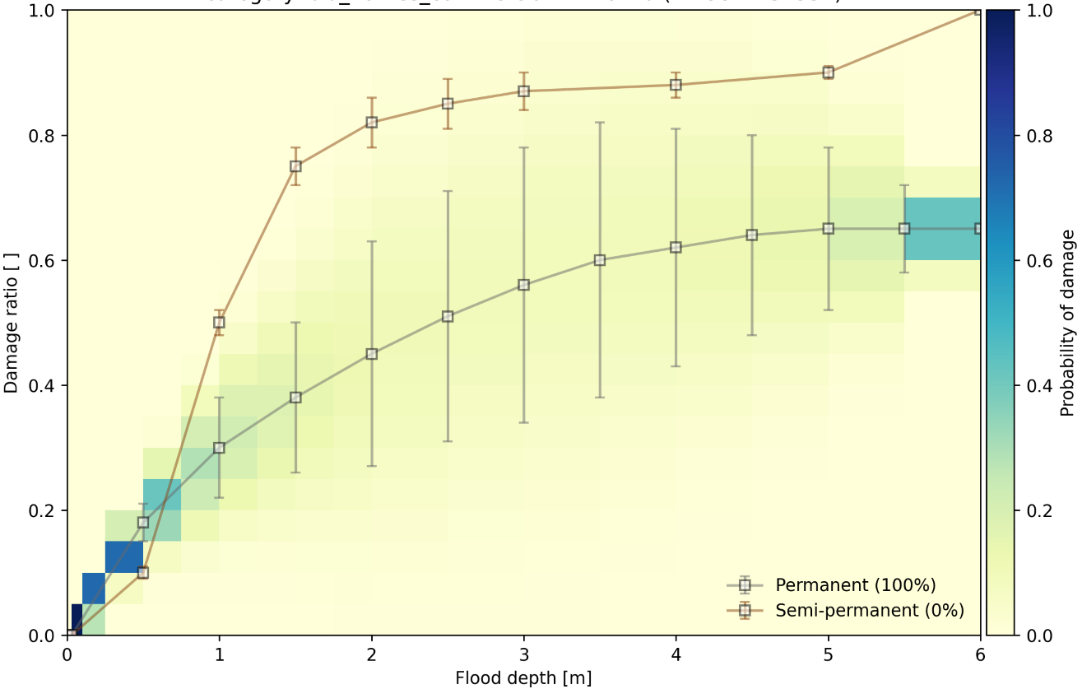
Simulating economic losses using the flood risk model framework
most time-consuming component
Risk modelling framework
Hazard component
Hydrological (rainfall-runoff) & hydraulic (rivers/drains) models
Outputs
Expected losses for extreme rainfall events
5, 10, 25, 50, 100, 200 years return periods
Exposure component
Locations, categories & economic value of buildings & roads
Average Annual Loss (AAL)
Average loss each year, over long-term
Vulnerability component
How much damage is expected for different flood depths?
Note: high data input requirements
Notes:
For four interventions, we have used the “flood risk modelling framework” set up in Stage 3 to see what impact each intervention would have on expected losses/damage
As a reminder, this “risk modelling framework” is made up of three components:
The hazard component is the flood model, which transforms rainfall time-series into expected flood depths – this is the most time-consuming component to run
The exposure component is where we define economic value that might be damaged by floods – where is it, what type of building or road is it, and how much would it cost to replace?
The vulnerability component is where we estimate the likely damage that each building or road section would suffer, if it was exposed to flood waters of different depths
The outputs of this modelling framework are expected economic losses for six different extreme rainfall events (ranging from 5 to 200 year return periods).
We can also use these to estimate the Average Annual Loss (or AAL) – this is the average yearly loss we should expect if we were to look at a very long period
By running this modelling framework with and without the interventions, we get an idea of how effective each one is at reducing economic losses due to floods
However, this modelling framework has high input data requirements, so we can only use it to test interventions which are fairly well-defined

Slide 34
Evaluating interventions using the risk model framework
Run flood risk model framework with & without intervention
Evaluate change in modelled losses:
  50-yr event loss: example of an extreme event
  Average Annual Loss (AAL): average long-term yearly loss expected
Which interventions are most effective and how does this vary?
Notes:
For each of the selected interventions, we ran the full risk model with and without the intervention in place, to see what difference it made
We focus on differences for two loss metrics in particular – the 50 year loss (as an example of an extreme event likely to exceed local capacity) & AAL (the long-term average, useful for planning & budgeting)
This gives a lot of insight into which interventions are most effective at reducing losses and also how this might vary (e.g. for different parts of the city, or for small-vs-large storms, etc)
In the following slides, we’ll look at these results for each of the four interventions

Slide 35
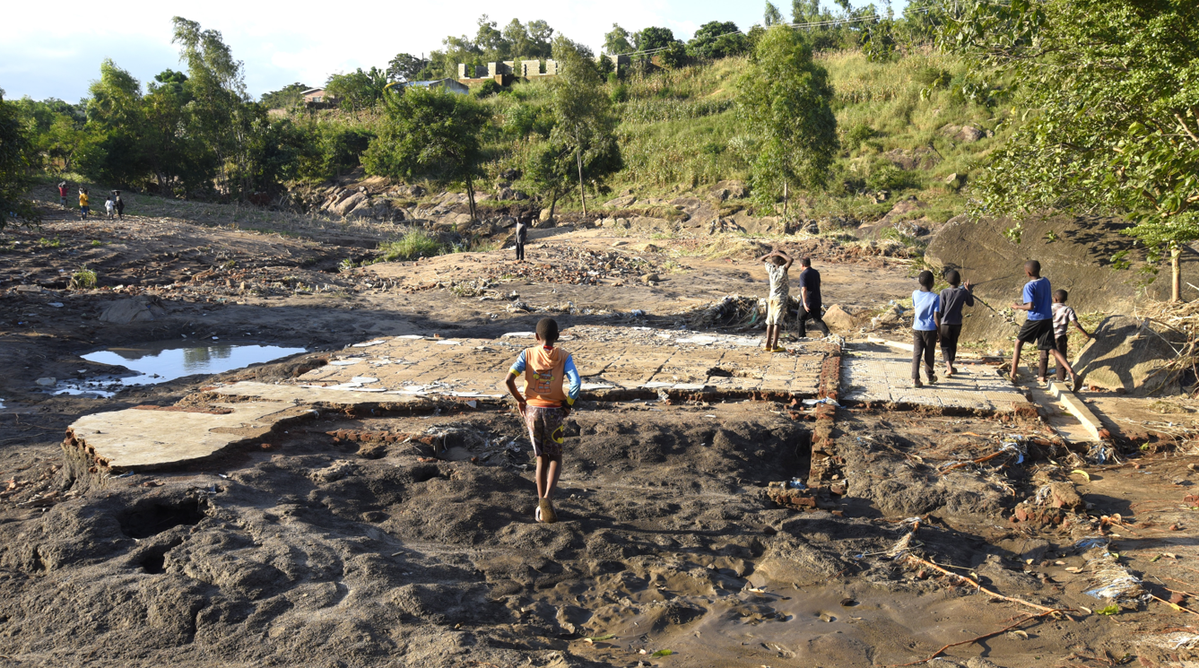
No buildings permitted in River Buffer Zones
Example of damage from fluvial flooding in downstream reaches (South Lunzu)
Notes:
Here we can see an example of just how destructive fluvial flooding can be, for buildings close to the rivers.
Whereas pluvial flooding (local ponding due to rainfall) mostly damages building contents, fluvial flooding can cause significant structural damage, as well as injuries & fatalities.

Slide 36
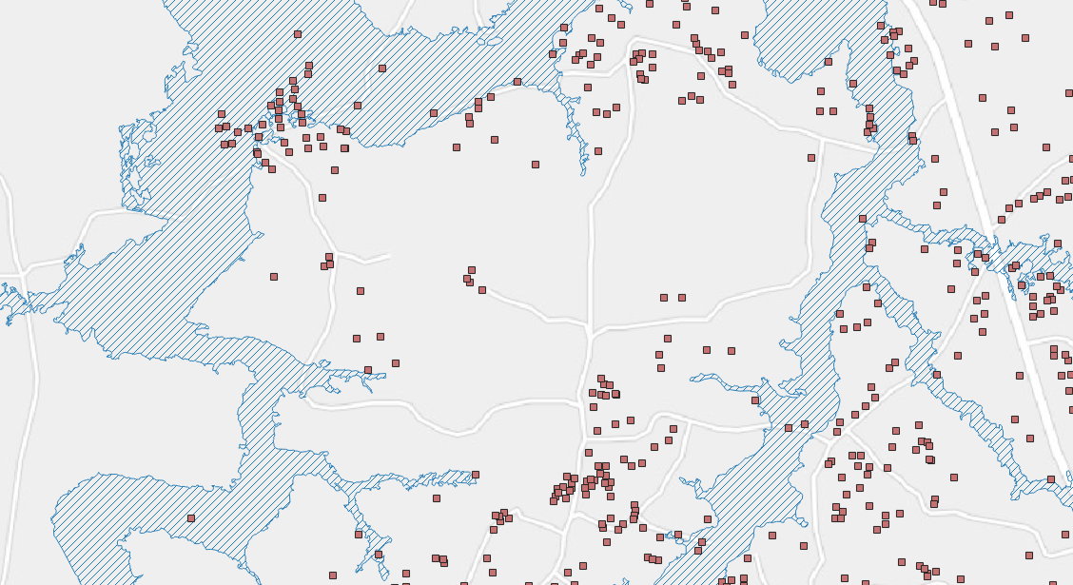
No buildings permitted in river buffer zones
Risk modelling framework
Hazard
Exposure
Vulnerability
Buildings within 50-yr flood extent to be relocated
Buildings outside of flood extent left where they are
Notes:
As shown in the graphic at the top-right, running this intervention involved changes to the exposure component only (with other components left unchanged)
All buildings found to be within the 50 year flood extent polygons (the dashed blue shapes here) were removed, assumed to be relocated elsewhere in the City

Slide 37
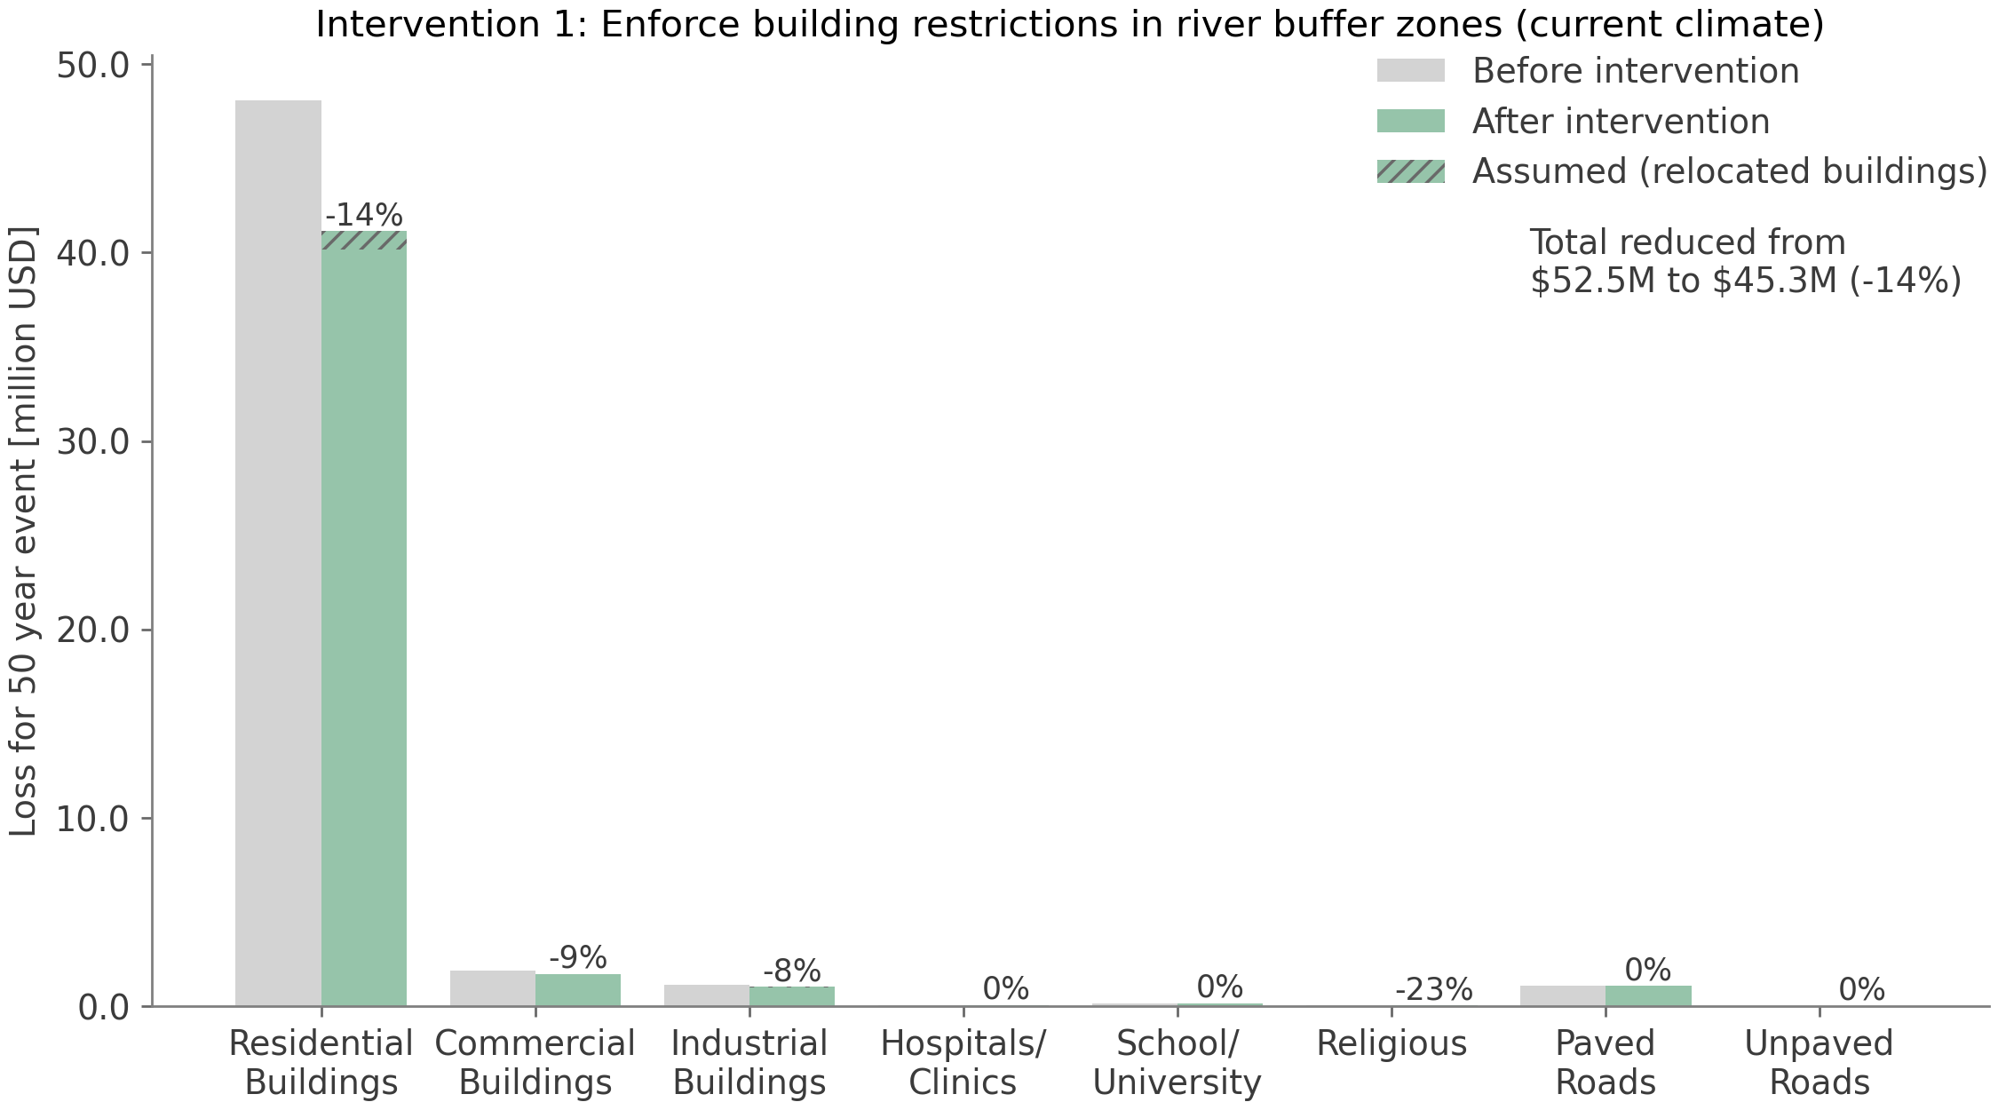
No buildings permitted in river buffer zones
Loss before intervention
Loss after intervention
Overall 50-yr loss reduced by 14%
Notes:
Here we see the differences in losses modelled for the 50 year storm event, for each of the different building & road subcategories considered in our study
For each subcategory, the grey bars show losses before the intervention and the green bars show losses after the intervention
Note: dashed green part of the bars represents assumed losses for relocated buildings – we don’t make any assumptions about exactly where they’re moved to, just that they’re out of the river buffer zone
So we can see here that enforcing the “river buffer zones” would likely reduce the 50-year loss by about 14%, driven mostly by changes for residential buildings

Slide 38

No buildings permitted in river buffer zones
Average Annual Loss reduced by 12%
Notes:
In the same way, this figure shows the expected change in losses with regards to the Average Annual Loss (AAL)
This is expected to fall by about 12% - slightly less than the reduction seen for the 50 year event, which is something interesting we’ll explore further later

Slide 39
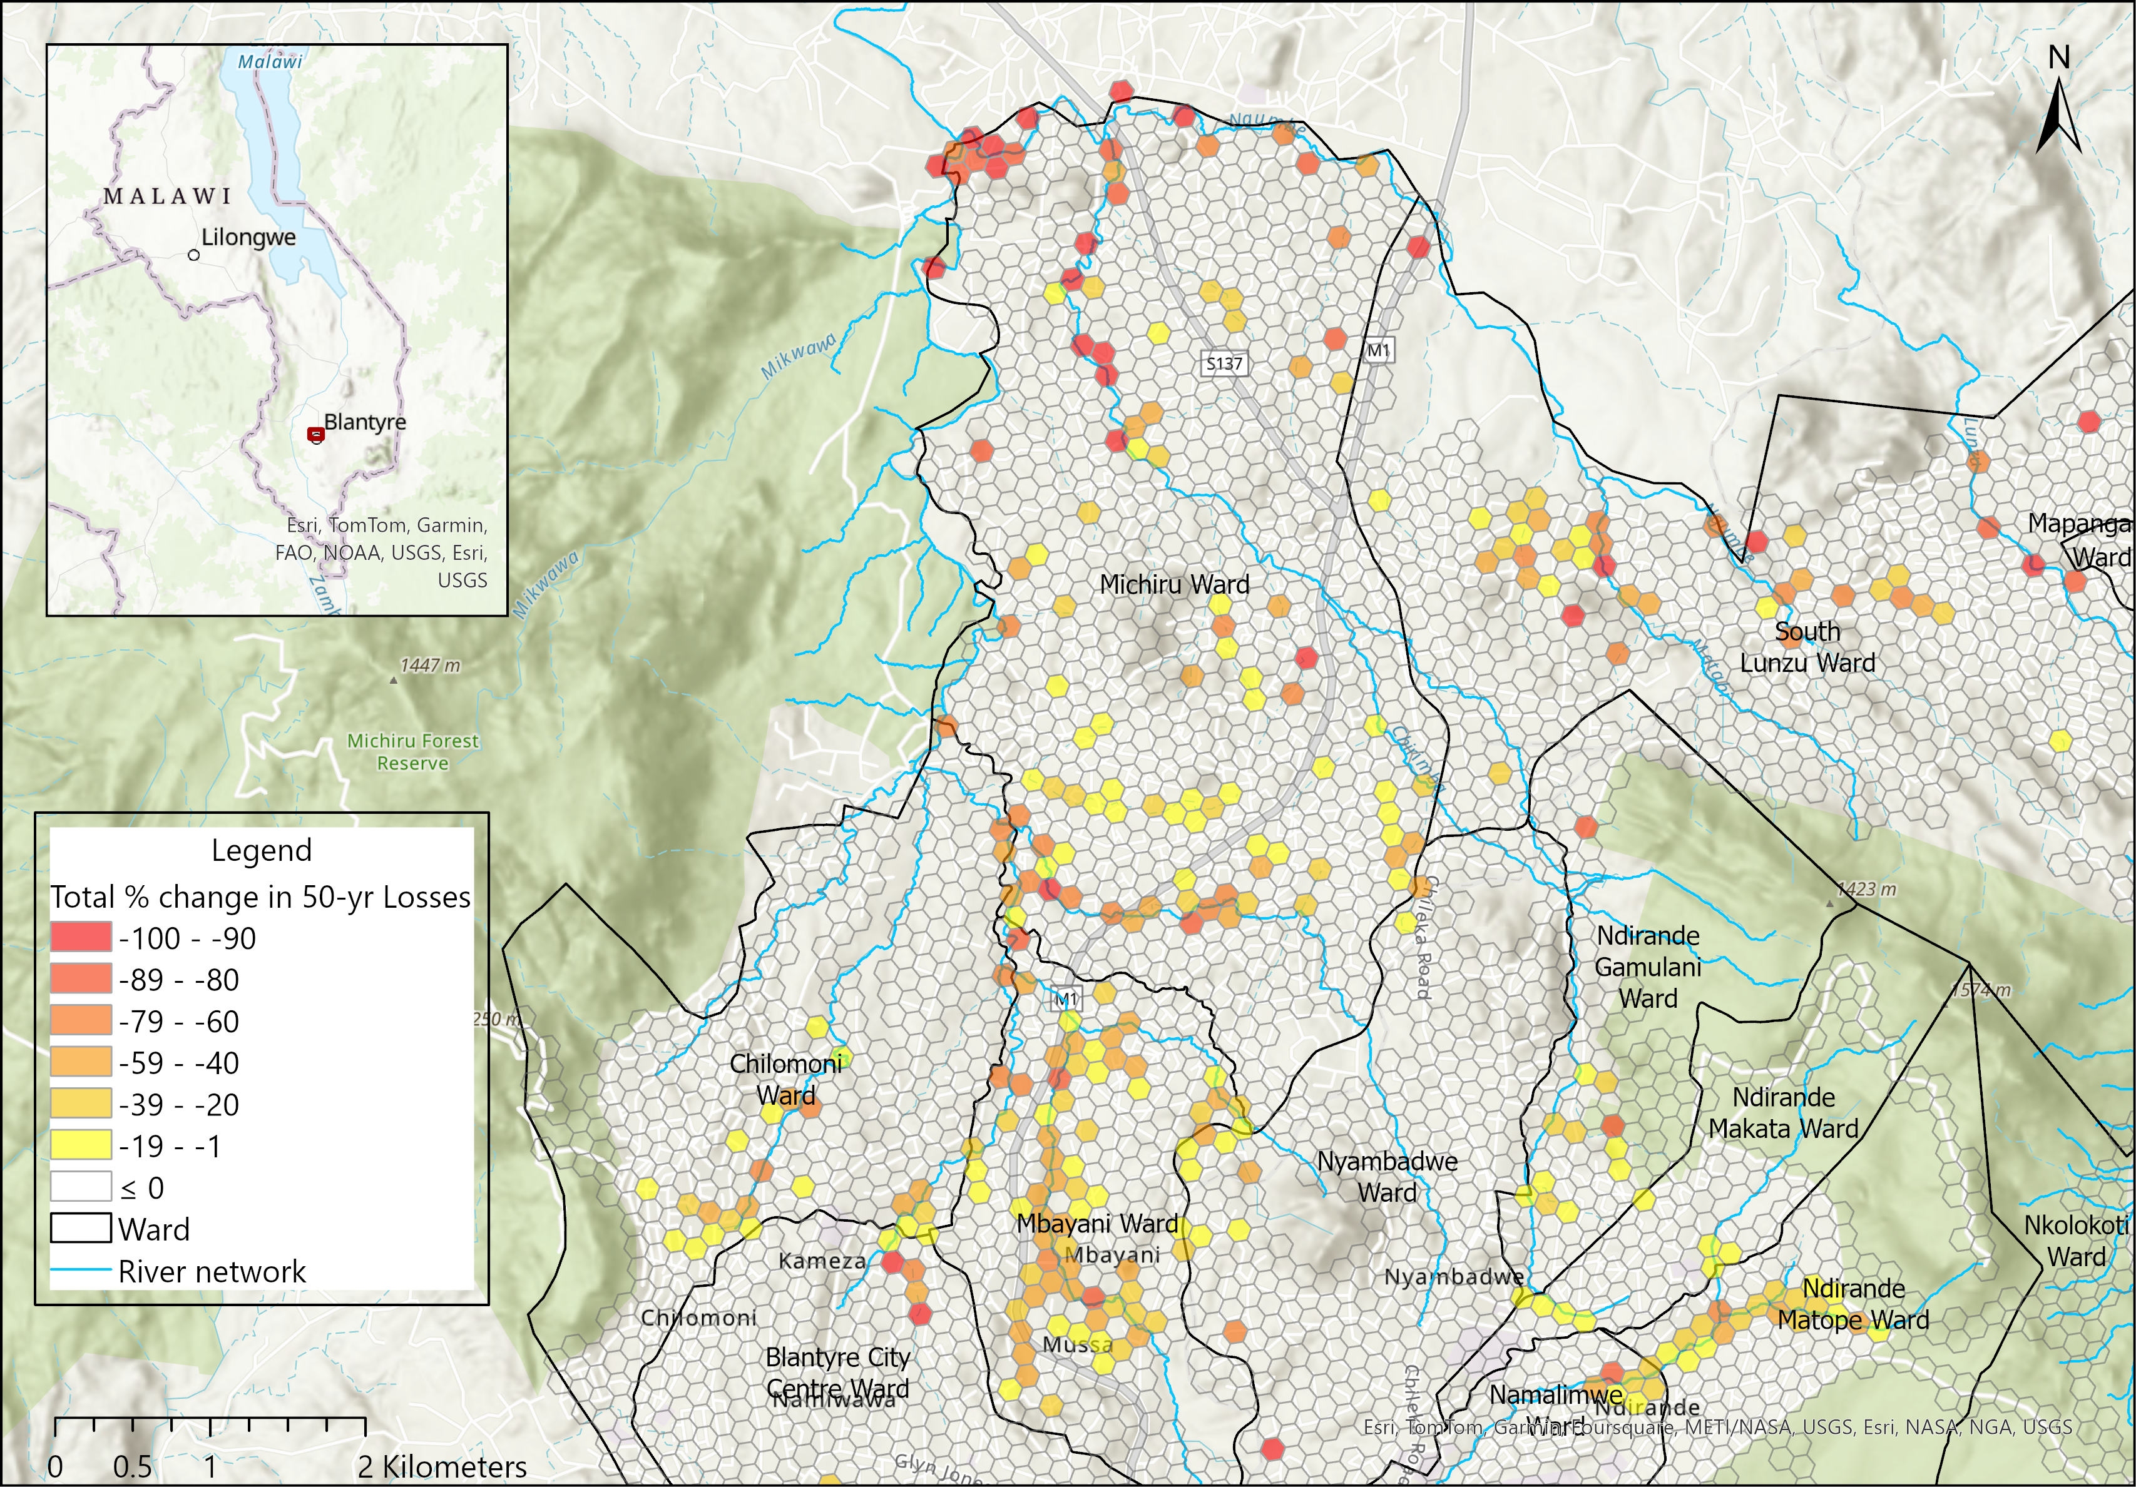
No buildings permitted in river buffer zones
Notes:
It’s also useful to see how losses are expected to change for different parts of the City
Here we see percentage changes in the 50-year loss (aggregated to hexagons for a consistent spatial overview), with red hexagons indicating very substantial reductions in simulated losses
The most obvious insight from this map is that Intervention 1 can be very effective along the rivers (the blue lines here) but has no impact at all in other parts of the City

Slide 40
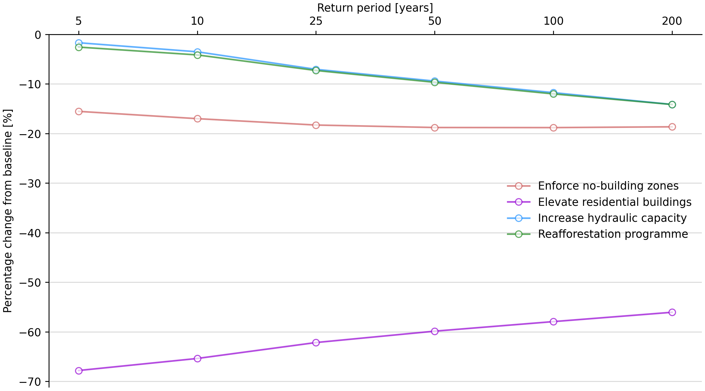
Do interventions help more for small or large flood events?
More effective for larger storms
Limited impact for small storms
Efficacy increases up to 50-yr storm, then constant
Highest impact is for small storms (shallow pluvial flooding across city)
Less effective for larger storms (deeper floods)
Notes:
It is also interesting to compare how effective these interventions are for storms of different sizes – ranging from 5-yr to 200-yr return period events
In this figure, each line represents one of our interventions – on the x-axis we see the six storm return-periods, and on the y-axis is the percentage reduction in losses (compared with the pre-intervention loss for the same storm)
The vertical position of these lines shows how effective each intervention is (with more effective interventions at the bottom) and the slopes of these lines indicate whether they get more or less effective for larger storms.
We’ll look briefly at each in turn.

Slide 41
Project Byproducts

Slide 42
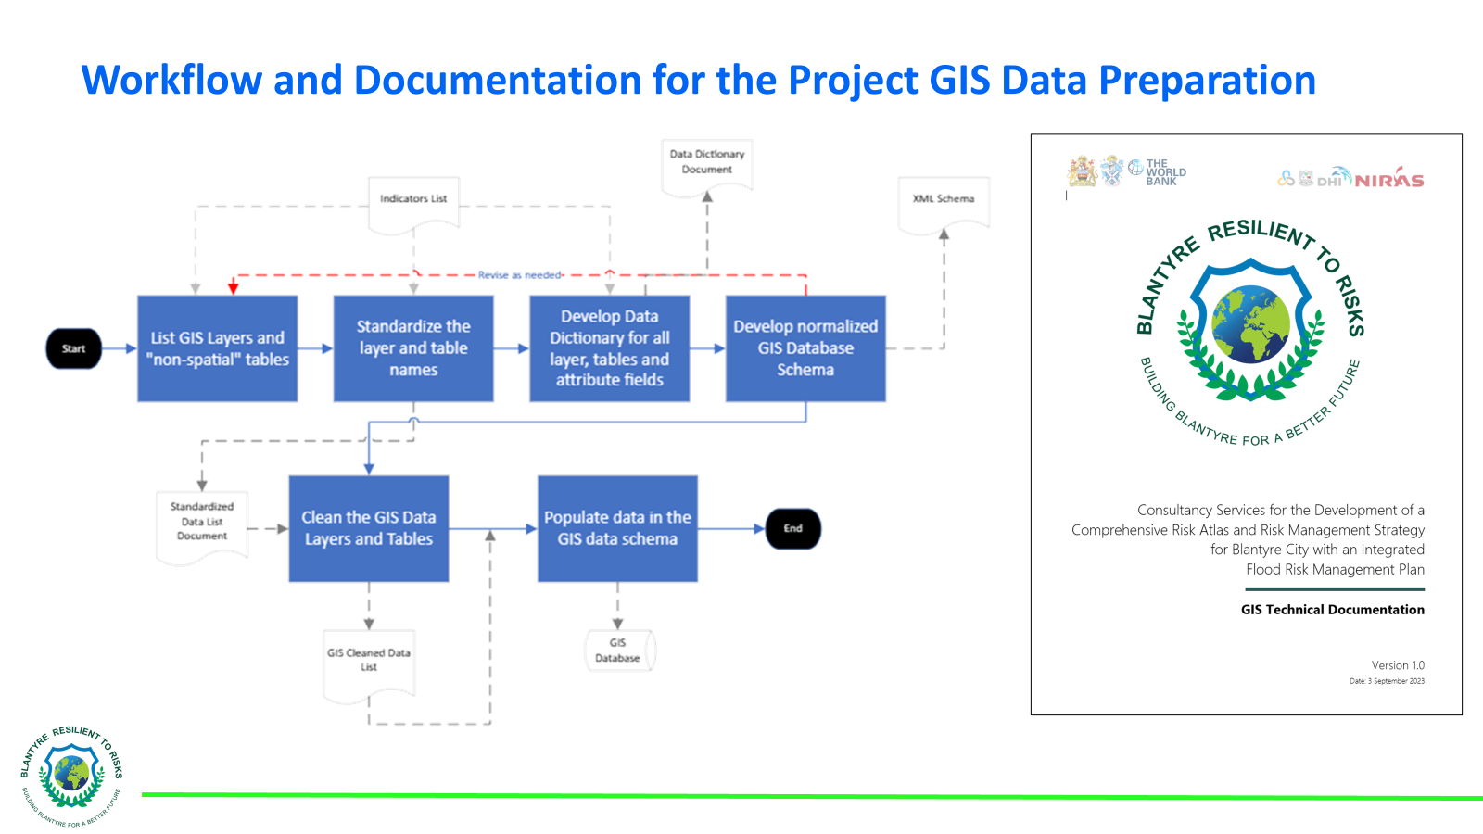
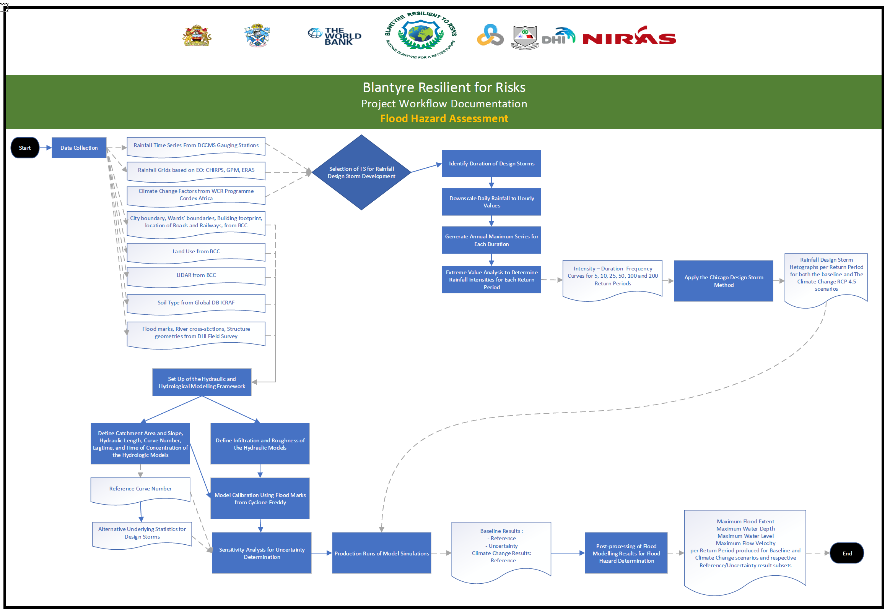
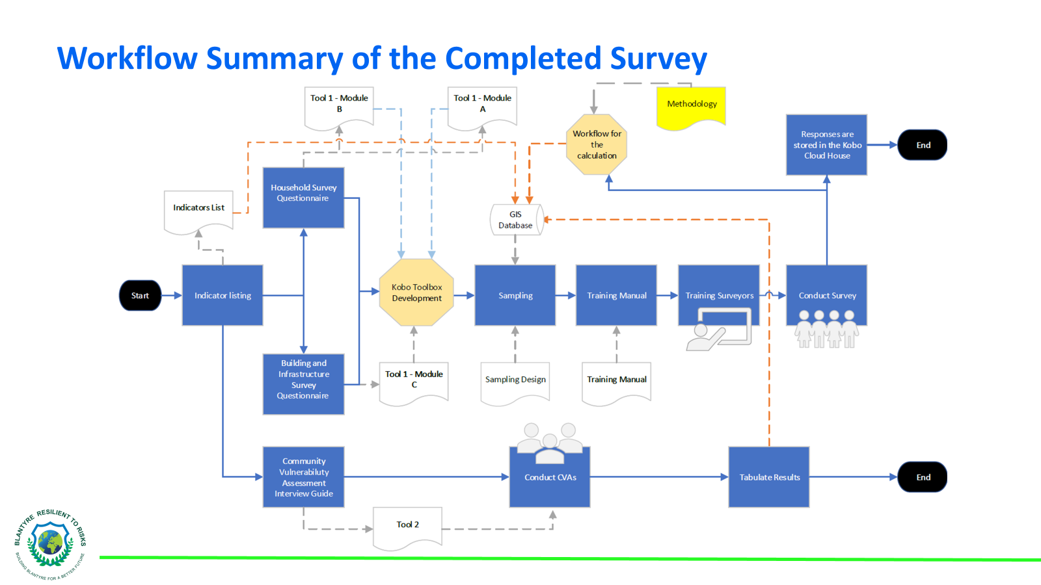
Documented Workflows for Future Replication and Adaptation

Slide 43
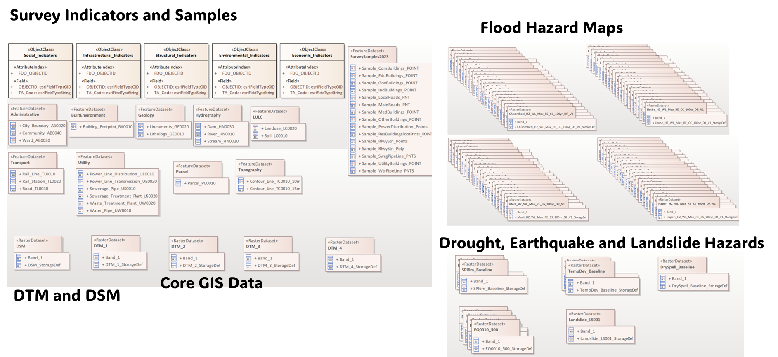
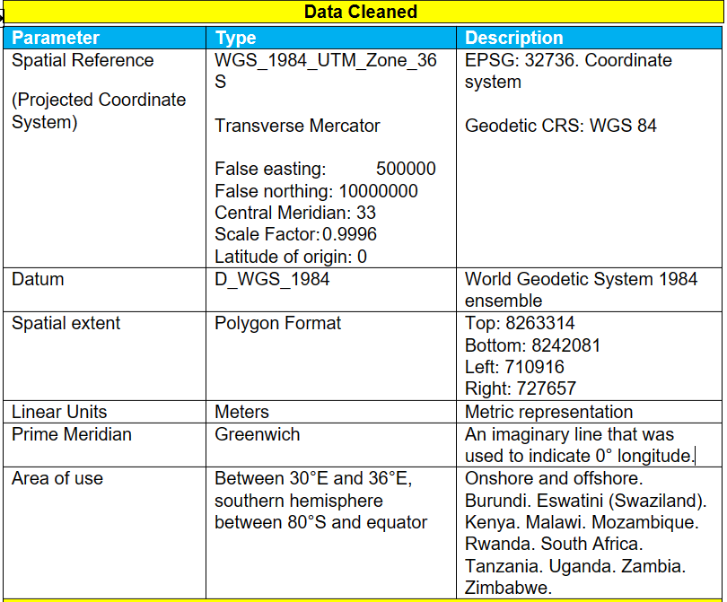
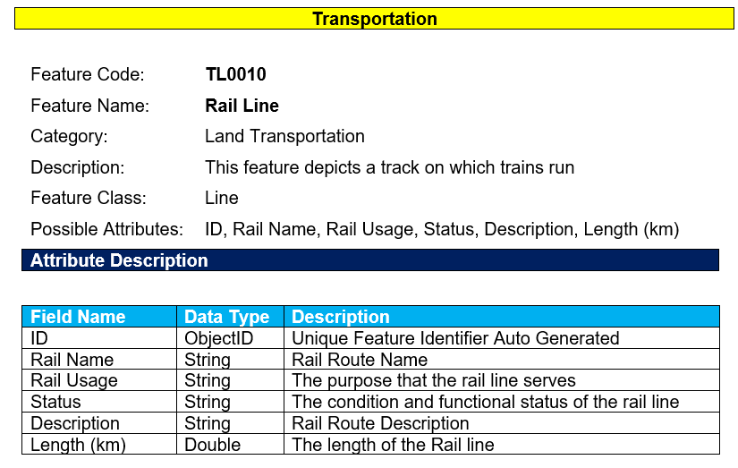
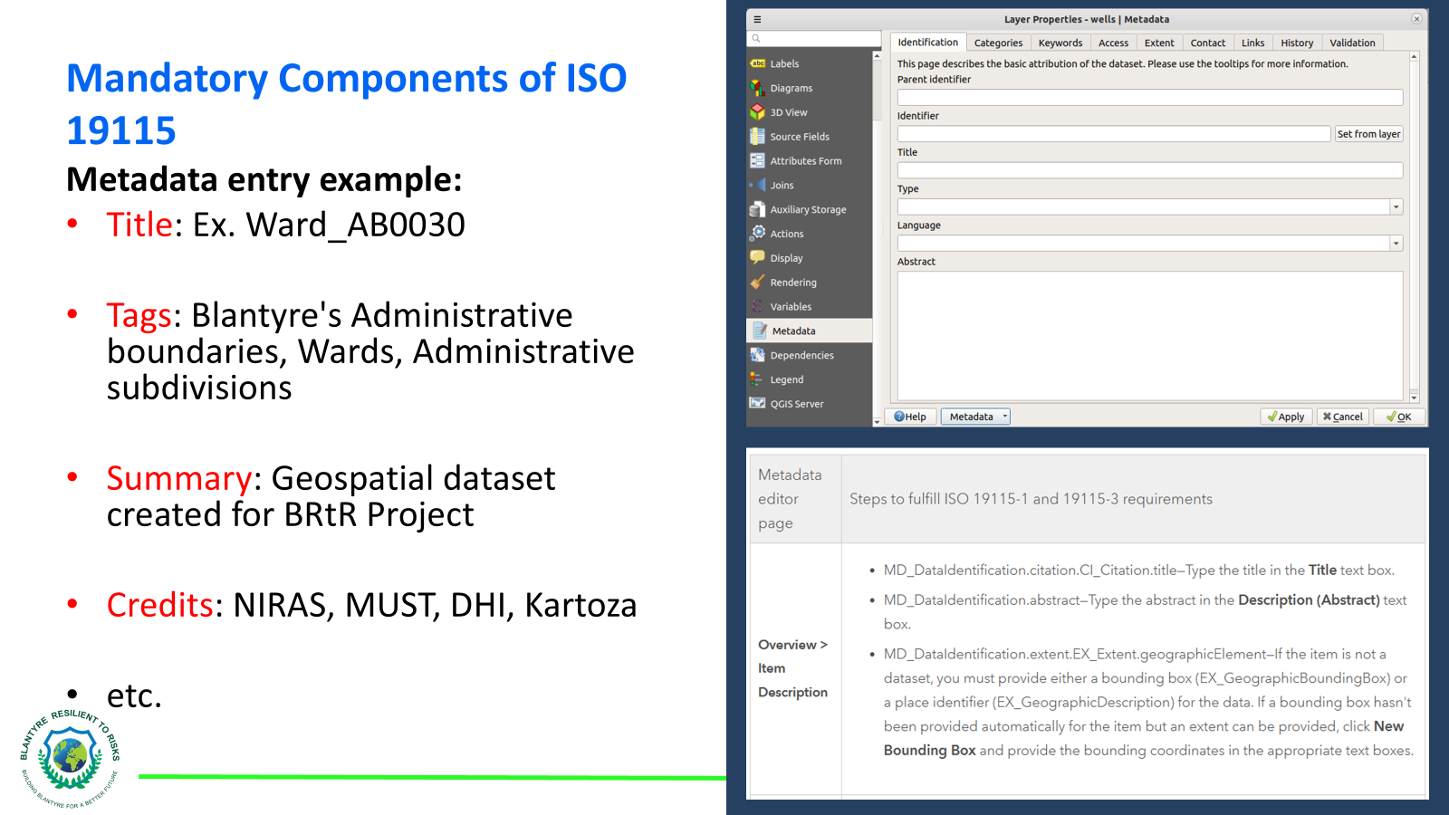
Core Cleaned One-Stop Source for GIS Data in Blantyre
Integrated Database Schema
Data Cleaning / Data Dictionary Protocols
ISO Compliant Metadata

Slide 44
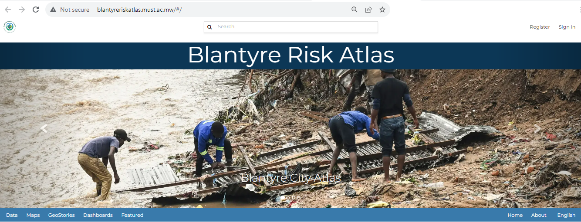

Online Atlas (GeNode)
https://bit.ly/4ffXNKq
https://bit.ly/4ffXNKq

Slide 45
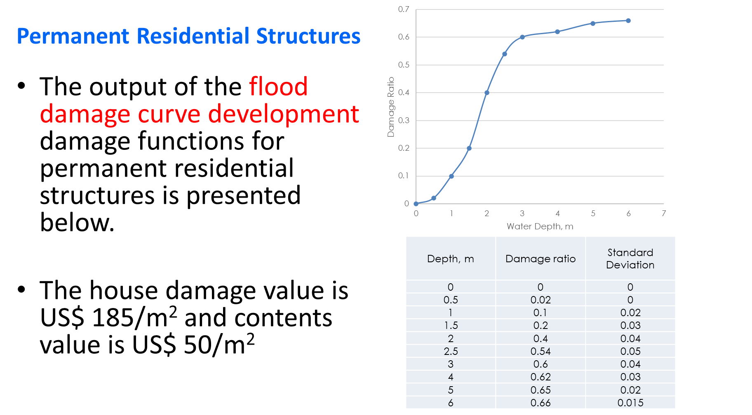
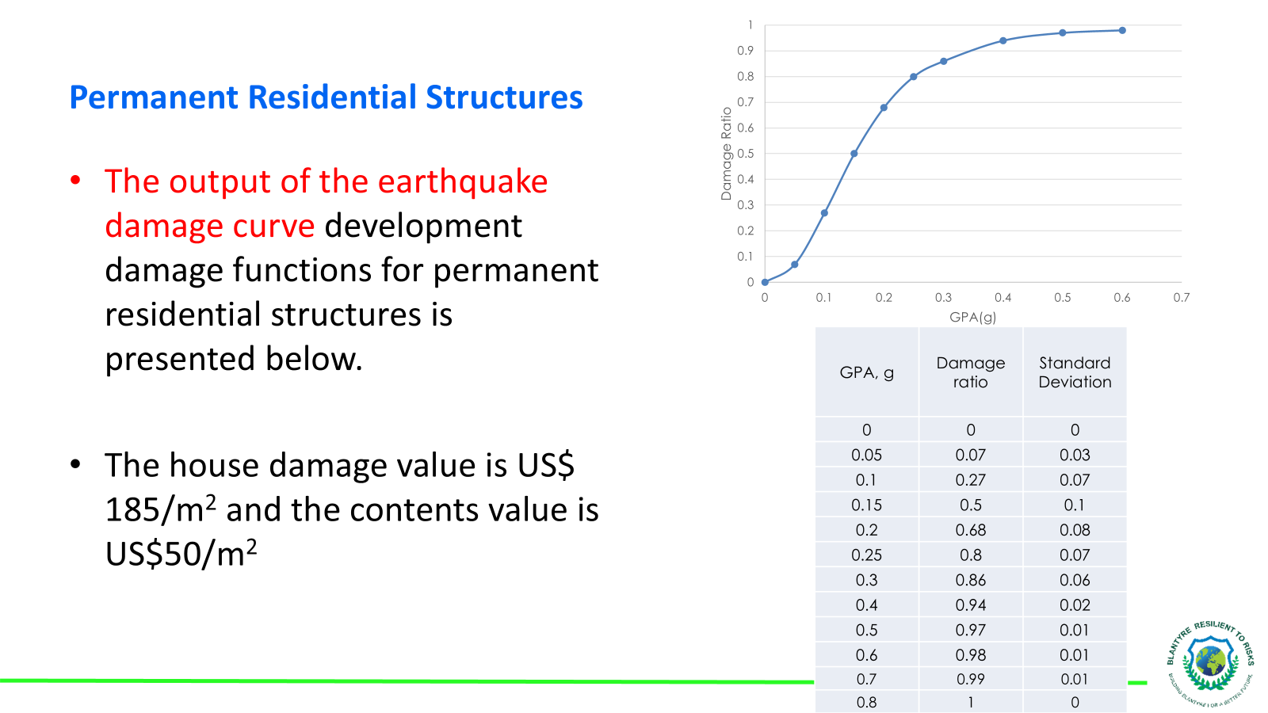
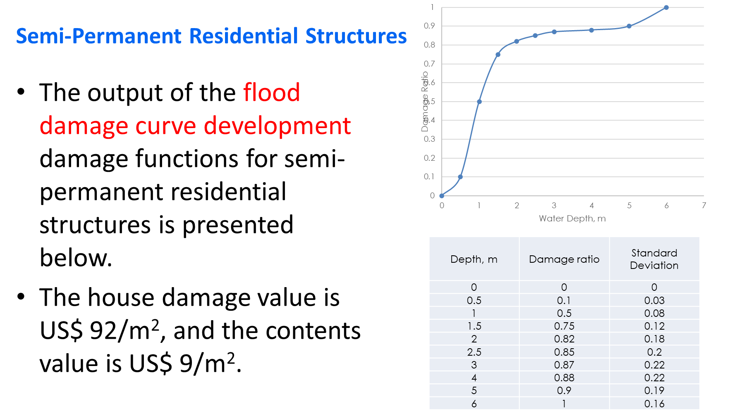
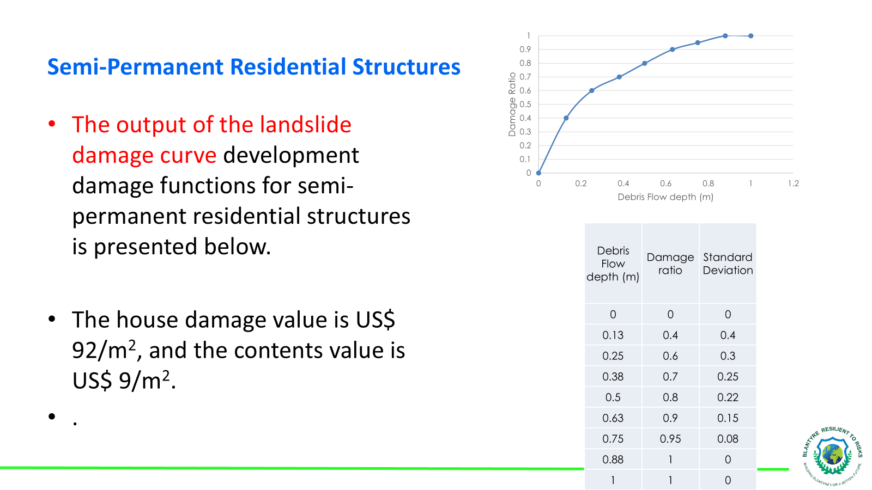
Damage Functions for Blantyre Exposed Elements

Slide 46
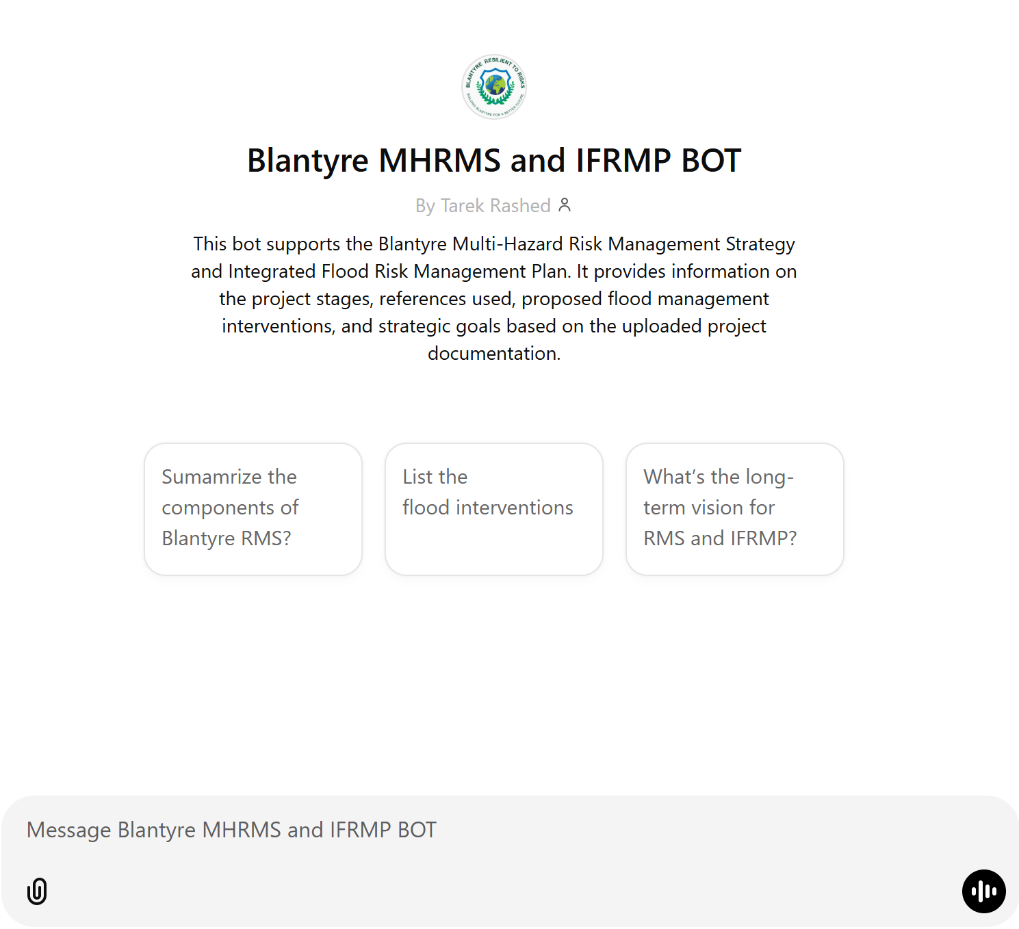

BRtR BOT
https://bit.ly/41r6HBv

Slide 47
BRtR: A Collective Journey
Comprehensive Approach: We've outlined 14 key interventions designed to reduce flood risks and enhance Blantyre's resilience significantly.
Community at Heart: Central to our plan is the well-being of Blantyre's communities. Every intervention is crafted to safeguard lives, livelihoods, and local ecosystems.
Collaborative Effort: Success hinges on our collective action. This plan calls for the unwavering commitment of all stakeholders—government, private sector, communities, and international partners.
Investment in the Future: Implementing these interventions is an investment in Blantyre's sustainable development, ensuring that economic growth and environmental protection go hand in hand.
Adaptive and Dynamic: IFRMP should continually monitored, evaluate, and adapt to meet emerging challenges and incorporate new insights.

Slide 48
Thank You!!

