Slide 1

Balanced scorecard slide 1
Institutional Assessment of the DoDMA and Malawi's DRM System.
Session 1: Assessment Findings.
May 2023

Slide 2

Session 1: Presentation Overview
Overview
Introduction and Background
Objectives and Scope
Frame of Disasters in Malawi
Methodology and Approach
Emerging Issues
Summary of Findings
Recommendations
Discussions and Comments.

Slide 3
Introduction and Background.

Slide 4
The Frame of Disasters In Malawi.
Floods due
to Tropical Storms and Cyclones ++++
Drought +
Landslides +
Fires (Urban and Rural) +
Earth Quakes and Landslides +
Epidemics and Communicable Diseases +
Damage and Loss of Property and Infrastructure
Deaths
Livelihoods of Communities in high risk areas.

Slide 5
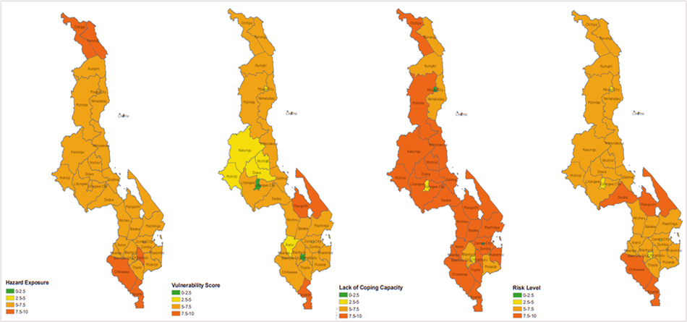
The Frame of Disasters In Malawi.
Districts and regions in Malawi by the level of hazard exposure, Vulnerability and Coping capacity by the community risk assessment platform,.
Most at-risk and affected districts in Malawi by Overall Score
Nsanje (8.8)
Chikwawa (7.7)
Mangochi (7.6)
Dedza (7.6)
Chiradzulu (7.4)
Machinga (7.3)
Thyolo (7.3) Lilongwe (7.2)
Mulanje (7.2)
Phalombe (7.2).
Source: Netherlands Red cross, 2022.

Slide 6
Session 1: Scope of the Assignment.
Review the outcome of the Policy Review and include its recommendations in the institutional investment plan
Status of the establishment of all the institutional components of the Malawi DRM System at national, district and local levels and identify the gaps.
Level of mandate accomplishment of each of the institutional components of the DRM System and gaps.
Definition of the minimum adequate operational resources required by each of the institutional components to fulfil their mandate (i.e. Offices, communications, mobility, etc.) and identification of gaps.
Efficacy of national-to-local and local-to-national communication and coordination protocols between DoDMA, district and local DRM committees.
Efficacy at the District level of the Preparedness and Response Plans, and Operational Protocols.
Efficacy at District level of means/established procedures to integrate disaster risk reduction and risk prevention into Development Planning
Efficacy of the Public Awareness Program both at national and District levels.
Adequacy and efficacy of the strategy to disseminate early warnings amongst DoDMA, the District and Local DRM committees and to activate the respective Preparedness and Response Plans.
Efficacy of the Community-based Disaster Risk Management Strategy and gaps.
Identification of gaps in the NRS that require specific strategies and additional resources.
Linkage of the DRM investment plan with the Climate Change Investment Plan as well as Multi-Sectoral Investment Plan for DRM and Climate Change Adaptation.

Slide 7
Session 1: Defining DRM and Emerging issues.
  Defining Malawi's Disaster Risk Management System?
  National DRM Systems constitute the driving forces and institutions involved in the integration, coordination and development of policy frameworks, planning instruments, implementation, monitoring and evaluation o processes and products in any phase of DRM at the National and Local Authority Level.
  Some initial findings of the Assignment were overhauled due to some emerging issues observed during the assignment;
  Occurrences of Cyclone Freddy which brought in new developments in National Response.
  Establishment of the National Emergency Operations Center in Blantyre, 2022.
  Completion of the functional review and structure re-alignment exercise of the Department of Disaster Management Affairs, 2023.
  Repeal of the 1991 act, and subsequent enactment of the DRM Bill in April, 2023.
  Review of the National DRM policy, 2015.
  Considerations to accommodate some of the changes were made through out the report findings and recommendations, where possible.

Slide 8
Session 1: Approach and Methodology.

Slide 9
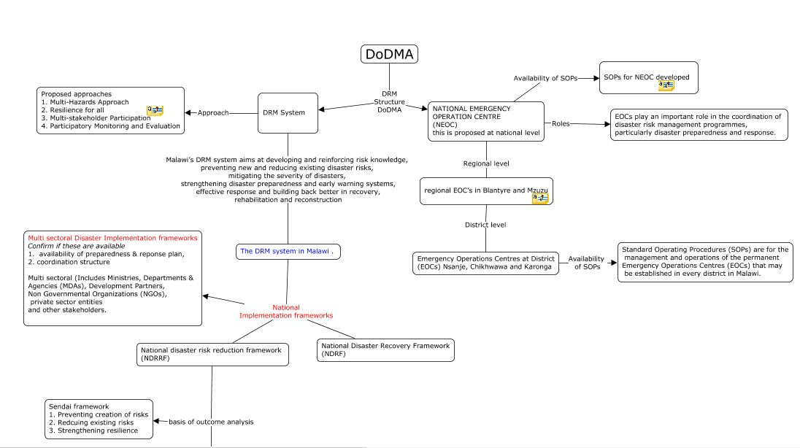
Session 1: Approach and Methodology.

Slide 10
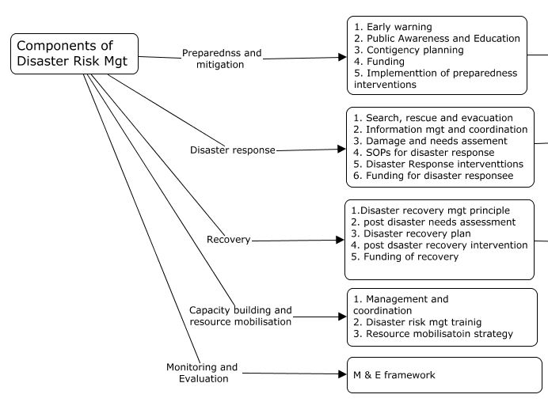
Session 1: Approach and Methodology.
Overall Assessment Approach and Approach.
Multi – Institutional Capacity Needs to address Underlying Disaster Risk Drivers.
Multi-sectoral and Multi-Risk / hazard-specific Capacity assessments
Multi-stakeholder Coordination Capacity Assessment
Multi – Dimensionaliv) Consideration of cross-cutting Sustainable Development
Mainstreaming Gender-Related issues in Disaster Risk Management
WB Ready 2 Respond Approach.

Slide 11
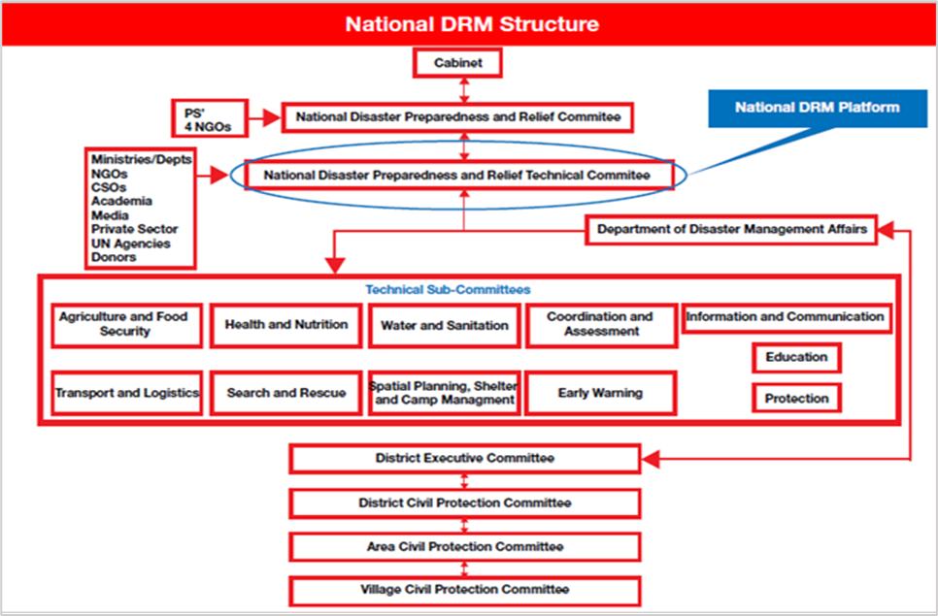
Session 1: Institutional Framework of Malawi’s DRM System.

Slide 12
Balanced scorecard slide 5
The Non-Structural DRM Challenge in Malawi.
National Level
District
Community Level
Rating
Institutional Coordination
components
Policies and Strategies
DRM / CCA & Gender Mainstreaming
D-Risk Financing
Despite numerous investments to strengthen the legal, policy and regulatory environments in Malawi, a number of non-structural gaps and challenges still prevail amidst the increasing frequency and intensity of disasters countrywide including gaps in institutional coordination, outdated DRM Policy, Inadequate DRM/CCA and Gender Mainstreaming, and Inadequate funding of Disaster risk and contingency funding and Low update on DRF options at the community level (among others)

Slide 13
Balanced scorecard slide 5
The Non-Structural DRM Challenge in Malawi.
National Level
District
Community Level
Rating
DRM Planning
Preparedness and Response
Risk Prevention / Mitigation and Reduction
Recovery and building back better
Non-Structural challenges and Gaps persist across all stages of DRM and Authority levels with the biggest challenges including Risk Prevention,, Mitigation and Reduction, Recovery and Building Back better – Main challenges include inadequate funding, shortage of technical and human capacity, gaps in existing laws and enforcement capacity, High Costs of Investments, etc

Slide 14
Balanced scorecard slide 5
DRM Investment Needs by Authority Level.
National – Local Perspective on Structural DRM Challenges
National Level
District Level
Community Level
Priority Level
DRM Planning
Preparedness & Response
Risk Prevention / Mitigation and Reduction
Recovery and building back better
Investment priorities vary across all DRM Authority levels. Priority at the national level is enhancing DRM

Slide 15


Balanced scorecard slide 2
DRM Investment Priorities.
Pillar 1: Enhancing institutional capacity of DoDMA and other DRM supporting institutions at national and local authority levels to effectively execute their mandate
Pillar 2: Reduce existing risks and prevent new risks.
Pillar 4: Investing in post-disaster recovery and build back better.
Reduced impact of disasters on the lives, livelihoods and assets of individuals, communities and the nation.
Proactive investments to address the effects of disasters and build back better and safer .
Ensuring that disaster preparedness and response is timely, adequate, relevant and right for communities.
Proactive investments to enhance the understanding and adoption of innovative disaster risk reduction measures and practices, this pillar will focus on mainstreaming disaster risk management across key sectors in the country
Pillar 3: National Disaster Preparedness and Response Capacity Enhanced and Strengthened. strengthened.
Pillar 5: Knowledge management, research and mainstreaming.

Slide 16
Linkages to Other National and International DRM Frameworks.
Pillar 1
National Resilience Strategy – Resilient Agricultural Growth
Malawi vision 2063 – Agricultural Productivity and Commercialization
Pillar 2
National Resilience Strategy – Risk Reduction, Flood Control and EWS, Response Capacity.
Malawi Vision 2063 – Increased Industrialization
Pillar 3
NRS – Human Capacity, Livelihoods Improvement, Social Protection.
Vision 2063 – Urbanization
National Climate Change Investment Plan – Adaptation
National Climate Change Investment Plan – Mitigation
Pillar 4
NRS – Enhancing Catchment protection and Management.
NCCIP – Capacity Building for DRM.
NCCIP – Climate change Research, Technology Development and Transfer
No | Sendai Framework for disaster reduction | National Resilience Strategy | Malawi 2063 | National Climate Change Investment Plan
1 | Priority 1. Understanding disaster risk | Pillar 1: Resilient Agricultural Growth | Pillar 1: Agricultural Productivity and Commercialization | Priority 1: Adaptation
2 | Priority 2. Strengthening disaster risk governance to manage disaster risk | Pillar 2: Risk Reduction, Flood Control, and Early Warning and Response Systems | Pillar 2: Industrialization | Priority 1: Mitigation
3 | Priority 3. Investing in disaster risk reduction for resilience | Pillar 3: Human Capacity, Livelihoods, and Social Protection | Pillar 3: Urbanization | Priority 3: Climate change research, technology development and transfer
4 | Priority 4. Enhancing disaster preparedness for effective response and to “Build Back Better” in recovery, rehabilitation and reconstruction | Pillar 4: Catchment Protection and Management |  | Priority 4: Capacity building

Slide 17
Linkages to Other National and International DRM Frameworks.
Pillar 1
National Resilience Strategy – Resilient Agricultural Growth
Malawi vision 2063 – Agricultural Productivity and Commercialization
Pillar 2
National Resilience Strategy – Risk Reduction, Flood Control and EWS, Response Capacity.
Malawi Vision 2063 – Increased Industrialization
Pillar 3
NRS – Human Capacity, Livelihoods Improvement, Social Protection.
Vision 2063 – Urbanization
National Climate Change Investment Plan – Adaptation
National Climate Change Investment Plan – Mitigation
Pillar 4
NRS – Enhancing Catchment protection and Management.
NCCIP – Capacity Building for DRM.
NCCIP – Climate change Research, Technology Development and Transfer
Pillar 5
Vision 2063 – Knowledge and skills development.
Links to the Sendai Framework (SFDRR)
Priority 1. Understanding disaster risk
Priority 2. Strengthening disaster risk governance to manage disaster risk
Priority 3. Investing in disaster risk reduction for resilience
Priority 4. Enhancing disaster preparedness for effective response and to “Build Back Better” in recovery, rehabilitation and reconstruction

Slide 18
Balanced scorecard slide 4
Expected Returns on Investment
Overall Impact and alignment to the SFDRR - Improved livelihoods of Malawians, Reduction in deaths and injuries associated with disasters; and Sustained economic growth
Reduced disaster mortality
Reduced no. of people affected by disasters
Reduced direct disaster economic loss concerning the global gross domestic product (GDP)
Reduced disaster damage to critical infrastructure and disruption of basic services, among them health and educational facilities
.
Increased number of local authorities that have disaster risk reduction strategies
Increased availability of and access to multi-hazard early warning systems and disaster risk information and assessments.

Slide 19

Balanced scorecard slide 9
Expected return on Investment
Enhanced Community Preparedness
Enhanced Community resilience
Reduced Death Rate due to Disasters
Reduce and prevent disaster Risk
Reduced loss and damage to property and infrastructure due to disasters
Reduced Death due to Disasters
Reduced Loss and Damage to Property and Infrastructure due to Disasters.
Improved Livelihoods.

Slide 20
Balanced scorecard slide 3
Prioritized Budget / Cost Projections
The Financial Perspective
Interim Investments .
Pillar 1: Enhance institutional capacity of DoDMA at national and local authority levels to effectively execute its mandate – 4.6%
Best return Investments .
45%
26%
Pillar 2: Reduce existing risks and prevent new risks -
Pillar 4: Investing in post-disaster recovery and build back better .

Slide 21
Balanced scorecard slide 6
Key Success Factors.
INTERNAL or SECTOR COORDINATION PERSPECTIVE
Legal Reforms
Leadership and political support
Policy Reforms
Mandate ownership and accountability
Local Coordination and communication
Community Capacity
Adeq Funding
Partnerships
Continuous review and foster adherence to appropriate accountability, reporting and responsibility structures
Eff Monitoring and reporting Systems
Institutional Reforms and coordination strengthening
Managing Change
Enhanced National, Local and Community Based DRM Capacity to plan, prepare, Respond, Reduce and Build back better.

Slide 22
Balanced scorecard slide 8
Financing and Resource Mobilization Strategies
Financing - multiple funding instruments and mechanisms from government disbursements donors, development partners etc.
Primary source - National budget (assuming resource commitment through National development budget
Resource Mobilization Strategies
Financially Viable Non-traditional Partnerships.
Non-Traditional Partners and Funders
Cost Reduction, Synergies, Minimization and Saving.
Private Sector Engagment
Synergies technical support cost sharing and funding –Synergies are established between Government and the private sector. .

Slide 23
Balanced scorecard slide 10
THANK YOU

