Slide 1


NATIONAL GUIDELINES FOR MAINSTREAMING DISASTER RISK MANAGEMENT
Geoffrey Chavula, MUBAS

Slide 2
Presentation Outline
1. Background and Rationale;
3. Steps for mainstreaming DRM in Malawi;
4. Enablers for mainstreaming DRM Guidelines; and
5. Conclusion.

Slide 3
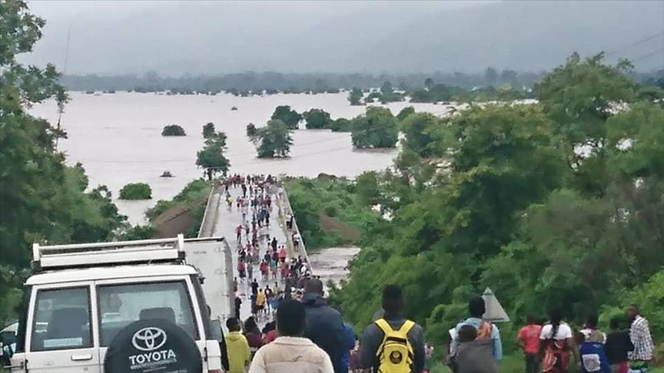

Slide 4
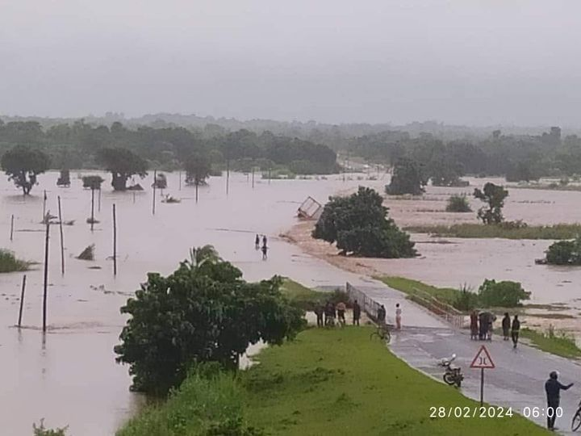

Slide 5
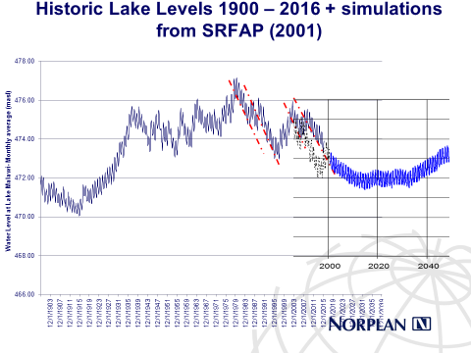

Slide 6
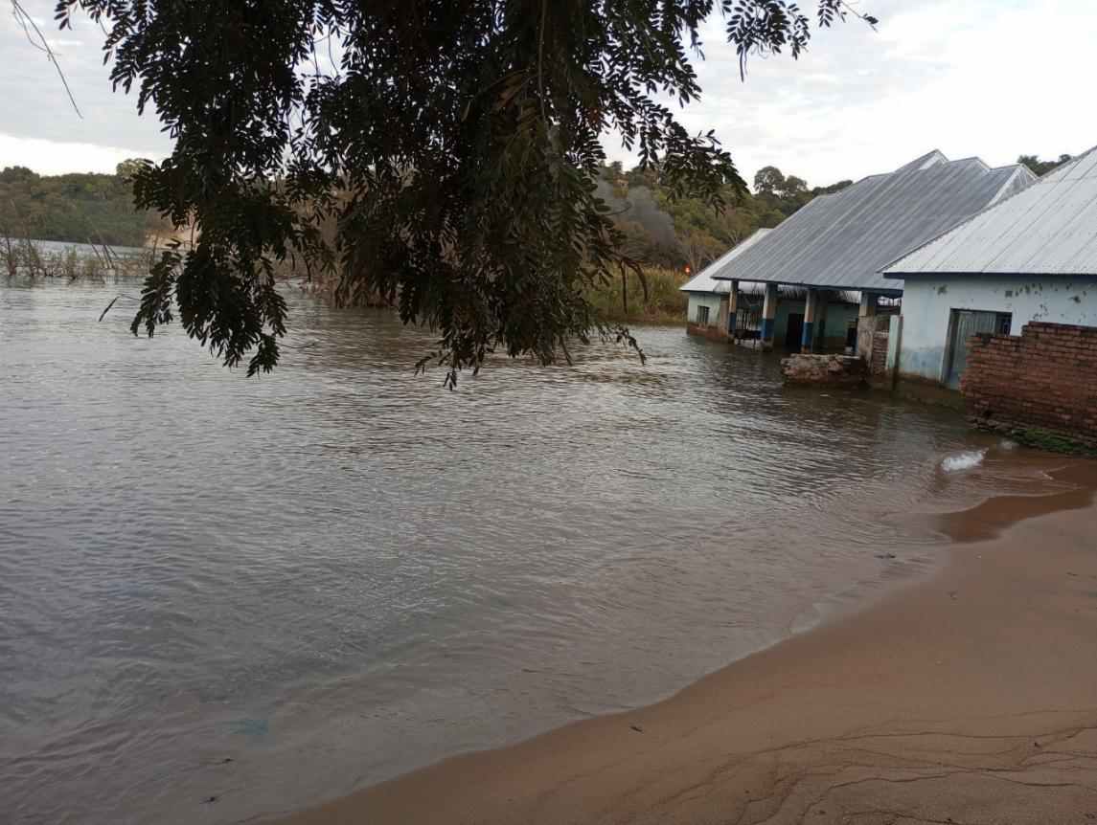

Slide 7
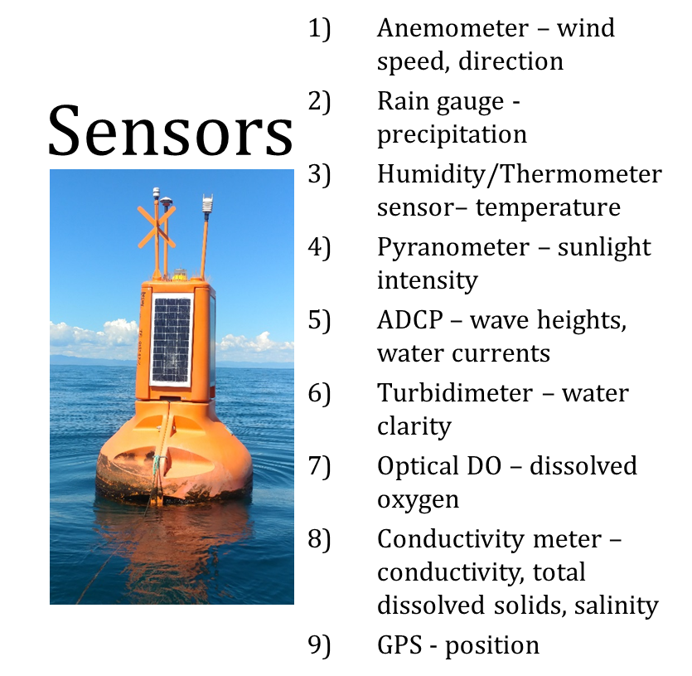
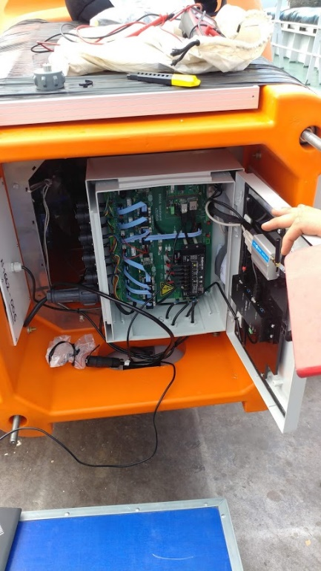
Buoy specifications
  Powered by solar panels (4) and battery
  Communication using GPRS using a local mobile phone service provider
  Server maintained at DCCMS and Nortek
  Web-based Access

Slide 8
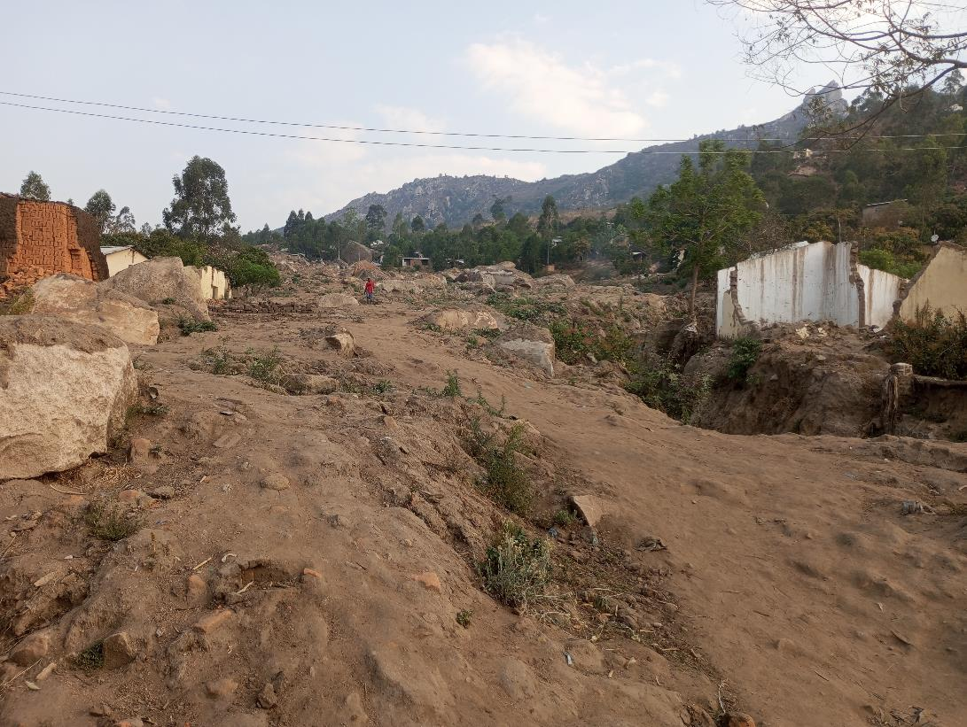

Slide 9
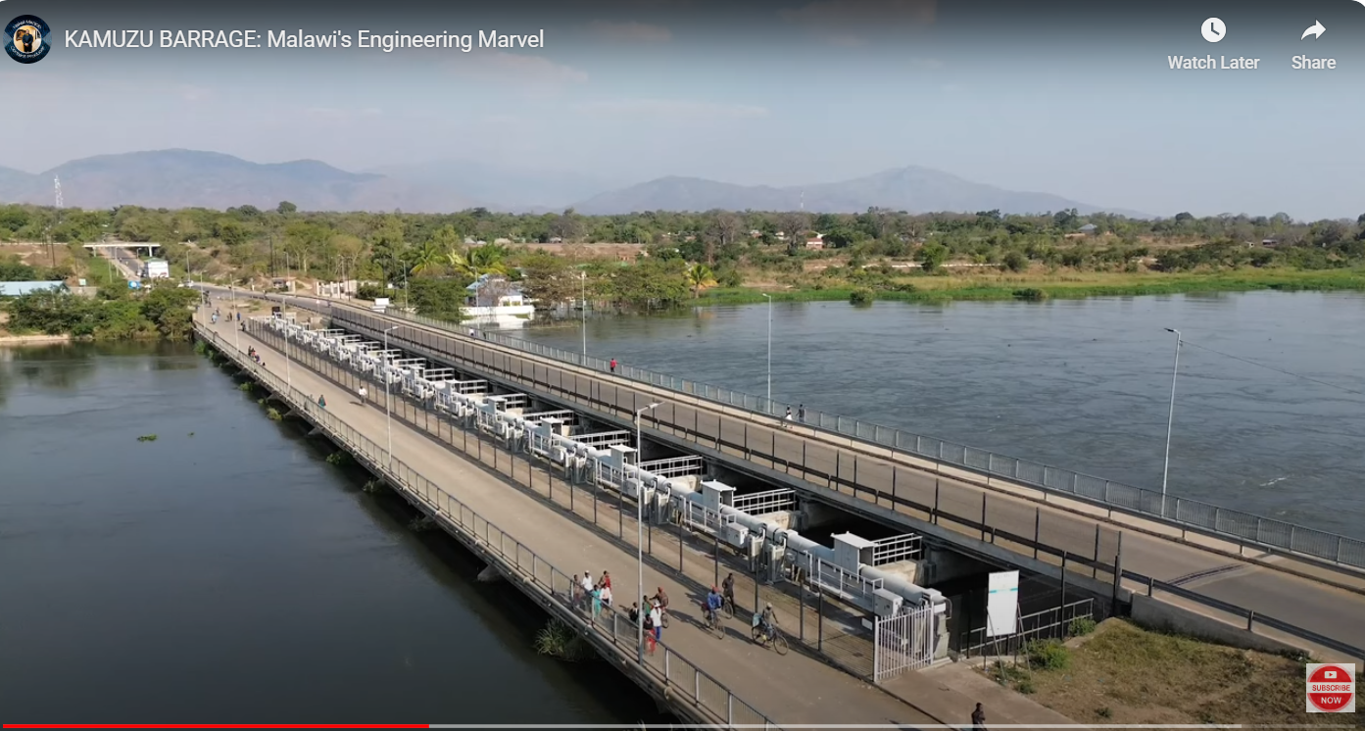

Slide 10
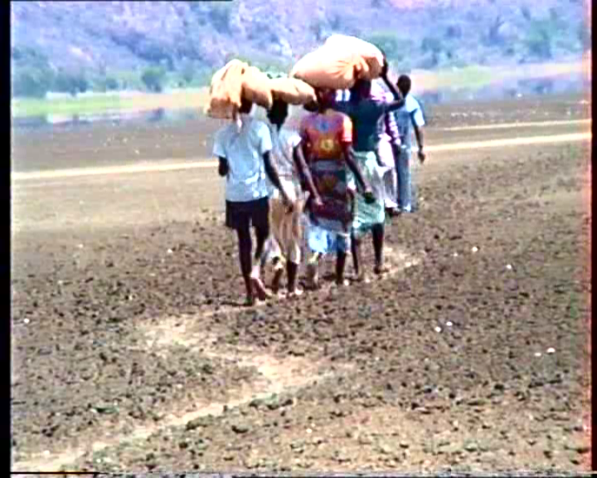
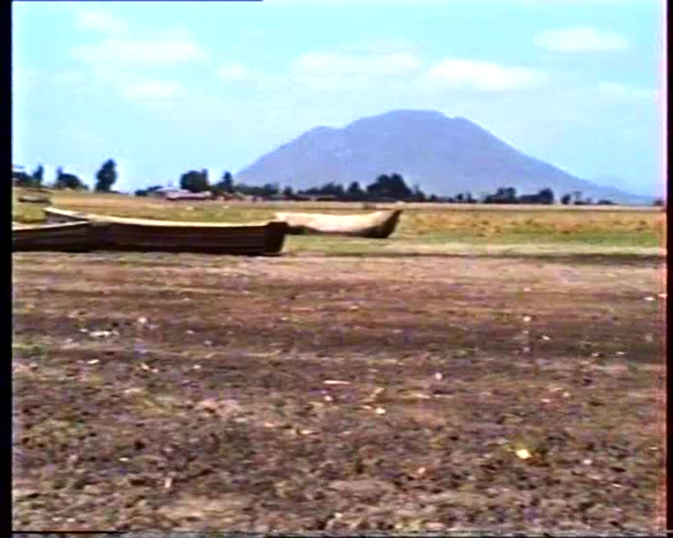
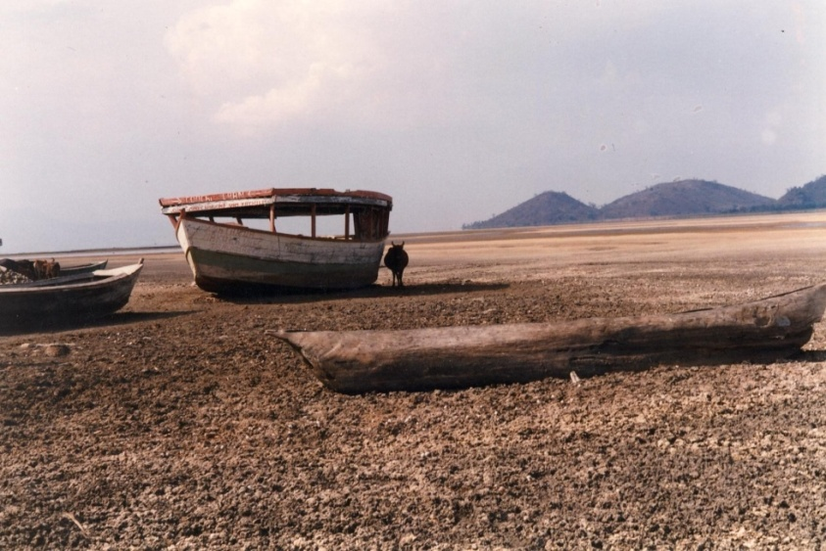
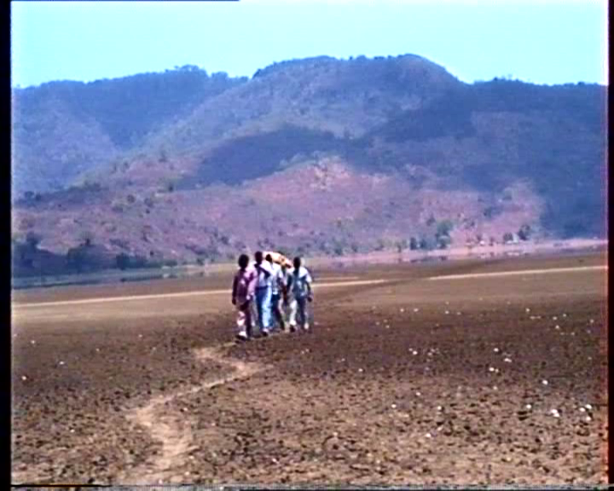
When ecosystem services collapse. Who suffers? The case of the Lake Chilwa in 1996
Pictures by LEAD

Slide 11
Background and Rationale
The Government of Malawi, through DoDMA, developed DRM mainstreaming guidelines specifically to achieve the following objectives:
(i)To guide central government in budget allocation and screening of development investment projects;
(ii)To guide government ministries, departments and agencies to integrate DRM into their sectoral policies, plans and laws;

Slide 12
Background and Rationale ... cont.
(iii)To guide local authorities to integrate DRM in development plans, budget allocation and investment projects;
(iv)To guide the Department of Disaster Management Affairs in coordinating DRM mainstreaming in the country, across all levels of governance and stakeholders;

Slide 13
Background and Rationale ... cont.
(v)To assist industry and private productive sectors to become aware of the risks they are exposed to, and to put in place strategies for handling risks appropriately; and
(vi)To ensure that the built environment and local artisans adopt safer construction guidelines, and put them into practice as a way of “building back better, safer and resilient”, which is the direct way of mainstreaming DRM in construction.

Slide 14
Background and Rationale ... cont.
The guidelines are generic and simple in nature, and common for all relevant sectors of development;
They provide a step-by-step approach to be followed by each social economic sector in mainstreaming DRM in development planning and the project cycle;

Slide 15
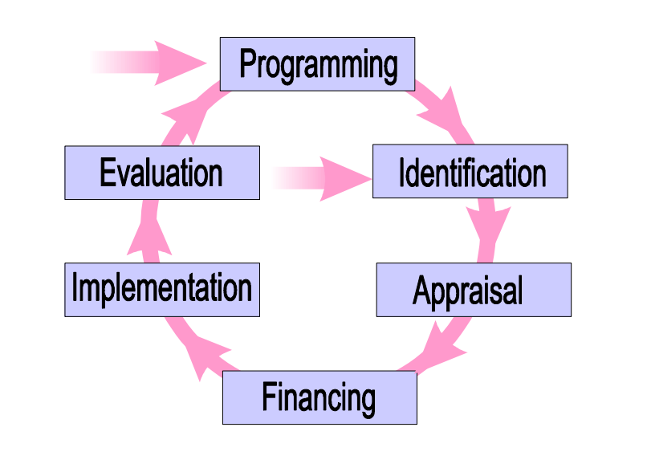
Background and Rationale ... cont.

Slide 16
Steps for mainstreaming DRM in Malawi
The methodology adopted for developing National Guidelines for Mainstreaming DRM (NG4MDRM) involved desk reviews, stakeholder consultations, and field surveys;
In the NG4MDR, the mainstreaming processes is discussed under the following 10 requisite steps:

Slide 17
Steps for mainstreaming DRM in Malawi ... cont.
Step 1:
Understand commonly occurring disasters in Malawi, and the locality of interest;
Investigate their causes, impacts, frequency of occurrence, and their magnitude;
Explore potential measures that need to be put in place in order to avert the severity of their associated impacts on human life, property, and the environment;

Slide 18
Steps for mainstreaming DRM in Malawi ... cont.
Step 2:
Conduct a quick DRM screening process in order to determine whether mainstreaming DRM is required or not;
For development plans and projects that require a detailed risk assessment and risk analysis, they should be further vetted for DRM mainstreaming using Step 3;

Slide 19
Steps for mainstreaming DRM in Malawi ... cont.
Example:
Aim: To check whether the institution, strategy, policy, programme or project has considered and addressed existing or future risks associated with disasters or not. This rapid and rough screening of risks and opportunities is intended to make a decision on whether to proceed with a detailed DRM assessment or not.
When it should be done: The screening should be done at the beginning of the planning process of a new activity or during the review of a running activity.
How it should be done: The screening should be done by way of answering key questions for DRM screening (see Table 1). It is recommended to conduct a detailed assessment if the screening results show the high risks and the limited capacities to cope with them.

Slide 20
Steps for mainstreaming DRM in Malawi ... cont.
Question | Answer (yes/no) | Explanation
Are there any estimated risks associated with the planned activity?
Are these risks high or low?
Has the planned activity considered these risks?
Has the activity included actions to address these risks?
Do these actions reduce vulnerability to disaster risks?
Are there any additional actions or opportunities to reduce risks and vulnerability?
Do you have sufficient capacity to deal with the estimated risks?
Is there a need for a detailed assessment?

Slide 21
Steps for mainstreaming DRM in Malawi ... cont.
By whom:
At the national level - Director of Planning and his Team of relevant experts in the respective Departments/Ministries, including the DRM Desk Officer;
At the district level - the Director of Planning and the entire DEC should conduct this screening process;
At the Area and Village levels - the Traditional Authority (TA)/Village Headman (VH) and their teams, respectively, should conduct the screening process.

Slide 22
Steps for mainstreaming DRM in Malawi ... cont.
Step 3:
Undertake a detailed disaster risk assessment and risk analysis for development plans and projects that require incorporating DRM in their implementation process in accordance with the results of the screening carried out in Step 2;
Step 4:
After conducting risk assessment and analysis in Step 3, a SWOT analysis for the institution, project, plan/policy/legislation, processes or district/city should be done as the next step in the process of mainstreaming DRM;

Slide 23
Steps for mainstreaming DRM in Malawi ... cont.
Step 5:
Identify and prioritize entry points for mainstreaming DRM. It is absolutely necessary to determine entry points for DRM mainstreaming for the given institution, project, plan/policy/legislation, processes or district/city;
Step 6:
Develope priority actions to be mainstreamed into the institution, project, plan/policy/legislation, processes or district/city. Since funding is most of the times a limitation for the implementation of all recommended DRM actions, it is only prudent to prioritize the selected actions for averting disasters;

Slide 24
Steps for mainstreaming DRM in Malawi ... cont.
Step 7:
Incorporate priority actions into the institution, project, plan/policy/legislation, processes or district/city. After the prioritization process, all the selected priority actions are then incorporated in the institution, project, plan/policy/legislation, processes or district/city;
Step 8:
Develope an implementation and monitoring plan for the identified priority actions of DRM. After Step 7 of DRM mainstreaming process, the next step is to develop an implementation plan as well as a monitoring plan for the given activity/institution selected under Step 6;

Slide 25
Steps for mainstreaming DRM in Malawi ... cont.
Step 9:
Implement and monitor the integrated elements; and
Step 10:
Conduct an M&E for the implemented activities.

Slide 26
Enablers for Mainstreaming DRM Guidelines
(a)Restructuring the institutional setup of DoDMA by, inter alia, establishing DRM Focal Points in each and every MDA and in the private sector, to facilitate DRM mainstreaming during project planning, implementation, and operation and maintenance phases;
(b)Introducing a budget line for DRM activities in the country’s national budget to cover costs for DRM activities all the MDAs, considering that at the present moment there are no funds set aside for DRM activities; and that funds for relief and recovery efforts, which are mainly sourced from the ORT vote and development partners/NGOs are only mobilized after the disaster strikes;

Slide 27
Enablers for Mainstreaming DRM Guidelines
(c)To clearly define roles and responsibilities, with clear reporting lines, for the respective stakeholders involved in DRM activities in Malawi, and to enhance coordination and collaboration among them, with DoDMA playing the key role of coordinating all DRM activities; and
(d)To build capacity, both human and financial resources, at all levels of responsibility after noting that DRM service providers are not given adequate training; and that most of the districts do not have dedicated vehicles for DRM use, and other essential resources.

Slide 28
Conclusion
Discussed the 10 Steps as being key in the development of NG4MDRM;
Highlighted enablers for mainstreaming DRM

Slide 29
THANK YOU!

